Slide 1
Unit 07: Graphics software
By
Albert SINAMENYE

Slide 2
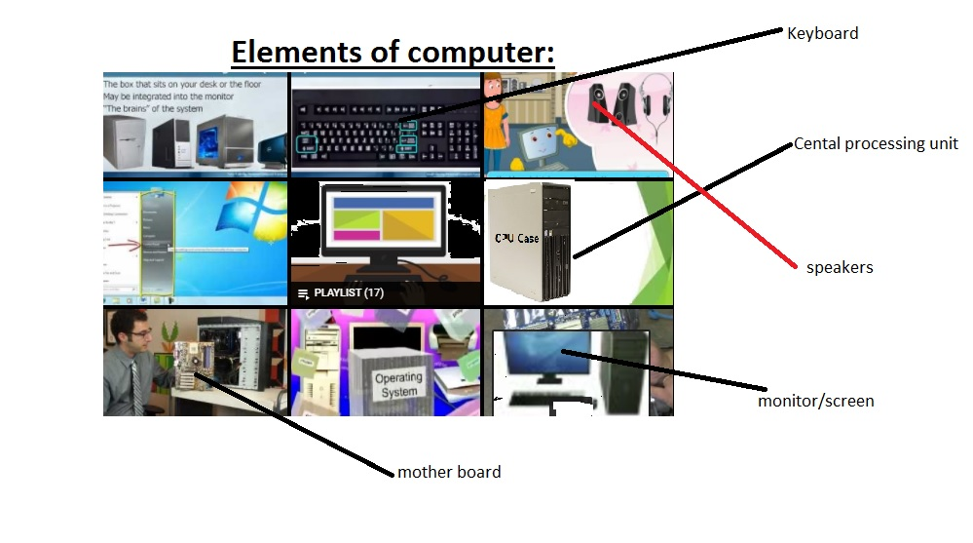
Computer elements:

Slide 3
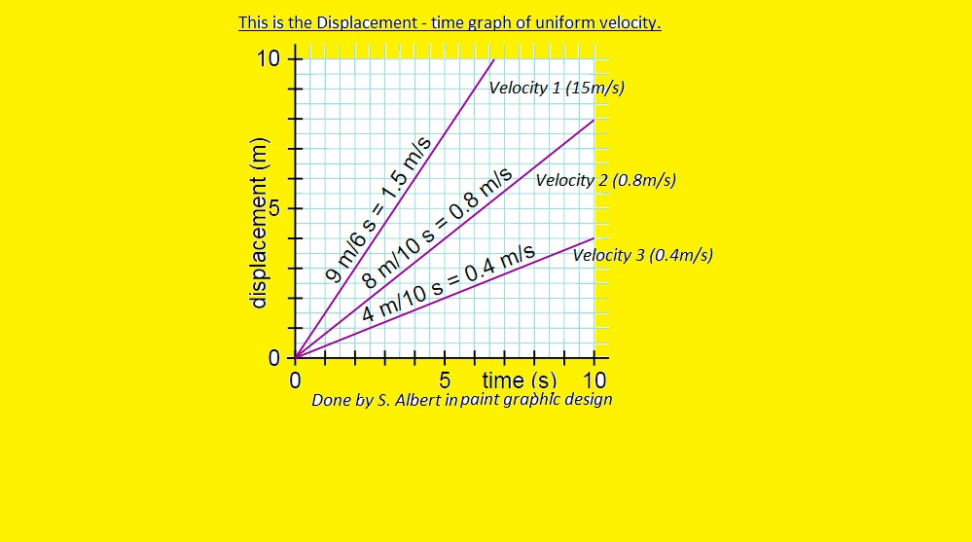
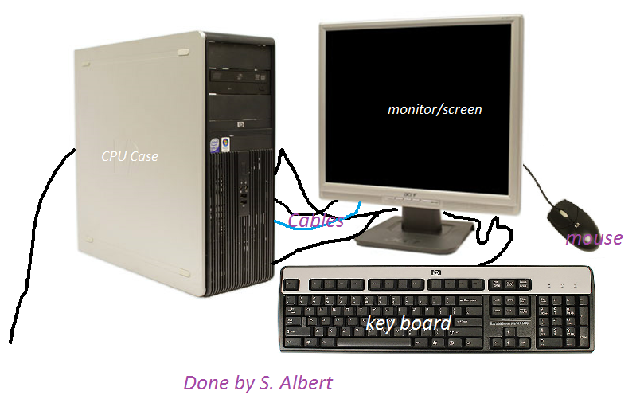
Here are the photos of my design:
Displacement – time graph
ICT Tools

Slide 4

A house

Slide 5
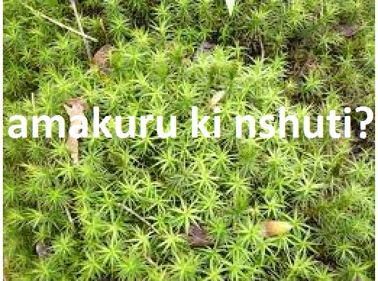

Slide 6
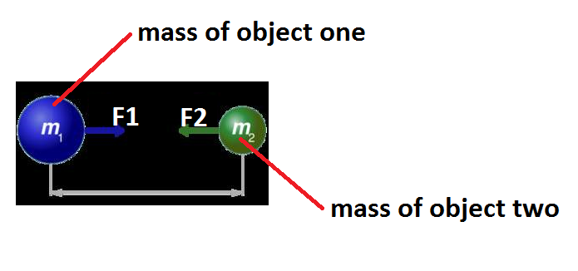

Slide 7
Thanks

