Slide 1
ICT AND PHYSICAL ENVIRONMENT
Prepared by Ferdinand Hasingizwumukiza
GS NDERA/GASABO

Slide 2
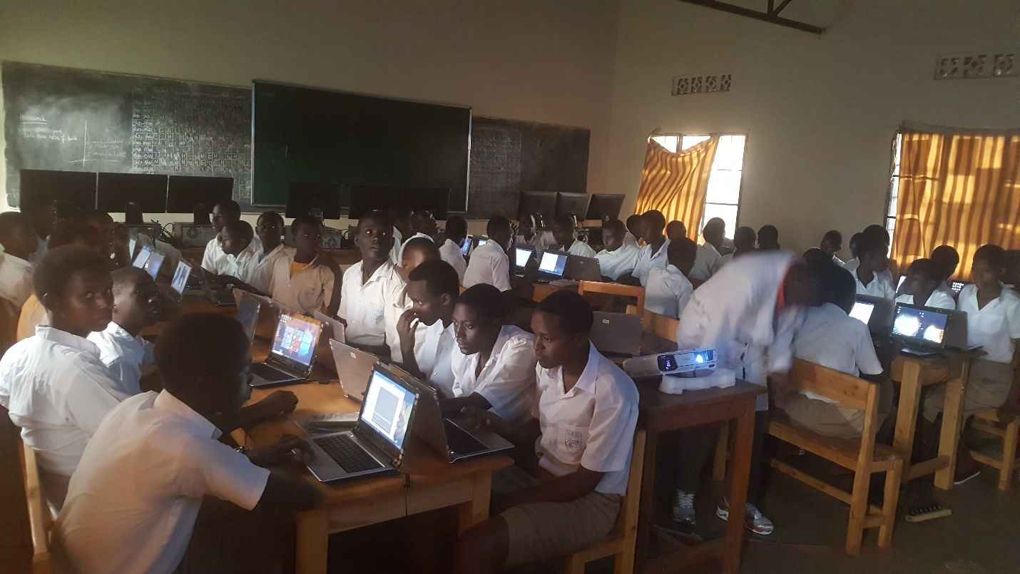
Students lab skills in ICT Room

Slide 3
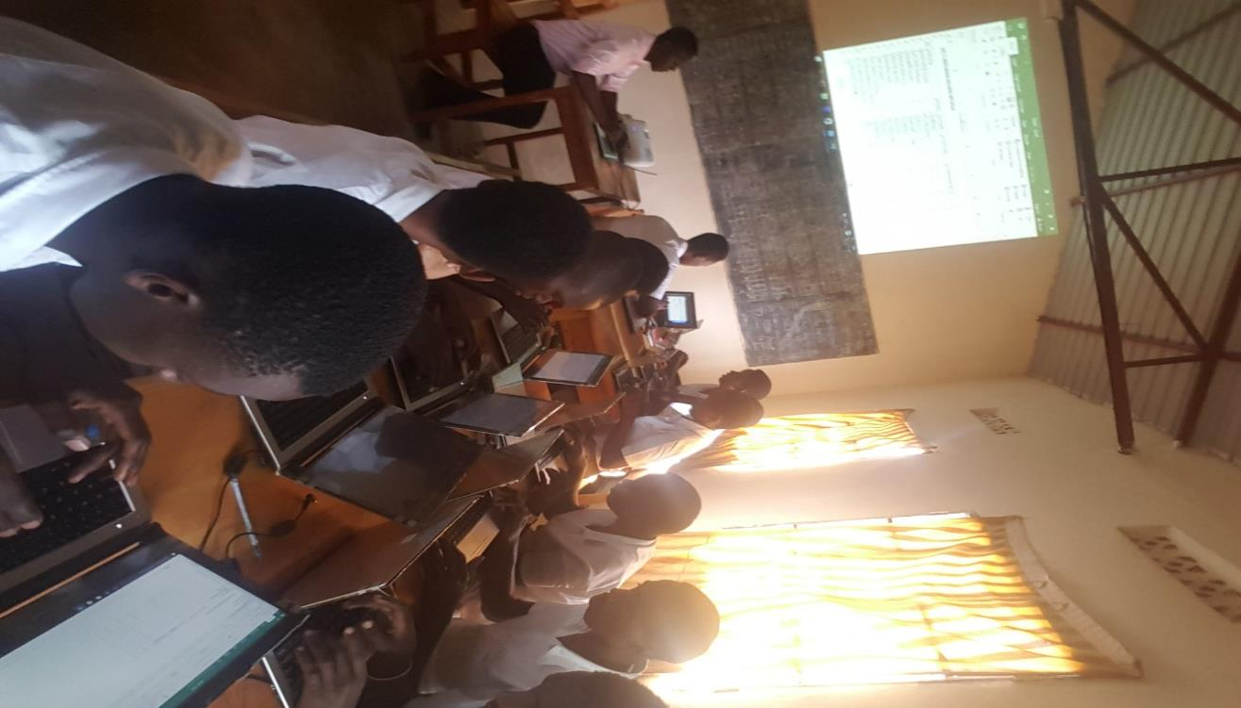
Teaching session in Computer Lab with Facilitator

Slide 4
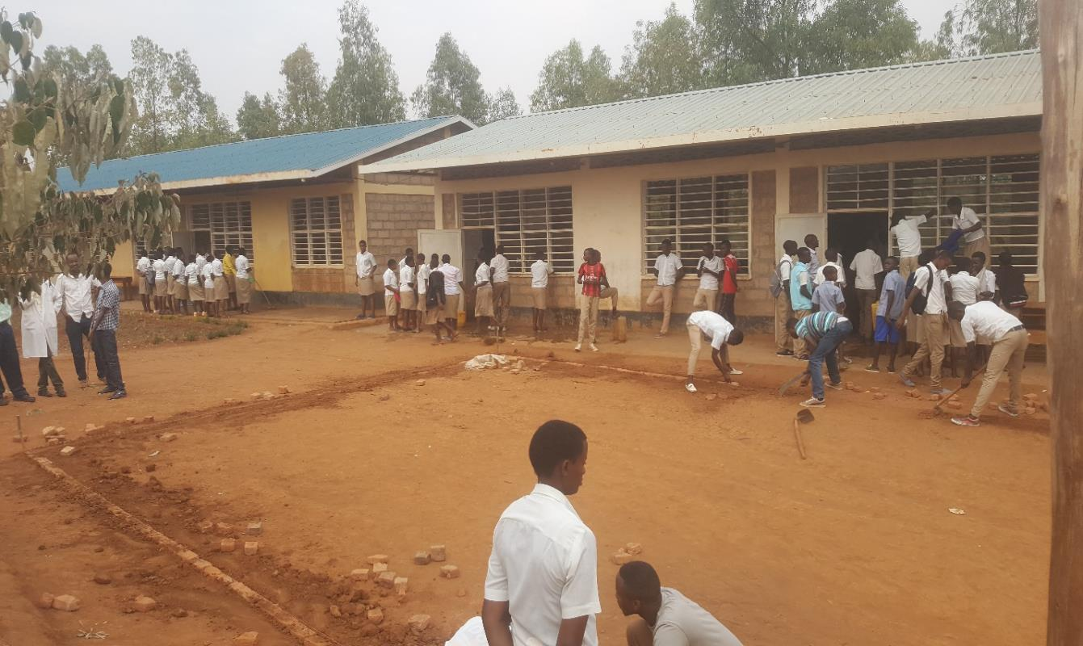
School where teaching practice took place

Slide 5
INTRODUCTION
In education institution also ICT Technology is one solution to improve the quality of education as Minister of education enhance on how implement ICT in all level of education primary level and secondary level to develop Technology
The use of e-learning is rapidly changing the classroom's common practice. Classroom organization and teaching method and the passage from the traditional to e-classroom in the new changing e–learning environment by making Smart classroom
ICT technologies were implemented in schools gradual changes started to take place. In institution where they use ICT have a big positive impact where used in different activity to develop institution.

Slide 6
WEEKLY USE OF COMPUTER LAB
.Teacher submit their organization at the beginning of the week and incorporate on time table according to their core subject towards non-core subjects
.The free access to students starts depend on timetable plan and accompanied by any ICT teacher in duties , or especially by computer lab keeper.
.When a teacher used computer lab within her/his students ,teacher must account and keep well projector, computers, and other devices used in that lesson and sign in the book before to submit the keys to the Computer Lab keeper to Deputy in Charge of studies

Slide 7
THE USE OF CELLPHONE IN LEARNING PROCESS
In each lab , we count the number of 50 computer laptops and 4 personal computers are used in the lesson mostly when it is computer Science lesson or ICT lesson , so We can estimated that in period of 40 minutes , all those computers should be used depends on lesson.
.The mobile phone should be incorporate in learning because it is a common and accessible teaching material that learner should get and use easily.
.Most of students have the knowledge to manipulate rather than to use computer.
.It is easy to carry and to use it at home when student has an assignment and get his free time for accessing it and can call his/her classmate to share the lesson ideas and enhance his own research.

Slide 8
THANK YOU ALL PARTICIPANTS
END OF THE SESSION

