Slide 1
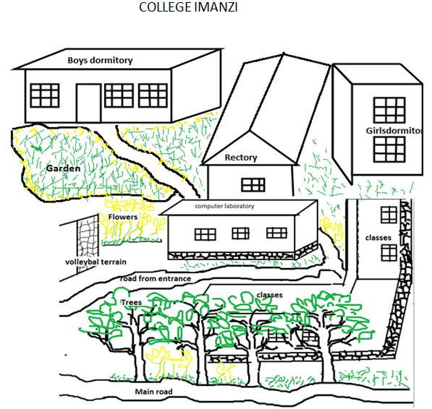
COLLEGE IMANZI NYARUGURU DISTRICT

