Slide 1

Discussion
What are the different purposes of assessment ?
Notes:
Activity: 15 minutes + 5 minutes for feedback to whole group

Slide 2



What is assessment?
Assessments are used for many purposes.
In the classroom, though, assessment is the wide variety of methods that teachers use to evaluate and measure student knowledge, understanding and competences.
Notes:
Make sure to acknowledge other purposes of feedback – diagnosing health of education system, assessing fitness for employment etc…
Many people assume that ‘assessment’ means taking a test, but assessment is broader than that. Method of assessment- not a purpose

Slide 3

Types of assessment
There are two main types of assessment:
      summative assessment
      formative assessment.
Both happen in most classrooms.

Slide 4

Summative assessment
Summative assessment sums up what a student has achieved at the end of a period of teaching, relating to the learning objectives and national standards
It is used to confirm what students already know and the skills they have
May provide data for individual or groups of students.
Also known as ‘assessment of learning’

Slide 5

Formative assessment
Formative assessment usually takes place during the learning process.
It is used to find out which learning objectives are being achieved.
It is used to inform future teaching and learning activities and provide feedback on how students can improve.
Also known as ‘assessment for learning’ (AfL).

Slide 6
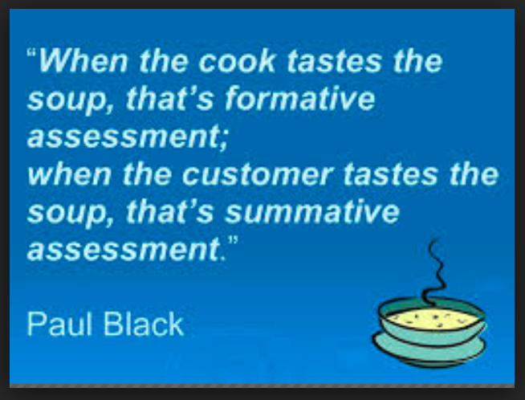

Slide 7
Summative and formative assessment - purpose
Summative assessment
The main purpose is to assess student achievement after learning has taken place.
Summative assessments tend to be high stakes.
May be used to compare different student’s achievement.
This ‘sums up’ past learning.
Formative assessment
The main purpose is to inform future teaching and learning goals.
Formative assessments are low stakes.
Results can be used to provide feedback and support to students on progress towards learning goals.
This guides future learning.
Notes:
Just because formative is low stakes – doesn’t mean it’s low importance

Slide 8
Purposes of summative assessment
The Rwandan Education Board indicates the following as some of the purposes of summative assessment:
Assigning grades
Certification of students’ achievement
Selection of students
Placement of students
Guidance and counselling
Administrative policy decisions
Programme assessment decisions
Notes:
Rwandan Education Board, Ministry of Education (2017) A guide to Classroom-Based and National Assessments in Rwanda
7.2: Purposes of Summative Assessment (assessment of learning)
The main purposes of summative assessments are for:
Assigning grades: providing marks/scores in the form of numbers or letter so as to communicate
the result to the concerned bodies (students, parents, organizations, etc.);
Certification of students’ achievement: Giving written witness about students’ successful
completion of a certain level of educational programme;
Selection of students: Serving for selection decision, if it is used for acceptance or rejection
of individuals into a given programme based on their competence;
Placement of students: Assigning students in to different fields of study;
Guidance and counselling: Guidance and counselling decision involves the assessment
data to help recommend programmes of study that are likely to be appropriate for the
students;
Administrative policy decisions: Making decisions such as holding school administrators
accountable, how some schools achieved best or poor, for sharing and scaling up best practices
to other schools, and understanding why some schools performing poorly, rewarding
best performing schools and determining school-career ladder or merit pay decisions;
Programme assessment decisions: Administrative decisions are also involved in areas
such as curriculum planning and teachers training.

Slide 9
Purposes of formative assessment
The Rwandan Education Board indicates the following as some of the purposes of formative assessment:
Determine the extent to which learning objectives and competences are being achieved
Monitor progress and provide feedback to students, teachers and parents
Diagnose or detect learning errors
Decide on the next steps
Identify students who are gifted and talented and those that need extra support
Motivate students
Help students to take control of their own learning
Notes:
Rwandan Education Board, Ministry of Education (2017) A guide to Classroom-Based and National Assessments in Rwanda

Slide 10
Summative and formative assessment - timing
Summative assessment
Summative assessment takes place at the end of a period of teaching, e.g. at the end of a unit, a term, or a year.
Allows teachers to determine what pupils have achieved in that time period.
Formative assessment
Formative assessment takes place day-to-day
Allows progress to be assessed more frequently
Allows current teaching and learning to be adapted

Slide 11
Summative and formative assessment – grading / recording
Summative assessment
Summative assessments are usually formally assigned a number or letter grade.
Results are usually formally recorded.
Formative assessment
Not usually graded, as the focus is students’ performance against particular learning objectives.
Results may be recorded to track progress.
Notes:
Formative- teach may recorded to check if feedback has worked

Slide 12
Discussion
What types of summative and formative assessment do you find in your classroom?
Notes:
15 minutes for discussion + 5 minutes feedback to whole group

Slide 13

Types of summative assessment
    Formal Tests / Examinations
    Assignments (project work)
    Laboratory work
    Oral or written reports
    Written essays
    Performances
    Whichever medium is used, the assessment will show what has been achieved.

Slide 14

Types of formative assessment
    Oral questioning (planned and spontaneous)
    Paper and pencil or online tests
    Class exercises
    Project work
    Debate
    Self or peer assessment
    Homework exercises
    Observations of in-class exercises
    Portfolios
    Whichever medium is used, the assessment must inform future teaching and learning.

Slide 15
Using tests in formative assessment
Written tests can be used very effectively for formative purposes
The important thing is how the information gathered through assessment is used.
The results of written tests can be used formatively to:
      Identify progress against learning goals, indicating what needs to be taught next.
      Identify misconceptions or misunderstandings, which can then be resolved.
      Allow students to better understand their own learning, helping them identify where they need to improve.

Slide 16
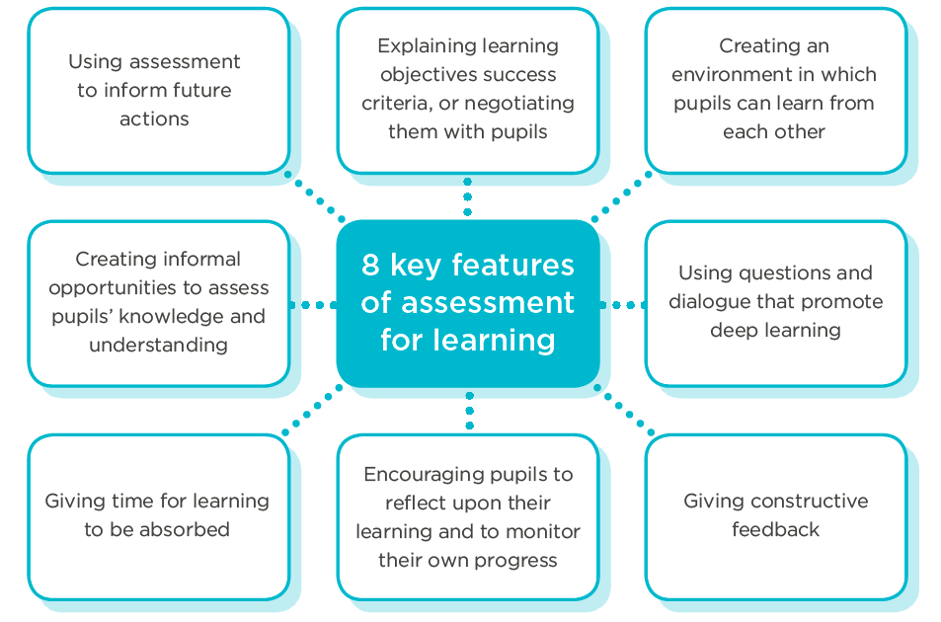
Principles of formative assessment
Notes:
For formative assessment to be effective it is important that the focus is on improvement.
So, students have to understand what they need to learn or the skills they need to develop.
The activity or test questions should be clearly linked to particular learning objectives
Encourage students to focus on their own progress rather than comparing themselves with others. Their improvement rather than their attainment is what is important. Students need to know how to improve, but also need to be motivated to do so, by recognising that they are making progress and by understanding that success is a result of their own efforts.

Slide 17
Planning to use the tests
    To successfully incorporate assessment into your teaching;
    Plan when you are going to use the tests at same time as planning learning.
    Make sure the tests are an integral part of teaching & learning.
    Give yourself time to follow up the information from the tests in the classroom.
Notes:
More information on how/when to plan assessment into teaching & learning will be covered slightly later on in this presentation.

Slide 18
Using assessment to inform future actions
    All formative assessment uses what you have found out about students’ learning to inform future actions
    This may be in the form of:
        providing teachers with an understanding of students’ strengths and weaknesses
        informing next steps in teaching and learning
        providing feedback to students on their progress in relation to the unit’s learning objectives.
        helping students to understand in what areas they have particular misconceptions or misunderstandings

Slide 19
Giving constructive feedback
Feedback is an important part of formative assessment – this allows pupils to understand where they need to develop their skills or understanding.
Feedback differs from simple praise. Praise is helpful for encouraging and motivating students.
Feedback is information which can be used by students to improve their performance.
The format of feedback will differ depending on the assessment task and learning objectives.
It is important that feedback is linked to the learning objectives, to allow students to see how it relates to their progress.

Slide 20

Giving constructive feedback
The Rwandan Education Board emphasises the importance of feedback as part of the learning process, suggesting several questions teachers should consider before providing feedback:
What is the key issue in the student work?
Has the student made an error?
What is the probable reason the student made this error?
How can I guide the student to avoid the error in future?
What did the student do well that could be noted?
Notes:
Rwandan Education Board, Ministry of Education (2017) A guide to Classroom-Based and National Assessments in Rwanda

Slide 21
Giving constructive feedback
Make feedback specific
    Concentrate on behaviours, not intent
    Feedback should be appropriate to the age of the students
    Emphasise praise and positive feedback
    When giving negative feedback, model the correct method
    Help students to focus on ‘processes’ rather than outcomes
    Teach students how to judge their own performance – remember peer feedback can be an effective option too.
Notes:
Points and examples from Rwandan Education Board, Ministry of Education (2017) A guide to Classroom-Based and National Assessments in Rwanda-
Make feedback specific
e.g. “Four words were spelt incorrectly in your composition”: ‘transportation, diversification, improvisation, and electrification”. Instead of: “Too many misspelled words”.
Concentrate on behaviours, not intent
e.g. “When you face the class, you speak so softly that most students cannot hear what you are saying”. Instead of: “You should try to overcome your shyness”.
Feedback should be appropriate to the age of the students
Emphasise praise and positive feedback– especially when learning new concepts, skills and competences.
When giving negative feedback, model the correct method
Help students to focus on ‘processes’ rather than outcomes
Teach students how

Slide 22

Giving time for learning to be absorbed
Formative assessment is an ongoing process, with results from assessments informing future teaching and learning
It is important that students have time to respond to any feedback or comments and to improve.
The opportunity for consolidating understanding and skills is an important part of formative assessment.

Slide 23
Encourage reflection
An important part of formative assessment is students’ involvement in their own learning.
Offer students opportunities to discuss the outcomes of the test and to reflect on their, progress and next steps.
Teachers can teach students how to judge their own performance:
      Explain the criteria used to judge performance
      Emphasise the importance of self-monitoring and goal setting
      Help students adapt their learning strategies to meet different task or learning needs.
Notes:
. Rwandan Education Board, Ministry of Education (2017) A guide to Classroom-Based and National Assessments in Rwanda

Slide 24
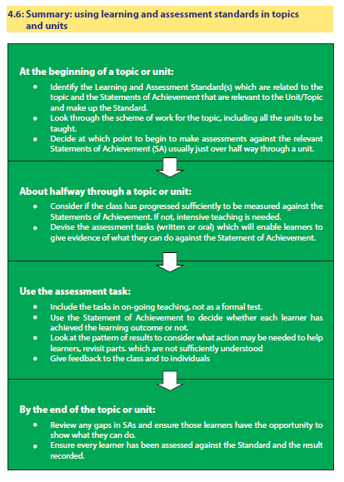
Notes:
Rwandan Education Board, Ministry of Education (2017) A guide to Classroom-Based and National Assessments in Rwanda
This talks about Learning and assessment standards, but the process works equally well with Unit assessment criteria and learning objectives
Focus on standard of achievements – with time built in to cycle for students knowledge / skills to be measured against standard of achievement
Options for assessment include formal (individual unit statements / tests) & informal (peer review / questioning/ record sheets of student discussions etc)
Govt advice is 3-4 assessments per term minimum - 3 competences to be assessed formally during the term
DAVID – just a quick view of this – to link it in to the previous cycle – don’t have to read it!

Slide 25
Notes:
Rwandan Education Board, Ministry of Education (2017) A guide to Classroom-Based and National Assessments in Rwanda
Actually very similar to cycle shown on previous slides – if taken to apply to topic/unit of work
Focus on standard of achievements – with time built in to cycle for students knowledge / skills to be measured against standard of achievement
Options for assessment include formal (individual unit statements / tests) & informal (peer review / questioning/ record sheets of student discussions etc)
Govt advice is 3-4 assessments per term minimum - 3 competences to be assessed formally during the term
DAVID – just a quick view of this – to link it in to the previous cycle – don’t have to read it!

Slide 26
Notes:
Think this is more relevant and covers similar ground Rwandan Education Board, Ministry of Education (2017) A guide to Classroom-Based and National Assessments in Rwanda
Actually very similar to cycle shown on previous slides – if taken to apply to topic/unit of work
Focus on standard of achievements – with time built in to cycle for students knowledge / skills to be measured against standard of achievement
Options for assessment include formal (individual unit statements / tests) & informal (peer review / questioning/ record sheets of student discussions etc)
Govt advice is 3-4 assessments per term minimum - 3 competences to be assessed formally during the term
DAVID – just a quick view of this – to link it in to the previous cycle – don’t have to read it!

Slide 27
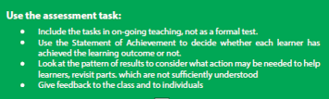
Using assessment tasks
Notes:
Rwandan Education Board, Ministry of Education (2017) A guide to Classroom-Based and National Assessments in Rwanda
Not necessarily formal test – include & record tasks that have taken place during teaching / learning
Results from assessment are to be used formatively – (just as identified in cycle above) to change / adapt further teaching to better suit needs of students
Importance of feedback – teachers need to plan time into the instructional process to support their students by being aware of what is happening in the classroom all the time and then providing ongoing guidance and direction during activities.

Slide 28

Can test outcomes be used formatively?
Yes, test outputs can be used formatively!
    Tests can provide helpful formative information e,g;
    student’s misconceptions
    areas for additional reinforcement
    This information can be used to adapt teaching plans and better ensure student progress.
    Formative test feedback should…
    focus on how students can improve
    not focus on individual grades / levels
Notes:
If tests are used in middle of teaching / learning cycle rather than just at end, emphasis becomes what students still need to learn NOT what they have learnt – providing helpful information such as;
Misconceptions
Areas/domains requiring additional reinforcement
These can be used to inform planning for rest of the unit – ensuring that students misconceptions are addressed & their learning needs catered for.

Slide 29
Examples of formative uses for test outcomes
tracking individual students’ progress over time
providing feedback to individual students – including how to make improvements
identifying patterns of performance in individuals and groups to inform future teaching and learning
Identifying implications for teaching the unit
Showing parents how their children are progressing
Notes:
identifying patterns of performance in individuals and groups – there is a learning objective that a group of students is struggling with, a particular student finds it hard to answer questions on higher order competences
Identifying implications for teaching the unit- what do you need to revisit now? How might you teach the unit differently next time

Slide 30

Activity
Look the following features of formative assessment.
Discuss which ones you think are most important to improve teaching and learning
How can you include them when you teach a unit?
Using questions to find out what students understand and what they don’t rather than seeing who has the correct answer.
Planning for questions that challenge students’ thinking
After a test asking students to discuss what they have learned from the outcomes
Encouraging student to talk about how they reached an answer
Using the test outcomes to Identify the students who do not seem to have made progress and what to do about it.
Explaining to students why they are taking a test
Ask students their views on the test
Notes:
Timing – 20 minutes. Possibly pair discussion

Slide 31
How does this relate to our training?
During these training sessions we will…
learn about the principles of what makes an effective formative test
Write our own formative assessment questions

Slide 32
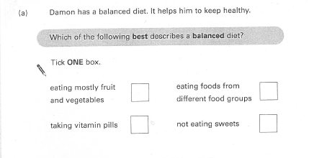
What makes an effective formative test question?
Look at this science test question…
Notes:
What think of the question? What is effective about it?
When writing a multiple choice assessment it is important to make sure that all the options make sense and there is a chance that students might choose them, even those that are not the right answer.
Options must be written to include & address any misconceptions that students might have.
This will give useful information to inform further teaching/learning in this area – as it will clarify not just who has mastered the subject knowledge but crucially what misconceptions need addressing / what students’ next steps are.
Open questions are constructed in slightly different way – but marking guides should be written to allow for collection of information about how students are answering / what approaches they are taking. (this will be looked at in greater detail in a later session)

Slide 33
Discussion
Look again at the science question on the previous slide
Why do you think those answer options have been chosen?
What misconceptions do they aim to address?
Notes:
10 min discussion – 5 minute feedback

Slide 34
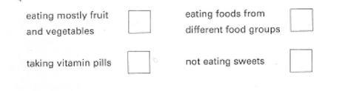
What makes an effective formative test question?
Partial understanding – one aspect of ‘balanced diet’
right answer
Partial understanding – not ‘balanced’ but focussing on what not to eat
Partial understanding – helpful in addition to ‘balanced diet’
Notes:
Have added this to 2.03 as a recap

Slide 35
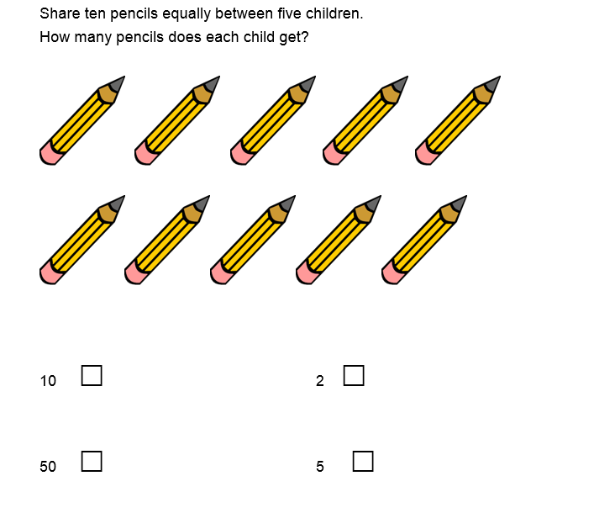
What makes an effective formative test question?
Look at this Maths question
Why do you think those answer options have been chosen?
What misconceptions do they aim to address?

Slide 36
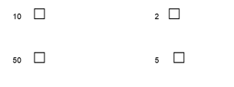
What makes an effective formative test question?
haven’t engaged with question – just counted number of pencils
right answer
Possible subtraction or just picked number within question
Multiplication instead of division

Slide 37
What else do we need to know to write formative questions?
Don’t worry! This is not the only training you will have on effective formative questions and how to write them!
Upcoming sessions include;
How to write effective formative items.
How to write effective marking guides.
How to create onscreen formative assessments.

Slide 38
DISCUSS
In our tests…
Should we use PASS MARKS?
Should be use TIME LIMITS?

Slide 39

Formative assessment quiz!
Notes:
Questions to be in separate document

