Slide 1
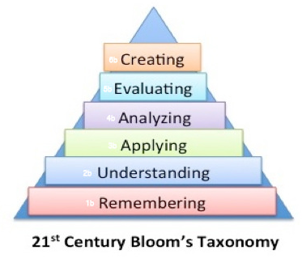

Writing competence based questions
Understanding levels of questioning – Bloom’s Taxonomy
Notes:
To be able to write questions that assess competencies we need to look carefully at what the question is asking the student to do. Are they being asked to just repeat or recall something they has learned (which as we saw earlier gives us only limited information) or are they being asked something that requires them to use what they have learned to show they understand and can apply it.
One way of thinking about what a question is asking and therefore what we are assessing is by looking at Bloom’s taxonomy. Some of you will be familiar with this- but briefly it is a way of classifying skills and learning objectives in order of complexity- From the most straight forward (remembering) to the most challenging (creating).
If we were assessing a knowledge based curriculum – we could do so effectively by only asking questions that address the bottom two categories: remembering and understanding. However, now we have a competence based curriculum, this is no longer enough we need to be asking questions which assess the higher order skills

Slide 2
Writing competence based questions
Higher order: Analysing, evaluating and creating
Medium order: Understanding and applying
Lower order: Remembering
Notes:
To make sure that the level of demand is appropriate for senior 4 and you are reflecting the competences within the curriculum, when you write your questions you need to make sure that there is a good balance of different types of question across Bloom’s taxonomy.
To simplify this process we have split question types into three categories: Lower order: Remembering; Medium order: Understanding and applying; and Higher order: Analysing, evaluating and creating.

Slide 3
Writing competence based questions
Lower order: Remembering
Questions that ask the student to remember previously learned information such as facts, definitions, dates or formulas.
Questions typically use command words such as:
Choose Define Label List identify | Name Select Outline Match Describe | What When Where Which Who Why
Notes:
The list of command words isn’t complete – this is just a selection
Even in a competence based curriculum there will still be some questions that will focus on lower order skills, but they should be fairly limited
Tend to be assessible through multiple choice or short answer questions as they usually have clearly defined right or wrong answers
The command words are only suggestions, they are not the only thing that defines the level of competence. For example look at the command words in the final column. If the question asked was ‘Who holds the world record for the 100 metres sprint?’ the question would be lower order – it is a fact that can be learned and repeated. If on the other hand the question was ‘Who do you think is the greatest sports person of all time? Give thre

Slide 4
Writing competence based questions
Medium order: Understanding and Applying
Questions that ask the student to show they understand ideas, concepts, rules and formula by explaining or applying them (eg. using their knowledge to solve a problem)
Questions typically use command words such as:
Classify Compare Contrast Demonstrate Explain Illustrate | Interpret Show Summarise Apply Develop Model | Organize Solve Examine Express Calculate
Notes:
These types of question tend to better reflect a competence based curriculum as they begin to show that a student can use what they have learned for a particular purpose (solve, calculate, classify, apply) or move beyond just being able to reproduce it by showing they can develop it (explain, contrast, compare, interpret).
Therefore it gives a better picture of what a student can actually do and how well they have grasped what they unit has tried to teach them than recall alone

Slide 5
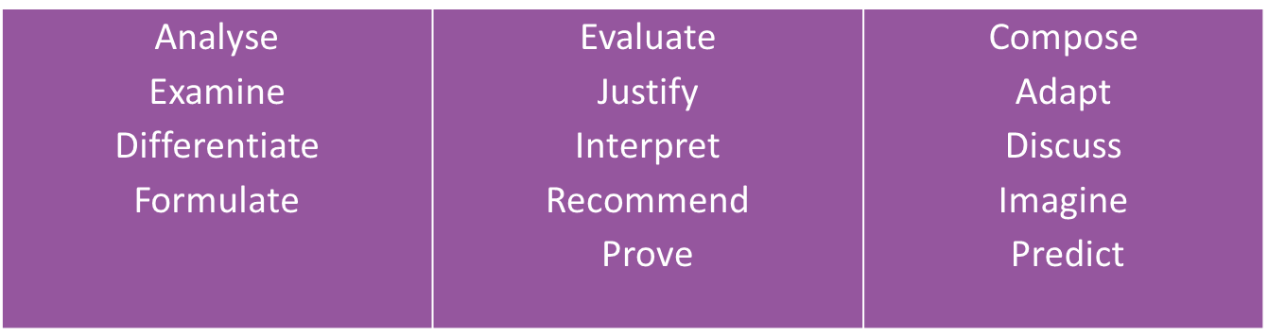
Writing competence based questions
Higher order: Analysing, evaluating and creating
Questions that ask the student to examine information, data and ideas in detail. This could be to:
interpret them or break them down to show how their different parts are related (analysing)
make judgements, comparing the strengths and weaknesses of different approaches and interpretations (evaluating)
bring them together in a new way to propose alternative solutions or produce new perspectives (creating)
Questions typically use command words such as:
Notes:
These questions are the most demanding as they require the student to be independent by making their own judgements, reaching their own conclusions or give their own views or interpretations based on evidence.
They are often more complex because they require the student to go through several different stages to reach an outcome– for example for analysing: before the student can show how the different parts of an argument or sets of data are related, first they may need to categorise or group them.
While it is not impossible to assess higher order competences through closed questions, they are more likely to need the students to be able to give open responses to show what they can do.
As mentioned earlier, the typical command words are indications only do not always belong strictly to one order of questioning or another- you might have noticed that interpret is included in the examples for both medium and higher order- to some extent it will depend on the question as a whole. You should use your judgement as to which order you think the question is and just use the command words as a broad indicator.

Slide 6
Writing competence based questions
Activity
Look in the envelopes on your table
In groups discuss what the questions are assessing and classify them as lower, medium or higher order
Notes:
On your tables you should have some envelopes and in them are a series of questions- in groups discuss which headings you would put them under- higher order, medium order or lower order.
For some the answer will be fairly obvious, for others, less so. Shows that this is not an exact science and you need to use your judgement, but you do need to be able to justify your thinking.
Allow 10 – 15 minutes

Slide 7
Writing competence based questions
Label the parts of flower.
Design an experiment to demonstrate that sunlight is essential for photosynthesis.
Which do you think is the biggest problem facing Rwanda today? Give examples of how it could be solved.
Analyse the main challenges facing Rwanda today. Evaluate the pros and cons of different possible solutions.
How does climate in Rwanda vary according to location?
Explain why the climate in Rwanda varies according to location?
Interpret the figures in the table to show which factor had the biggest impact on the speed of reaction.
Notes:
Go through the selection of questions on the slide- ask for show of hands as to whether people thought they were high, medium or lower order. Ask individuals to explain why. Repeat the point that these are not ‘correct’ answers, the point is the discussion as to why (link to formative…)
Label the parts of flower (L)
Design an experiment to demonstrate that sunlight is essential for photosynthesis (M)
Which do you think is the biggest problem facing Rwanda today? Give examples of how it could be solved.(M)
Analyse the main challenges facing Rwanda today. Evaluate the pros and cons of different possible solutions. (H)
How does climate in Rwanda vary according to location? (L)
Explain why the climate in Rwanda varies according to location? (M)
Interpret the figures in the table to show which factor had the biggest impact on the speed of reaction. (H)
For the lower or medium questions ask what could be done to them to move up to the next level.

Slide 8
Evidence for excellence
in education
© National Foundation for Educational Research 2018
All rights reserved. No part of this document may be reproduced or transmitted
in any form or by any means, electronic, mechanical, photocopying, or otherwise, without prior written permission of NFER.
The Mere, Upton Park, Slough, Berks SL1 2DQ
T: +44 (0)1753 574123 • F: +44 (0)1753 691632 • enquiries@nfer.ac.uk
  www.nfer.ac.uk

