Slide 1

Re-cap
What are the general principles of writing open and closed questions?
Notes:
10 minutes

Slide 2
Re-cap: General principles and style
Across open and closed questions
Five aspects to consider:
    language
    visuals
    contexts
    sensitivities
    student expectations
Notes:
Language – is my question written as simply and clearly as possible to ensure that all students interpret it as intended
Visuals – diagrams / illustrations
Context – a scenario (often used in science or mathematics) to give a situation in which to apply knowledge / rules.
student expectations

Slide 3

More closed questions
Notes:
Yesterday looked at multiple choice questions, but there are very many other types of closed questions (where students choose their answers from a given range).
Today, we will look at these

Slide 4
Sequencing
Number the stages below to show their order in making a cup of tea.
The first one has been done for you.
boil water
put tea bag in cup
pour boiling water onto bag
fill kettle
add milk and sugar
1
Notes:
Ideal for curriculum areas where there is a chain of cause and effect (sciences) a precise sequence of stages to be followed (eg an experiment) / a narrative (history / language / literature).

Slide 5
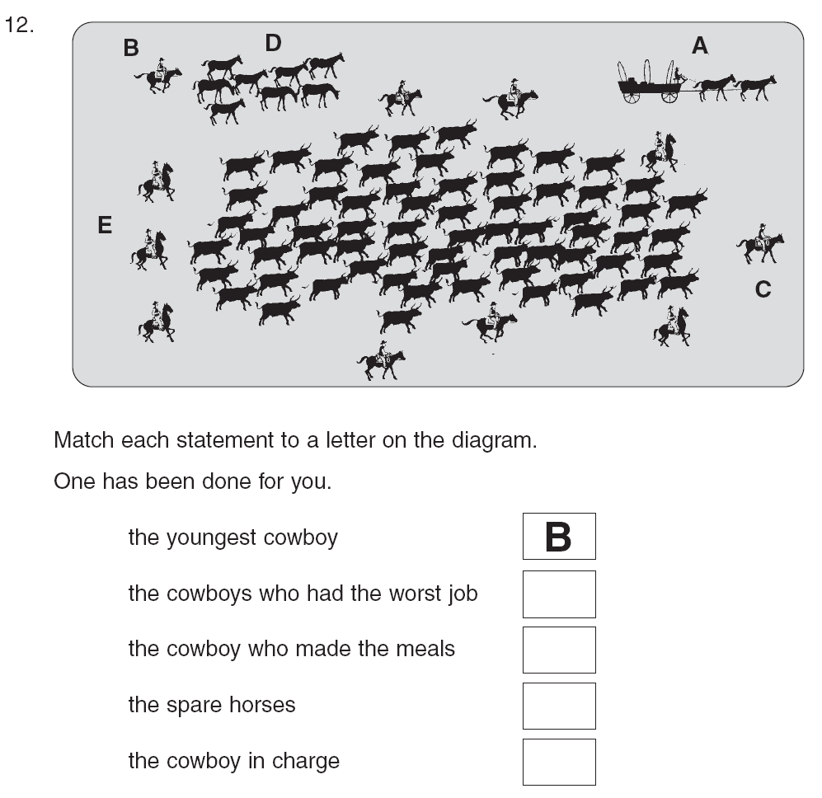
Labelling diagrams
Notes:
Labelling a diagram - ideal for sciences. Labelling parts in biology / labelling equipment needed for an experiment / literacy (to show understanding of an information text). Can be done as an open exercise, where students generate their own labels – or as here, as a closed task.
This was based on students having just read about the roles and tasks of the different cowboys.

Slide 6
Matching 1
Draw three lines to match the places in the story to the characters
Children
Tea room
Father
Schoolyard
Grandmother
Football match
Notes:
Three or four not too bad to mark. if you devise items with more than four matches to be made, then the pattern of responses has to be scrutinised to make sure it does not lead to increased marker error. If computer marked, then this is not a problem.
Apologies for the stereotypes.

Slide 7

Matching 2
A
B
C
D
Match each arrow to the force it represents.
Arrow
Force name
drag
reactive
weight
thrust
Notes:
Candidates must drag and drop the objects (arrows) and targets (forces) in order to form matching pairs. There must be an equal number of objects and targets.
There must be at least four matching pairs in order to minimise the potential of answering correctly by chance.

Slide 8
Matching 2
A
B
C
D
Match each arrow to the force it represents.
Arrow
Force name
A
drag
B
reactive
C
weight
D
thrust
Notes:
Candidates must drag and drop the objects (arrows) and targets (forces) in order to form matching pairs. There must be an equal number of objects and targets.
There must be at least four matching pairs in order to minimise the potential of answering correctly by chance.

Slide 9
Matching 3: unequal columns
hydrochloric
Strong acid
water
Weak acid
nitric
acetic
Neutral
oxalic
citric
Notes:
For science? Adapt, acid
Very useful for classification tasks in sciences
This is how this item looks on paper, when presented in a pencil and paper test. Instructions would say something along the lines of:
Draw six lines to match each chemical to the type of acid it is.

Slide 10
Matching 3: unequal columns
hydrochloric
Strong acid
water
Weak acid
nitric
acetic
Neutral
oxalic
citric
Notes:
This is how a student is intended to answer this type of question.

Slide 11
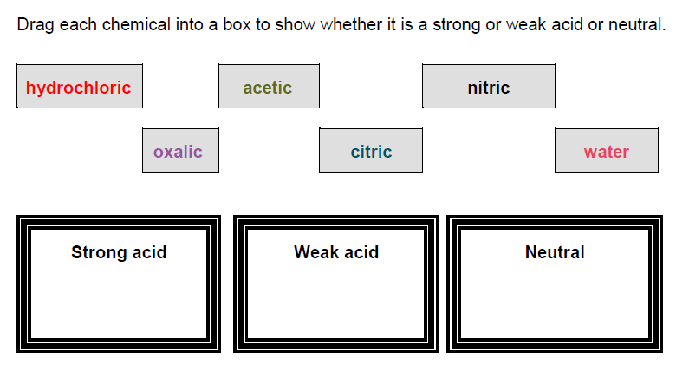
Drag and drop 1
Notes:
This is a different way of asking an matching question.
Students drag labels (reactions) from the list and drop them onto the appropriate area within an image, here in either the reversible or non-reversible boxes.
There can be any number of labels within the list and there can be more than two drop areas.

Slide 12
Drag and drop 2
Drag the speech marks in the correct place in the sentence.
What a brilliant surprise! said Emmanuel. I wasn’t expecting that on my birthday.
“ “ ” ”

Slide 13

Question Writing Activity
Task: On your table, try to write one example for each of these question types (sequencing, labelling, drop down, matching, and drag and drop) for your unit.

Slide 14

Open Questions

Slide 15
What are open questions?
Questions to which students generate their own answers.
Open questions encourage a fuller response from the student and place fewer limits on the student’s response.
As well as generating quantitative data (a mark), open questions can produce more in-depth formative data.
Notes:
This is in comparison to closed questions which provide a selection of limited pre-defined answers.

Slide 16
Advantages of using open questions
Opportunity to assess higher order competences such as analysis and interpretation
Students give a genuine personal response
Responses can show different levels of understanding
It reflects questioning used by teachers in the classroom
Can reduce quantity of reading required
Notes:
Pres 2

Slide 17
Disadvantages of using open questions
Students’ answers may be long and it can take a longer time to analyse to give feedback.
There will be a lot of variation in students’ answers.
More complex mark guides to
      account for all possible correct answers that students generate
      provide enough guidance to ensure consistent marking
The quality of the response may be influenced by the student’s writing skill
Can’t be machine marked

Slide 18
Short response 1
1 mark answers
How far does Gabriel have to walk to school each morning?
2 miles
But a student could answer:
Two miles
2 mil
Two
Two milleis
Two kilometres
Which ones would you give a mark to?
Notes:
Markers have to use their professional judgement in combination with the published mark scheme criteria to decide whether answers are creditworthy / what mark they get.
In the case of a question like this, the range of possible acceptable answers is probably fairly narrow but it is still not clear-cut.
Decisions would have to be made about whether to credit:
Answers written in words
Misspellings
Answers rounded up or down.
Suggest that the mark scheme could be made clearer by adding:
Accept answers with spelling errors when the meaning is clear e.g 2 mil, two millies
Do not accept answers which do not refer to miles

Slide 19
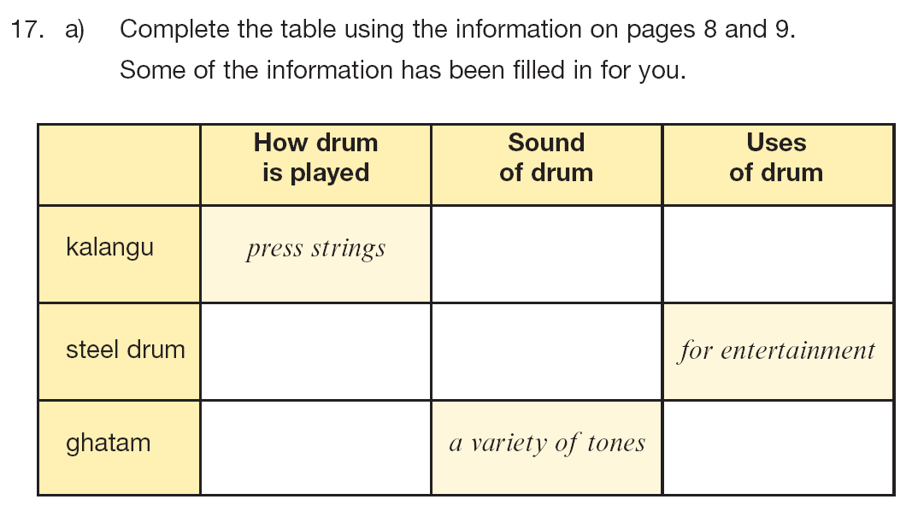
Short response 2: several short answers
Notes:
Sometimes you can combine several small pieces of information into a single question. This would probably generate 2 or more marks for complete accuracy and partial marks, if some answers are wrong.
It is useful because
The format keeps the answers short
Once the student understands the principles of what they are being asked and how they are being asked to provide their answer, then they can demonstrate a lot of understanding in an economic way.

Slide 20
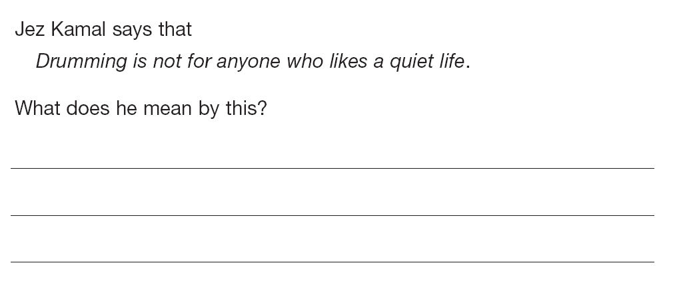
Short response 3
1 or 2 mark answers
Notes:
Longer answers expected here.
Expectation is that basic 1 mark answers provide a literal response about ‘noise’
2 mark answers recognise the metaphorical aspect of the phrase ‘a quiet life’.
Challenging to write the mark scheme for this.

Slide 21
Activity 1:
Advantages of different item types
You will now work in pairs.
Write one closed question of your choice.
Swap with your neighbour and re-write their closed question as an open response item.
Consider the advantages of the different item types (open vs closed) and when you would use each item type.

Slide 22

Marking guides
‘A marking scheme helps objectivity as the assessors are able to compare the evidence from the candidates with the requirements of the marking scheme. This will help the assessors to ensure that they give credit to all candidates in the same way.’
Guide to classroom-based and national assessments in Rwanda, 2017, Section 7.15

Slide 23
Marking guides
  Should be drafted and developed alongside the question.
  Should be reviewed by colleagues.
  Marking guides for closed questions are relatively straightforward.
  Marking guides for open questions should provide guidance for judging the correctness of answers and include example answers if possible.
  They should not consist only of examples. Example answers are not enough to guide marking.
Notes:
Mark schemes MUST be developed simultaneously with the item.
When colleagues review items, it may be best to give them a copy WITHOUT the answers – to answer the test as authentically as possible.
Then, they MUST also review the mark scheme.
Big difference between the work that goes into the mark schemes for open and closed items. It is complex to create a mark scheme even for a 1 mark answer.

Slide 24
Developing marking guides for open items
  Think of the main point(s) you would expect the student to make
  How many marks will you award for a correct answer? How many is it worth?
  Remember students can give a correct answer in many different ways. Think about the kinds of answers students are likely to give.
  Which ones deserve marks, which do not?
Notes:
You will not have access to as many responses as this (until questions are trialled on large numbers of students) so you will have to use the resources you have. Ask colleagues to answer the question in as many different ways as they can think of.

Slide 25
Marking guide development for open items
  Think about the kinds of answers students are likely to give.
  Which are creditworthy, which are not? Is it clear how to mark the responses using your initial marking guide?
  Organise the responses into groups based on their characteristics.
  Consider ‘allowable’ responses as well as the ideal creditworthy response and any uncreditworthy responses.
  Generic descriptions of each category followed by one or more examples are helpful for markers in applying the mark scheme more widely.
Notes:
Whether the current mark scheme makes it clear what mark it should get
Group them according to their characteristics. These characteristics indicate what the CRITERIA / PRINCIPLES are by which to judge the answers
Look at the answers that are partial / ‘just allowable’ (but not ideal) – your mark scheme has to tell markers what to do with these sorts of answers

Slide 26
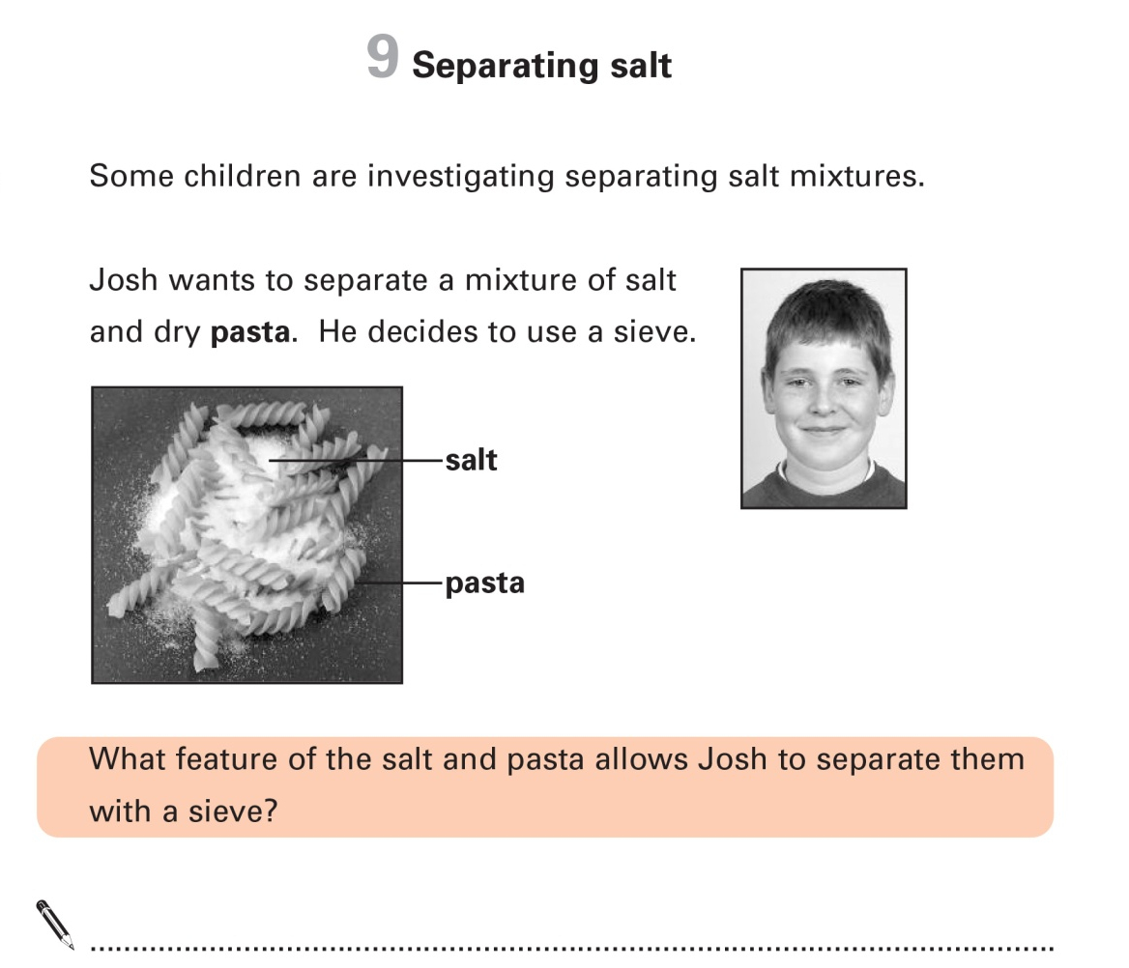
Example 1: Marking guide for open questions
Notes:
This is a simple 1 mark question from a science test for 11 years olds.
READ THROUGH THE QUESTION.
We think that the answer is fairly straightforward and that the mark scheme could be something like this: (next slide)

Slide 27
Unrealistic mark scheme
Award 1 mark for reference to:
different size.

Notes:
This would not account for many answers and would not provide markers with enough information to help them judge the acceptability of most student responses. On the next slide, you will see the mark scheme that was actually published to go with the question about separating salt from pasta.

Slide 28
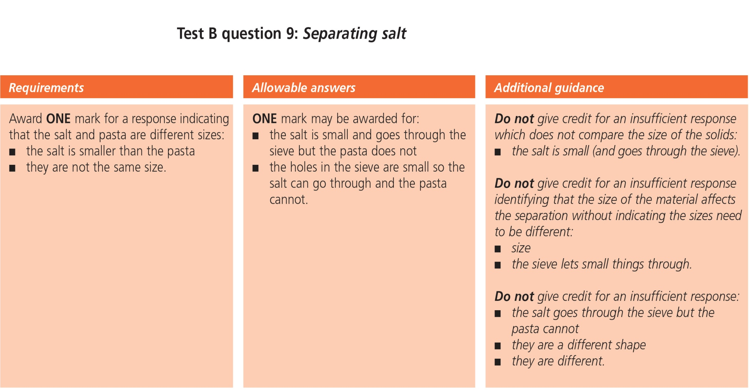
Example 1: Marking guide for open questions
Notes:
All this information was deemed necessary to ensure consistent marking for even a short question with basically one answer.
A section describing the minimum requirements of an acceptable answer (different sizes)
A section showing different borderline answers where markers may not be sure whether they fulfil the criteria (uncertainty whether the answers sufficiently express the idea of different size).
A section with additional guidance – all of these focus on reasons for not giving credit – with some explanation.

Slide 29
Example 2: Marking guide for open questions
This is the type of question where marks are given cumulatively: for the number of correct answers given.
Give two ways in which Sue can prevent tooth decay.
1.
2.
Notes:
This is the type of question where marks are given cumulatively: for the number of correct points made by the student. Markers simply count up the number of correct points and convert this to a mark. This one is a very simple question – where the student will receive one mark for each correct point.
But it would be possible to make this a harder question by asking students to give 3 answers and to convert the answer to marks like this:
3 correct answer = 2 marks
2 correct answers = 1 mark
1 correct answer = 0 marks.
Where there are two (or more) marks available, markschemes have to be fuller as you have to include:
The acceptable points answers (as before)
The allowable / borderline answers (as before)
Additional explanation to help distinguish incorrect answers (as before)
ALSO:
explain how students achieve one / two marks.
This is demonstrated on the next slide.

Slide 30
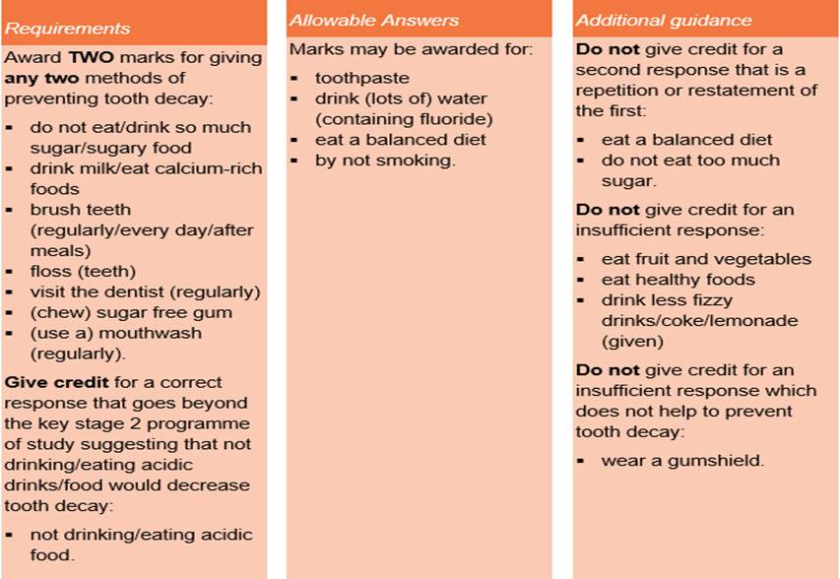
Example 2: Marking guide for open questions
Notes:
This follows the same structure as the previous markscheme
With
A section listing the variety of points that students can make (Left hand)
A section showing different borderline answers where markers may not be sure whether they fulfil the criteria. (middle section)
A section with additional guidance – all of these focus on reasons for not giving credit – with some explanation. (right hand section)

Slide 31
Example 3: Marking guide for open questions
This is the type of question where marks are given qualitatively: for the insight / quality / perceptiveness of the answer.
Notes:
This is the type of question where marks are given qualitatively: where the marker has to make a judgement call about how good the answer is. (not quantity but quality). This is where the difference between one or two mark answers is expressed through descriptive criteria and the marker has to make a judgement about which description the answer fits better.
Let’s go back to a previous example from a reading test for 11-year-olds.
Read through the question.

Slide 32
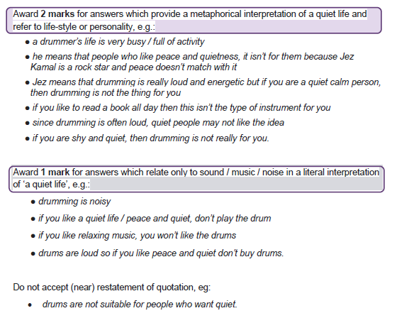
Example 3: Marking guide for open questions
Notes:
If there is time, then the English teachers in the room could use this mark scheme to mark the collected answers.
Did their answers fall roughly into the two categories of ‘literal’ ‘metaphorical’?
Otherwise, if not time to have this activity: explain how the criteria of ‘literal’ ‘metaphorical with the examples provided (showing the range of answers that fit the descriptor) instructs the teacher how to mark their own students’ answers.

Slide 33
Example 4: Marking guide for open questions
For more demanding questions assessing higher competences you may want to award more marks.
Greater number of marks = greater subjectivity = less reliable marking
To keep the marking as simple and straightforward as possible you should use a banded marking guide
Banded mark schemes are divided so that each band has a clear and precise description that shows how far the student has answered the question successfully.
For this project the maximum number of marks for a single question should be 6
For these questions you should use a banded marking guide with 3 bands of 2 marks.

Slide 34
Example 4: Mark guides for open questions
Use information from the diagram and your own knowledge to describe how adult cell cloning could be used to clone a zorse.
…………………………………………………………………………………………………………….
…………………………………………………………………………………………………………….
…………………………………………………………………………………………………………….
…………………………………………………………………………………………………………….
…………………………………………………………………………………………………………….
…………………………………………………………………………………………………….. (6 marks)
AQA GCSE Biology
Notes:
Possible answers
(i) Sexual reproduction: fusion / joining / combining of gametes / male and female sex cells/ sperm and egg / DNA fertilisation ……..from 2 parents
(ii) mixture of genes / DNA / genetic information / chromosomes
from both parents / horse and zebra

Slide 35
Example 4: Marking guide for open questions
Band 3 (5-6 marks) | There is a clear, detailed and accurate description of all the major stages of adult cell cloning.
Band 2 (3-4 marks) | There is an almost complete description of the early stages of the process and some aspects of the later stages. There may be some inaccuracies.
Band 1 (1-2 marks) | There is a simple description of the early stages of adult cell cloning. However, there is little other detail and the description may be inaccurate.
0 Marks | No relevant content.
Examples of points made in the response could include: Skin cell from zorse; (unfertilised) egg from horse; remove nucleus from egg cell; take nucleus from skin cell; put into (empty) egg cell; (then give) electric shock; egg cell divides/ embryo formed; (then) place embryo in womb/uterus
Notes:
Note advantage is that it gives finer grained detail as to how well they have responded, credits partial understanding
Band descriptors are helpful in giving formative feedback, makes clear what is needed to improve
Should try to avoid being influenced by the students writing skills – we are assessing understanding of biology not English. Don’t be influenced negatively by a well written answer with little content or a poorly written one that still shows they have grasped the learning objective.
Note the inclusion of indictive content- however only a guide, not a hurdle
Note the inclusion of a zero band – important that band one isn’t awarded as a ‘consolation’- may spare the student’s feelings but won’t help them progress

Slide 36
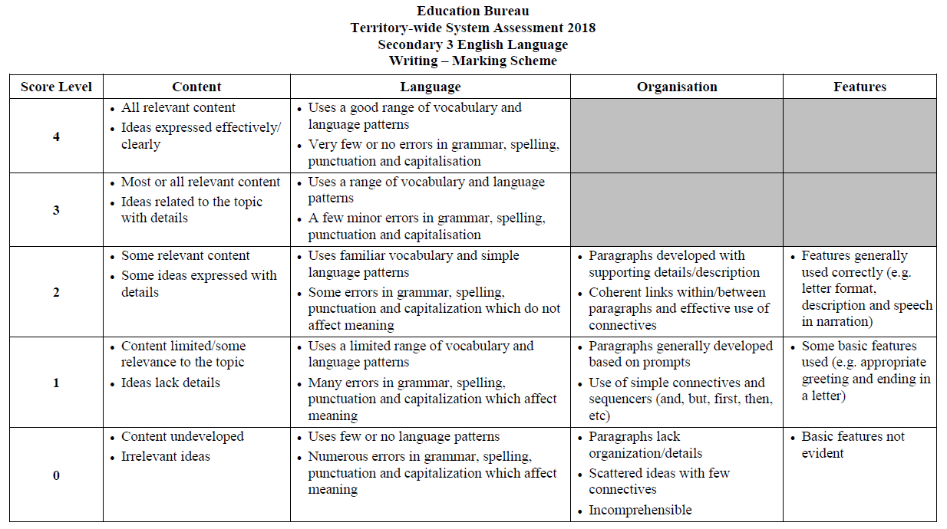
These kinds of marking guides can be very thorough.
Notes:
Here’s an example from Hong Kong. Assessing English language.
Show them this example of how far this can go (note that it’s not the most complex you can get).
This assessment would be out of 12.
Note different capabilities – advantages are: more reliable marking, more precise formative feedback
Issues: time consuming, still subjective (as discussed in previous slides), need to make sure categories don’t overlap (so the same thing is credited twice).
Also – Moodle can’t do this.

Slide 37
What the teacher can learn from student responses
How much a student understands (quantity) ✓
Insightfulness (quality) ✓
Scope of response ✓
Use of textual evidence ✓
Use of knowledge outside the test (legitimate and illegitimate) ✓
Engagement with text ✓
Is the student answering the question asked? ✓
Notes:
Marking for formative purposes is not the same as marking. What you want to find out from formative marking is what the student did right and what they did wrong / how they can make a good answer even better and how to feed back to the student.
For formative data, we need to categorise different types of wrong answer because these are the most revealing about performance – as well as different creditworthy approaches as well.
how much a pupil understands (quantity) how many truly unique points do they make in their answer
insightfulness (quality) – are they central / core issues or are they trivial / periferal (missed the point)
scope of response (Local / global)
use of extrinsic knowledge (legitimate and illegitimate)
engagement with the subject
is the pupil answering the question asked

Slide 38
Developing a marking guide
Identify a learning objective from your unit that lends itself to an open question with more than one mark.
Devise an open question and marking guide on this learning objective
Give your question (not marking guide) to your neighbour and see how they answer.
Get the question back from you neighbour:
Look at the answer and see if your marking guide covers it.
Adjust the marking guide if necessary to
        indicate how partial marks might be awarded
        ensure that wrong answers are not credited
        7. Discuss what you have learned with your neighbour
Notes:
For stage 3, please emphasise that the second group must represent the ‘awkward squad’ of the student body and find the holes in the questions, giving partial answers. Think of students that they know and imagine what answers they would give.

Slide 39
Evidence for excellence
in education
© National Foundation for Educational Research 2018
All rights reserved. No part of this document may be reproduced or transmitted
in any form or by any means, electronic, mechanical, photocopying, or otherwise, without prior written permission of NFER.
The Mere, Upton Park, Slough, Berks SL1 2DQ
T: +44 (0)1753 574123 • F: +44 (0)1753 691632 • enquiries@nfer.ac.uk
  www.nfer.ac.uk

Slide 40
Assessing English Language
Unit one: Geography of Rwanda
The tallest mountain in Rwanda is…
A. Marenga
B. Kabuye
C. Mount Karisimbi
D. Mont Muwogo
Good question but it is assessing knowledge of the content of the unit, not the student’s English language skills.
Notes:
Additional English Examples

Slide 41
Assessing English Language
The following question is a way to assess a learning objective linked to English Language from Unit one (present perfect tense) , that uses Geography of Rwanda as the context but doesn’t assess it.
Drop down:
My cousin [has worked/have worked/ will work/ could work] near Mount Karisimbi for the past five years
Or

Slide 42
Assessing English Language
Or you could do the same question as a multiple choice:
Choose the sentence with the correct tense.
My cousin have worked near Mount Karisimbi for the past five years.
My cousin will work near Mount Karisimbi for the past five years.
My cousin has worked near Mount Karisimbi for the past five years.
My cousin could work near Mount Karisimbi for the past five years.

