Slide 1
Assessment principles
There is no one ‘correct’ method of assessment: but there are guiding principles underlying good practice.
Any test or assessment should be
    reliable
    valid
    manageable
    What do these three words mean in daily life?
Notes:
Introduce this session by briefly referring back to different assessment methods e.g. summative, formative.
The partner/group discussion should yield some useful thinking around the terms e.g.
Reliable – dependable, won’t break down/let you down, does what is expected, can be predicted e.g. reliable weather, reliable car, reliable student
Valid – true, correct, can be verified, e.g. valid argument, valid concern etc
Manageable – what can be achieved, reasonable expectations, time/monetary/ability constraints
Manageable – what can be done in a certain time, achievable, e.g. the workload/homework was manageable,

Slide 2
Assessment principles
These three principles are distinct yet inter-related
Reliability
Validity
Manageability
Notes:
We will consider each one separately before showing how they affect each other and why they are essential to creating good assessments.

Slide 3
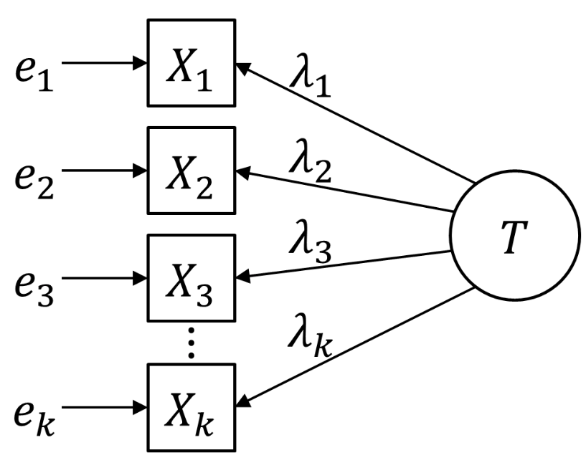
Reliability
Reliability is a complex statistical idea.
However, the main points of reliability are easy to grasp.

Slide 4
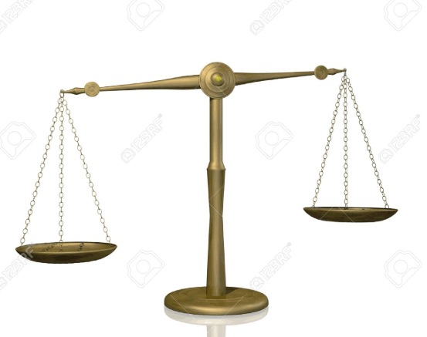
Reliability
A term often used in relation to statistical reliability when discussing assessment
But for our purposes today let us consider reliability as:
a weighing scales
This tool would not be of very much use if it gave a different result every time you weighed the same object
In the same way a test (and individual questions within the test) should give reliable results when answered by a large number of students over an extended period of time

Slide 5
Reliability
If a test is working properly, the most competent students should perform better in comparison with less competent students.
If the same test is taken by several classes of students and produces similar results, i.e. distinguishes between the most and least competent students, it is a reliable assessment which can be used time after time with broadly similar results in terms of performance.
A reliable question is one where able students are more likely to get it right and less able students are more likely to get it wrong no matter who is taking the test.
Notes:
Could mention the use of standardisation and large samples in large scale and national and international assessments

Slide 6
Internal factors affecting reliability
Question type – closed responses e.g. multiple choice, can make a test more reliable (one correct answer)
Length of test – the longer a test and the greater the number of questions, the more reliable it should be. BUT if a test is too long, some students will not attempt all questions, making it less reliable.
Facts are easier to assess reliably than opinions and attitudes
Bias can affect reliability, for example if a question favours girls rather than boys, students from rural/urban locations
Marking guide – unclear or insufficient instructions on how to award marks will lead to inconsistent and unreliable marking
Objective marking is generally more reliable than subjective marking
Notes:
But other factors affecting reliability may derive from the way the assessment is created i.e. may be built in to the assessment intentionally or unintentionally
If time permits issues around closed and open responses could be recapped here

Slide 7
Validity
Assessment is designed to measure specific competencies that matter within the subject and are appropriate to the ability of the student.
If the assessment measures what it is intended to, then the assessment is valid (or has validity).
A valid assessment produces an outcome that is representative of the skills learned and so gives a meaningful picture of achievement.
In other words: it actually tests the thing it sets out to test
Why is validity so important?
promotes confidence in teacher judgements
helps teachers to accurately guide future learning
Notes:
So reliability is desirable but it is not the only factor. Remember our metaphor of the weighing scales. An accurate pair of scales is one thing, having something worth measuring is another.
If time allows could consider mentioning content, criterion and construct validity

Slide 8
What is a valid test?
Discuss the following examples of assessments in terms of whether they are valid i.e. will assess what is intended:
A written test for deciding whether or not a student is able/ready to drive
A physics examination for 15 year olds that covers subject content from a university course
An examination testing creative writing which requires students to read a story and answer questions on it
A multiple choice test to determine whether a person is suitable to look after young children
Small group discussion (5 mins)
Notes:
1. Mention that one part of the UK driving test is computer based and tests knowledge of rules of the road, signs, hazards etc. But that a practical test is also needed to ensure public safety on highways.
2. Consider this example is problematic and how to avoid it – i.e. tying assessments closely to curriculum. Discuss implications of testing subject content vs competencies.
3. Consider importance of targeting appropriate assessment focus within subject area i.e. active and passive use of language
4. Knowledge versus attitudes – some things cannot be tested solely by a test. What is ‘suitability’ in this case?

Slide 9
Building in validity
When designing assessments we should ensure that:
the purpose is clear
everyone understands how results will be used
assessment is linked to curriculum units and specific learning objectives
your students are interpreting your assessment items in the way that you meant for them to be interpreted
questions are fair for all students i.e. not biased
marking guidance contains clear criteria by which to judge responses
Notes:
Discuss strategies for ensuring assessments are valid
Why are you setting an end of term exam? Needs to be more than ‘to give them a grade’
Discuss mismatch between question intention and interpretation.
Revisit bias and explore examples
Discuss importance of being able to defend what a particular mark means

Slide 10
Manageability
Making a selection of what to measure, how often to do it and what instruments to use is about manageability.
Any assessment system must be manageable and practical for students, teachers, markers and administrators in terms of:
preparation time
resources needed
delivery methods
ensuring accurate results
Notes:
There is a potentially infinite range of knowledge and skills in a subject that could be assessed
Invite teachers to consider what types of assessment/questions can be delivered effectively in their particular situation?
What affects manageability for you?

Slide 11
Balancing the big three
some forms of assessment might provide reliability at the expense of validity
reliable assessments are not necessarily valid
valid assessments should always be reliable
validity focuses on the accuracy of expected outcomes
reliability concentrates on precision and measures consistency of outcomes
valid and reliable assessments can only be delivered successfully in a manageable context
No assessment will be perfect, but awareness of the three principles will lead to improved outcomes for all
Notes:
Consider how the three principles are inter related
It is possible to produce highly reliable multiple-choice tests to minimise external factors that might interfere with the outcomes.
If assessment is predominantly focused on reliability, it will foreground the skills that are easiest to measure and compare and marginalize or ignore others.
It would be possible that one school could produce an extremely valid way of assessing their pupils based around talk, drama, writing in role. Elsewhere in the country another school could have an assessment system based around formal written responses and timed tests. Both of these approaches could be equally valid, producing meaningful outcomes that measure the skills they intend to. However, the results might not be reliable. If the pupils at the first school were assessed using the methods from the second the results might not be the same for pupils of similar ability.
Assessment individually tailored for the needs of every pupil, taken only when they are ready, covering the every aspect of the curriculum, in a range of contexts will produce highly valid results, but would be extremely difficult to manage.
Similarly, an assessment system could be made extremely reliable with every piece of work by every child checked and cross checked with every other piece of work by every other child to ensure they were of the correct standard, but the time and cost implications would clearly make such an approach unmanageable.

