Slide 1
“QA” = quality assurance
Writing a good test is very hard, and there are lots of things to watch out for.
Professional test writers will spend many hours checking their tests once they have written them.
Usually, dozens of people will see a test before it “goes live”.
We can’t do that – but we can do our best.
Notes:
Here Paul and David can extemporise a bit on the extensiveness of the QA procedures they use on tests in the UK.

Slide 2
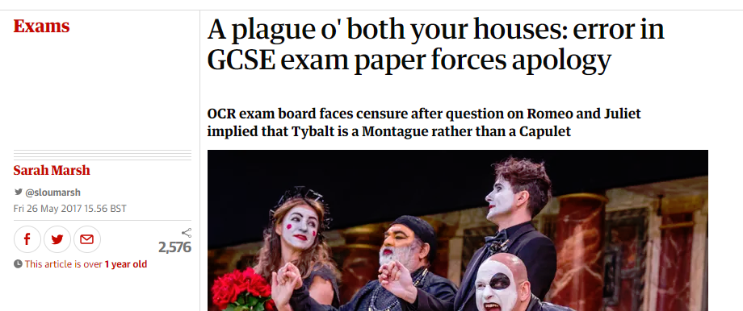
Why do we need quality assurance?
“How does Shakespeare present the ways in which Tybalt’s hatred of the Capulets influences the outcome of the play?”
Notes:
A good demonstration of how easy it is to ask nonsensical questions – even when it’s your full time job not to do so.

Slide 3

Why do we need quality assurance?
Notes:
Here an unfairly hard term slipped through (and it was a bad wording anyway).

Slide 4

How we will make sure we write high quality tests
Write your test.
Check your test.
Show it to a colleague.
  It is amazing how you – the test writer – can miss totally obvious problems with your test.
  We call this a “fresh pair of eyes”.
  Can they get the right answers?
Notes:
Here Paul and David can extemporise a bit on the extensiveness of the QA procedures they use on tests in the UK. Examination authorities use external expert reviews, for instance.
Stress the problem of knowledge – things you can’t see when you know them.

Slide 5
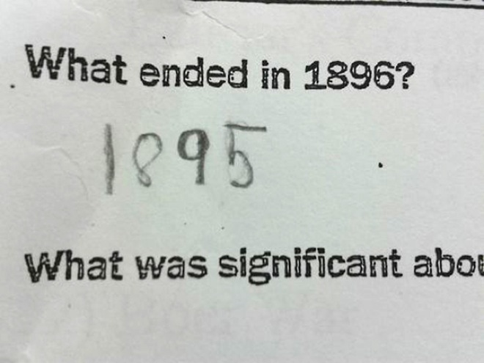
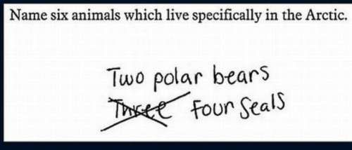
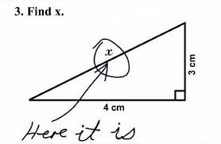
A fresh pair of eyes can spot different meanings to your questions

Slide 6
How we will make sure we write high quality tests
Notify NFER that your test is ready by sending an email to UNRE@nfer.ac.uk
NFER will give you feedback.
Improve your test based on the feedback
Try it with students or a colleague, make any improvements.
Notify NFER again.
NFER will review your test again and make final suggestions

Slide 7
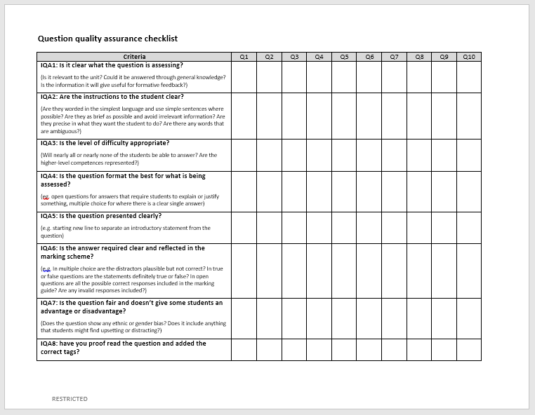
The QA checklist
Purpose: to help us focus on the most important aspects of our tests.
Works on two levels – the question level and the test level.
It is possible to have nine great questions making up a weak test!

Slide 8
The QA checklist
Notes:
Note that this is the item-by-item part
Draw out the most important features of the checklist:
8 questions
A separate column for every question – explain why – because it’s easy to flick through and forget things.
This is how NFER checks that its tests have no errors in them.

Slide 9
The QA checklist
IQA1: Is it clear what the question is assessing? (Is it relevant to the unit? Could it be answered through general knowledge? Is the information it will give useful for formative feedback?)
IQA2: Are the instructions to the student clear? (Are they worded in the simplest language and use simple sentences where possible? Are they as brief as possible and avoid irrelevant information? Are they precise in what they want the student to do? Are there any words that are ambiguous?)
IQA3: Is the level of difficulty appropriate? (Will nearly all or nearly none of the students be able to answer? Are the higher-level competences represented?)
Notes:
Most of these points will have been covered in previous training. Perhaps ask “why would that be a problem” for selected ones (e.g. none able to answer).
For 2, add that it’s important for the grammar and spelling to be right.

Slide 10
The QA checklist
IQA4: Is the question format the best for what is being assessed? (eg. open questions for answers that require students to explain or justify something, multiple choice for where there is a clear single answer)
IQA5: Is the question presented clearly? (e.g. starting new line to separate an introductory statement from the question)
IQA6: Is the answer required clear and reflected in the marking guide? (e.g. In multiple choice are the distractors plausible but not correct? In true or false questions are the statements definitely true or false? In open questions are all the possible correct responses included in the marking guide? Are any invalid responses included?)
Notes:
Note for 6 that this applies even for closed questions – this is where the fresh pair of eyes can be helpful in trying to “break” the questions.
Again, questions like “what happens if this goes wrong” and “what might this look like”.

Slide 11
The QA checklist
IQA7: Is the question fair and doesn’t give some students an advantage or disadvantage? (Does the question show any social status or gender bias? Does it include anything that students might find upsetting or distracting?)
IQA8: have you proof read the question?
Notes:
If not done before, brainstorm factors that could make a question unfair: language barriers, life experiences (richer or poorer students), cultural issues.
Note that Q8 is a reminder to check that they’ve done it – and that tags are required.

Slide 12
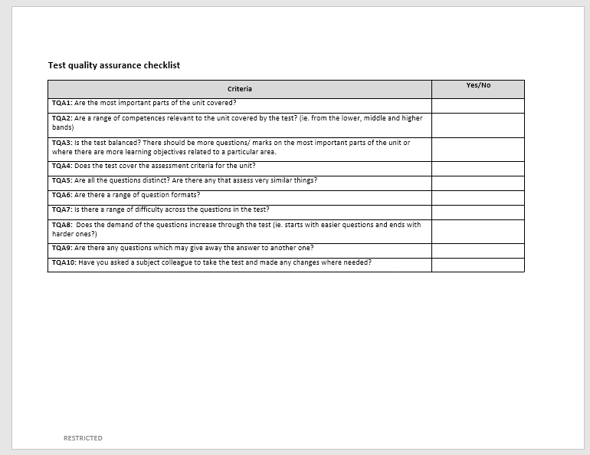
Page 2: test-level QA

Slide 13

Discuss
5 minutes in pairs
Is there anything else you need to remember to look out for?
What else do you find always trips you up?

Slide 14
Page 2: test-level QA
TQA1: Are the most important parts of the unit covered?
TQA2: Are a range of competences relevant to the unit covered by the test? (ie. from the lower, middle and higher bands)
TQA3: Is the test balanced? There should be more questions/ marks on the most important parts of the unit or where there are more learning objectives related to a particular area.
TQA4: Does the test cover the assessment criteria for the unit?
TQA5: Are all the questions distinct? Are there any that assess very similar things?
TQA6: Are there a range of question formats?
TQA7: Is there a range of difficulty across the questions in the test?
TQA8: Does the demand of the questions increase through the test (ie. starts with easier questions and ends with harder ones?)
TQA9: Are there any questions which may give away the answer to another one?
TQA10: Have you asked a subject colleague to take the test and made any changes where needed?
Notes:
All this should have been covered already. Questioning opportunities
For each one – especially Q5 onwards – why does this matter?
Q9 – what is this called (an enemy).
Note Q20.

Slide 15
Who uses the QA checklist?
You use it
Your fresh pair of eyes can use it.
NFER reviewers will use it.
REB staff can use it.
Notes:
Note that we don’t expect them to send us the results of their QA – but it’s good to do it because it’ll increase quality and help them develop as question writers.
REB – show that this is a potential use – as time goes on and system becomes self-sustaining, REB staff might use this checklist also.

