Slide 1
Definition and example component of computer hardware
Computer hardware is the collection of physical components that constitute a computer system. Computer hardware is the physical parts or components of a computer, such as monitor, keyboard, computer data storage, graphic card, sound card, motherboard, and so on, all of which are tangible objects

Slide 2
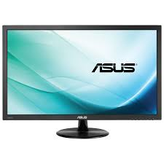
Monitor :is a device used to display data. It has loudspeakers and tuners

Slide 3
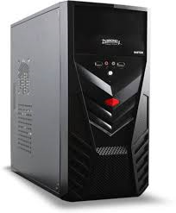
Central processing
The CPU case normally houses the power supply, the motherboard and the disk storage (hard disk drives, optical disk drives) that store data.

Slide 4
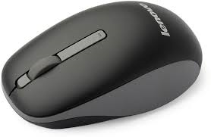
MOUSE is used appointing device with sensors that execute instruction by pointing.

Slide 5
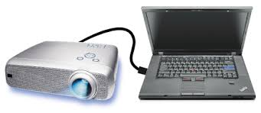
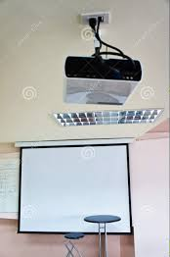
projector
Projector: Is an ICT device used to display data in bigger format on big screen. The data displayed is on the computer or any storage device connected to the projector. The data can be in form of text, video or images. There exist portable projectors that can be moved from place to place and there are also overhead projectors fixed in one single room. To data can be displayed on a projector screen or on a white wall for better view.

Slide 6
What is a software?
Software is intangible part of computer or is computer programs and data

Slide 7
printer
Printers: No computer is complete without a printer. At some point, you're going to want to print photos scan a document. A good, reliable, feature-rich printer can make these tasks simple as well as fun. The two primary types are inkjet and laser

Slide 8
Function of software
System software runs the hardware and computer system. The two main categories of system software are operating systems and utility software. Functions of system software are: The three major functions of system software are allocating system resources, monitoring system activities, and disk and file management.

Slide 9
What are the functions of application software?
The function of application software is to perform specific operations for various applications. These functions include writing reports, creating spreadsheets, manipulating images, keeping records, developing websites and calculating expenses.

