Slide 1
ICT TO SUPPORT ASSESSMENT
Prepared
by
Albert SINAMENYE

Slide 2
Introduction
Assessment is the process of gathering and discussing information from multiple and diverse sources in order to develop a deep understanding of what students know, understand, and can do with their knowledge as a result of their educational experiences; the process culminates when assessment results are used to improve subsequent learning.
Assessment can be formative or summative.
1. Formative Assessment
Formative assessment is often done at the beginning or during a program, thus providing the opportunity for immediate evidence for student learning in a particular course or at a particular point in a program. Classroom assessment is one of the most common formative assessment techniques.
2. Summative Assessment
Summative assessment is comprehensive in nature, provides accountability and is used to check the level of learning at the end of the program. For example, if upon completion of a program students will have the knowledge to pass an accreditation test, taking the test would be summative in nature since it is based on the cumulative learning experience.

Slide 3
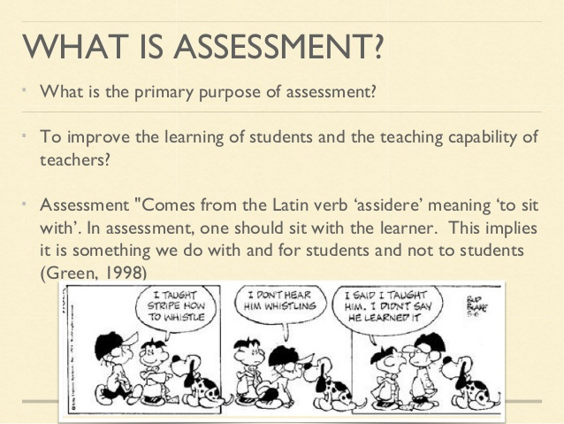

Slide 4
What are some examples of formative assessment?
Classroom Assessment Techniques (e.g., muddiest point, minute paper, memory matrix)
Homework exercises
Discussion responses
Journal Entries
Pretests
most formative assessments are designed for timely feedback so as to “tweak” the
teaching/learning environment for the better, before the end of a class
What are some examples of summative assessment?
Exams
Papers
Journals (when completed for a course)
Lab write-ups
Both formative and summative assessment are interconnected – an instructor typically
will use both types of assessment to gauge learning during and after a class

Slide 5
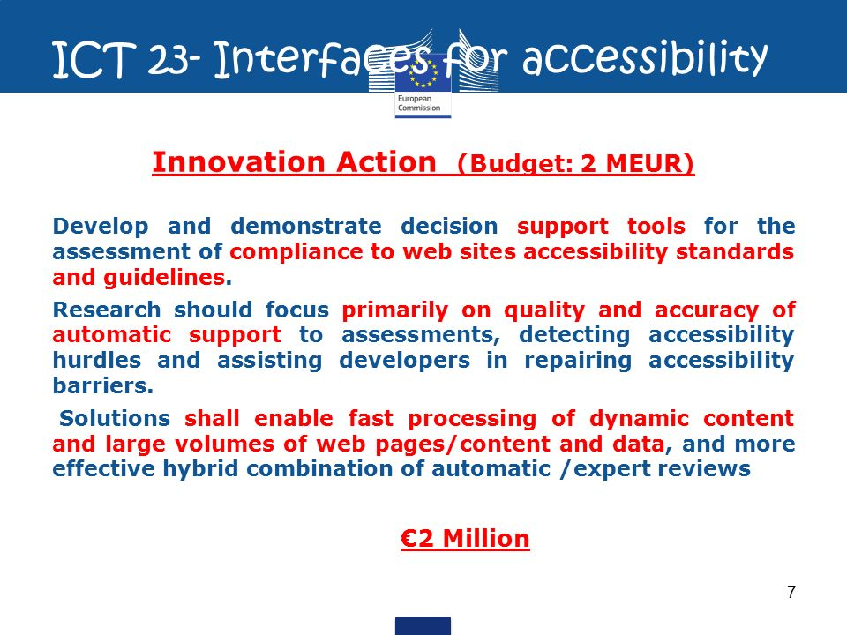
What is the role of ICT in assessment?
In the world of ICT-led innovation, new styles of learning have an exciting image but assessment usually fails to raise much enthusiasm.
E-Assessment stated that the ICT based assessment can be undertaken with many devices, such as traditional desktop computers or laptops, with portable communication devices such as smart mobile phones, with digital devices such as iPods or through the use of electronic gaming devices. ICT based assessment can use a multitude of formats,

Slide 6
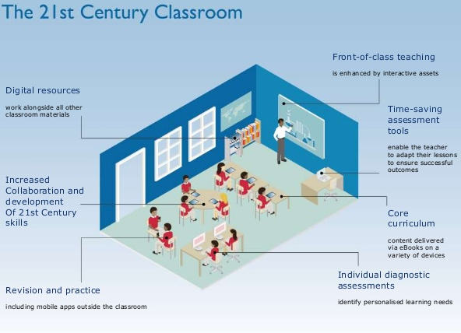
Digital tools to support assessment.

Slide 7
Contribution of ICT in assessment
Me as a teacher
I could easily store the assessment information online and access it.
Timely feedback helped me to understand my children’s progress in a more realistic fashion.
Commenting on learners’ progress was a quickest way of continuity and planning for the next action.
I involved parents to share the feedback and received their comments also.
I was a bit conscious about reliability and validity of peer assessment but with the help of criteria, my learners made decisions independently and logically.
Students
Got instant feedback through e-mail while being assessed and decided for the next step. This strategy made them responsible for their own learning.
Were more autonomous and stimulated and showed readiness to bring change according to the assessment criteria.
Saw progression in their own learning more easily while assessing their own work.
Were very much aware of that those technology integrated assessment activities are part of their learning so their participation became strong.
Were more engaged due to technology integration and completed the task with more success. Students always find use of technology their very own way of learning.
Developed their social skills, research skills and thinking skills.

Slide 8
Contribution of ICT to my school:
Acquired quality teaching and learning sessions.
Produced e-confident learners.
I used my school’s data gathering tool; LMS and the spreadsheet to record their marks over time. This compilation of marks showed their progress in a glance. I could easily make my future action plan by analyzing the data.
I used various features of MS Word to mark my learners work; comment feature to give them feedback, highlight feature to mention various assessing reasons.
The use of ICT encouraged learners’ autonomy. They developed higher order thinking skills as they critically analyzed their work.
They developed a sense of ownership of the assessment process as they self and ear checked their work. They made a comprehensive connection between their learning and technology support.
Parents can also access these online marks which would help me to involve parents also to plan for my learners’ progression.
I will reflect my view with the reference of three features; my own development, learners’ progress and betterment of my school.

Slide 9
Thanks
Be blessed

