Slide 1
UNIT 8: COMPUTER NETWORKS
CLASS: S5MCE
TERM: 2
TEACHER: Celestin NTUZIBAGIRWE

Slide 2
DEFINITION OF COMPUTER NETWORKS
A computer network, or data network, is a digital telecommunications network which allows nodes to share resources. In computer networks, networked computing devices exchange data with each other using a data link. The connections between nodes are established using either cable media or wireless media.

Slide 3
CHARACTERISTICS OF COMPUTER NETWORKS
Speed: As you know computer can work very fast. It takes only few seconds for calculations that we take hours to complete. You will be surprised to know that computer can perform millions (1,000,000) of instructions and even more per second.
Accuracy: - The degree of accuracy of computer is very high and every calculation is performed with the same accuracy. The accuracy level is 7
Diligence: - A computer is free from tiredness, lack of concentration, fatigue, etc. It can work for hours without creating any error.
Versatility: - It means the capacity to perform completely different type of work. You may use your computer to prepare payroll slips

Slide 4
CHARACTERISTICS OF COMPUTER NETWORKS
5. Power of Remembering: Computer has the power of storing any amount of information or data. Any information can be stored and recalled as long as you require it, for any numbers of years
6. Power of Remembering : Computer has the power of storing any amount of information or data. Any information can be stored and recalled as long as you require it, for any numbers of years
7. No Feeling: - It does not have feelings or emotion, taste, knowledge and experience. Thus it does not get tired even after long hours of work. It does not distinguish between users.
8. Storage: The Computer has an in-built memory where it can store a large amount of data. You can also store data in secondary storage devices such as floppies,flash disk can be carried to other computers.

Slide 5
TYPES OF COMPUTER NETWORKS
We put together this handy reference guide to explain the types of networks in use today, and what they're used for.
Personal Area Network (PAN)
Local Area Network (LAN)
Wireless Local Area Network (WLAN)
Campus Area Network (CAN)
Metropolitan Area Network (MAN)
Wide Area Network (WAN)

Slide 6
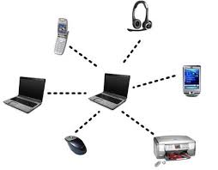
TYPES OF COMPUTER NETWORKS (cont’d)
A personal area network (PAN) is a computer network used for data transmission amongst devices such as computers, telephones, tablets and personal digital assistants.

Slide 7
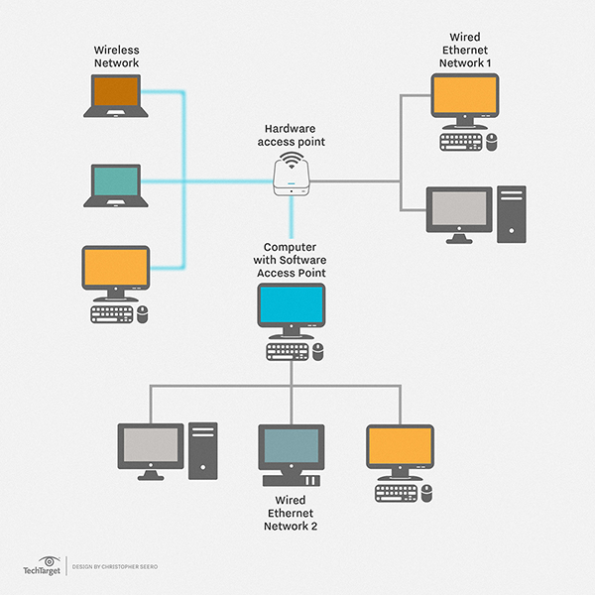
TYPES OF COMPUTER NETWORKS (Cont’d)
A local area network (LAN)may serve as few as two or three users (for example, in a small-office network) or several hundred users in a larger office. LAN networking comprises cables, switches, routers and other

Slide 8
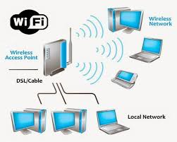
TYPES OF COMPUTER NETWORKS (Cont’d)
A wireless local area network (WLAN) is a wireless computer network that links two or more devices using wireless communication within a limited area such as a home, school, computer laboratory, or office building.

Slide 9
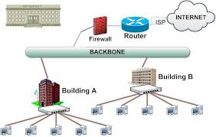
TYPES OF COMPUTER NETWORKS (Cont’d)
A campus network, campus area network, corporate area network or CAN is a computer network made up of an interconnection of local area networks (LANs) within a limited geographical area

Slide 10
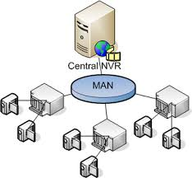
TYPES OF COMPUTER NETWORKS (Cont’d)
A metropolitan area network (MAN) is a network that interconnects users with computer resources in a geographic area or region larger than that covered by even a large local area network (LAN) but smaller than the area covered by a wide area network (WAN).

Slide 11
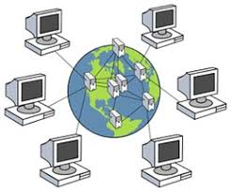
TYPES OF COMPUTER NETWORKS (Cont’d)
A WAN (wide area network) is a communications network that spans a large geographic area such as across cities, states, or countries.

Slide 12
Group work (in pairs)
A. explain the types of computer networks
B. discuss about the characteristics of computer networks
Thanks!!!!!

