Slide 1
training on 21st cld
21st CENTERED learning design

Slide 2
INTRODUCTION
Educators globally are working to design new models of learning that better prepare learners. The purpose of this guide is to help educators identify and understand the 21st century skills that are demonstrated in students’ work products.
Student work is what students produce when they complete a learning activity. It can be something they completed in one class period or the results of an extended project that took place both in and outside of school.

Slide 3
CONT…
This guide describes six dimensions of students’ 21st century learning, each of which represents an important skill for students for develop:
• collaboration
• skilled communication
• knowledge construction
• self-regulation
• real-world problem-solving and innovation
• use of ICT for learning

Slide 4
CONT…
For each dimension, this guide will help you to determine how strongly the student work demonstrates the related skill. Each dimension has the same structure:
• The overview introduces key concepts for that dimension.
• The “big ideas” define important attributes of the student work for each dimension.
• The rubric uses the big ideas to help you assign a number from 1 to 4, or I to 5, according to how strongly the student work demonstrates the given skill.
• The flowchart shows how to choose the best number in each case.

Slide 5
Unit i. Collaboration
This unit explores the broader meaning of collaboration, and your understanding of it. In today’s workplace young people are expected to collaborate and this rubric helps you to understand what we mean by collaboration. It helps you to design lessons where students can develop collaboration skills. It will also introduce you to the dimensions of collaboration which are: students working in groups or pairs, sharing responsibility, making substantive decisions together, and being co-dependent on one another.

Slide 6




BIG IDEAS of collaboration

Slide 7
BIG IDEA ONE: WORKING TOGETHER.
What does working together mean?

Slide 8
BIG IDEA ONE: WORKING TOGETHER.
Students are working together when they work in pairs or groups to:
• discuss an issue
• solve a problem
• create a product

Slide 9
CONT…
Students’ work in pairs or groups might also include people from outside the classroom, such as students in other classes or schools, or community members or experts. Students can work together face to face or by using technology to share ideas or resources.
    What kind of technologies students can use to work together? (brainstorm)

Slide 10
Example.
IS THIS WORKING TOGETHER? ANSWER YES OR NO.
Pairs of students gave each other feedback. YES.
Students did their work alone. NO
A small group discussed an issue together.
The whole class discussed an issue.
A student used Skype to interview a student in another town.
Students used OneNote to share their story drafts and give each other feedback.
Each student created his/her own story and sent it to the teacher for feedback.

Slide 11
BIG IDEA TWO: SHARING RESPONSIBILITIES
What does sharing responsibility mean?

Slide 12
CONT…
Students are sharing responsibility when they are working in pairs or groups to develop a common product, design, or response. Shared responsibility is more than simply helping each other: students must collectively own the work and be mutually responsible for its outcome.
If the group work involves students or adults from outside the classroom, this qualifies as shared responsibility ONLY if the students and the outside participants are mutually responsible for the outcome of the work.

Slide 13
EXAMPLE.
IS THIS A SHARED RESPONSIBILITY? ANS YES OR NO AND WHY?
Students conducted a lab experiment together.
Students gave each other feedback.
A student worked with a peer in another country via Skype and Microsoft Office 365 to develop a joint website.
A student interviewed a peer in another country via Skype about the local weather.

Slide 14
CONT..
Students had joint responsibility for carrying out the lab experiment.
One student “owned” the work, and the other was only helping.
The students shared responsibility for the development of the website.
This is a task that students conducted together, but they did not have mutual responsibility for any particular outcome

Slide 15
BIG IDEA 3: SUBSTANTIVE DECISIONS
What does substantive decisions mean?

Slide 16
CONT…
Students are making substantive decisions when they are actively resolving important issues that will guide their work. Substantive decisions are decisions that shape the content, process, OR product of students’ work:
Content: Students are using their knowledge of an issue to make a decision that affects the academic content of their work together, such as taking a stance on a topic they will then write about, or deciding on the hypothesis they will test.
Process: Students are planning what they will do, when to do it, what tools they will use, or the roles and responsibilities of people on the team.
Product: Students are making fundamental design decisions that affect the nature and usability of their product.

Slide 17
example
DID THESE STUDENTS MAKE SUBSTANTIVE DECISIONS?
Students discussed which capital city to choose for their project, based on what they knew of the political systems of each country. The students negotiated their ideas.
Students worked together to identify capital cities of particular countries in Europe.
Students devised a plan for creating their music video for international children’s day. Students discussed who would direct, shoot, and edit the video; what technologies they would use; and the timeline for completing different stages of the work.
Students filmed a video according to the list of steps the teacher provided.

Slide 18
CONT…
This is a content decision that will shape their work together.
This decision does not affect the rest of their work.
These decisions are fundamental to the work process for the entire project.
The teacher planned the process of their work, not the students.

Slide 19
BID IDEA 4: INTERDEPENDENT.
What does inter-dependent work mean?

Slide 20
CONT…
Students’ work products are interdependent when there is evidence that all students contributed and the work was integrated into a coherent product.

Slide 21
cont
Most interdependent work involves two levels of accountability:
Individual accountability: each individual on the team is responsible for a task that he or she must complete in order for the group to do its work. The role of each student on the team is essential.
Group accountability: the students must work together to produce the final product or outcome. Students must negotiate and agree on the process, design, and conclusions of their work.

Slide 22
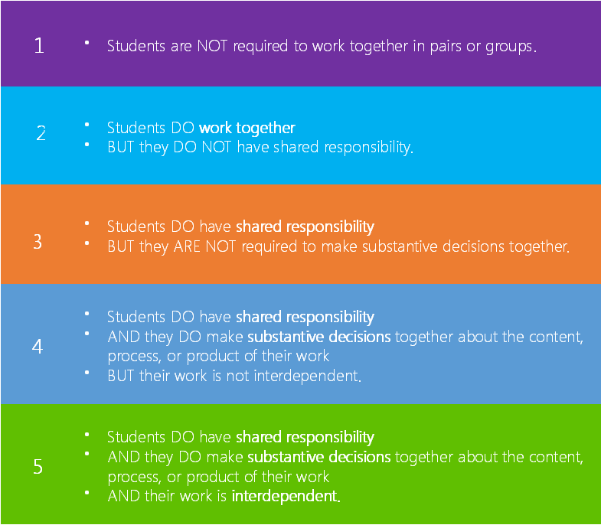
Rubric - Collaboration

Slide 23
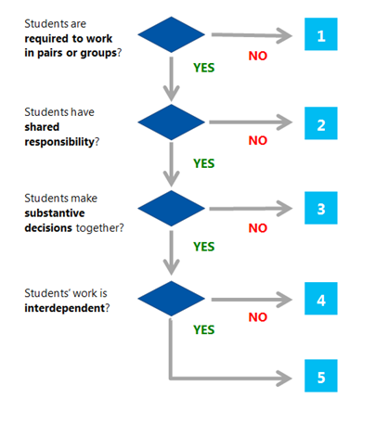
Decision Tree - Collaboration

Slide 24
unit ii: SKILLED COMMUNICATION

Slide 25
INTRODUCTION
Skilled communication in the 21st century learning refers to the ability of individuals to communicate clearly, using oral, written, and non-verbal languages. Society now requires that everyone has these abilities, because the demands of social relations and the global economy call for a much more diverse set of communication skills. This unit introduces the concept of skilled communication and supports teachers to design learning activities where young people can develop this important skill.

Slide 26
INTRODUCTION
This unit will introduce you to the dimensions of skilled communication which are: Extended communication, Multi-modal, Requires supporting evidence, Communication designed for a particular audience

Slide 27
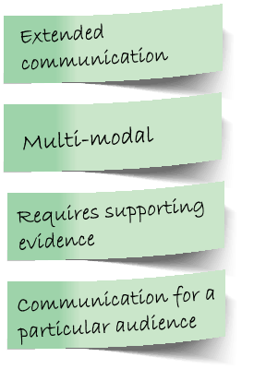
BIG IDEAS OF SKILLED COMMUNICATION

Slide 28
BIG IDEA 1: Extended communication
What does extended communication mean?

Slide 29
BIG IDEA 1: Extended communication
Extended communication is required when student must produce communication that represents a set of connected ideas, not a single simple thought.
In written work, extended communication is the equivalent of one or more complete paragraphs rather than a sentence or phrase.
In electronic or visual media, extended communication might take the form of a sequence of video, a podcast, or a page of a presentation that connects or illustrates several ideas.
A single text message or tweet is NOT extended communication. If students are engaged in electronic communication, this is ONLY considered extended communication if it produces an outcome that requires students to connect the ideas they discussed (for example, producing documentation of what they learned or next steps for resolving an issue that arose). The duration of an electronic chat is not considered in evaluating extended communication.

Slide 30
BIG IDEA I1: Multi-modal
Communication is multi-modal when it includes more than one type of communication mode or tool used to communicate a coherent message. For example, students might create a presentation that integrates video and text, or embed a photograph into a blog post. The communication is considered multi-modal only if the elements work together to produce a stronger message than any one element alone.
If the learning activity offers students the opportunity to choose the tool or tools they will use to communicate, we consider it to be a multi-modal communication opportunity.

Slide 31
BIG IDEA I1I: Requires supporting evidence
Communication requires supporting evidence when students must explain their ideas or support their thesis with facts or examples.
For this rubric, a “thesis” is a claim, hypothesis, or conclusion. Students must have a thesis when they are asked to state a point of view, make a prediction, or draw a conclusion from a set of facts or a chain of logic. The communication requires evidence if students must describe their reasoning or provide supporting facts or examples. The evidence should be sufficient to support the claim that the student is making.

Slide 32
BIG IDEA IV: Communication designed for a particular audience
Students are required to design their communication for a particular audience when they must ensure that their communication is appropriate to the specific readers, listeners, viewers, or others with whom they are communicating. It is not sufficient for students to be communicating to a general audience on the internet. They must have in mind a specific group with specific needs in order to shape their communication appropriately.

Slide 33
rubrics

Slide 34
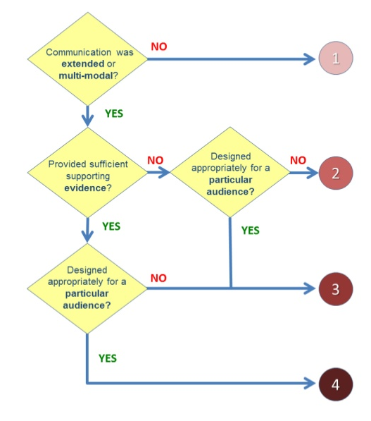
Decision tree

Slide 35
unit iIi: Knowledge Construction

Slide 36
introduction
Knowledge construction provides a rationale for giving young people an opportunity to move beyond memorizing facts and to develop their critical thinking and reasoning skills. The 21CLD: Knowledge Construction course introduces you to the dimensions of Knowledge Construction which are: Knowledge construction, Knowledge construction as the main requirement , Apply their knowledge, Interdisciplinary so that students can build deep knowledge that they can transfer and apply in practice.

Slide 37
BIG IDEAs of knowledge construction:

Slide 38
BIG IDEA I: knowledge construction
Knowledge construction happens when students do more than reproduce what they have learned; they go beyond knowledge reproduction to generate ideas and understandings that are new to them.
The skills of knowledge construction are often considered “critical thinking.” Activities that require knowledge construction ask students to interpret, analyse, synthesise, or evaluate information or ideas.

Slide 39
Interpretation means drawing inferences beyond the literal meaning. For example, students might read a description of a historical period and infer why people who lived then behaved the way they did.
Analysis means identifying the parts of a whole and their relationships to each other. For example, students might investigate local environmental factors to determine which are most likely to affect migrating birds.
Synthesis means identifying the relationships between two or more ideas. For example, students might be required to compare and contrast perspectives from multiple sources.
Evaluation means judging the quality, credibility, or importance of data, ideas, or events. For example, students might read different accounts of an historical event and determine which ones they find most credible.
Notes:
Inferences: A conclusion reached on the basis of evidence and reasoning

Slide 40
EXAMPLES: Is these knowledge construction?
ANSWER YES OR NO
Students searched the Internet for information about local activities to help the environment and analysed the information to decide what else could be done.
Students searched the internet for information about local activities to help the environment and gave a presentation to describe what they found.
A student’s paper compared and contrasted information from multiple sources.
A student’s paper describes information they found online or in books.
Students who have not learned about parallel lines examined several different pairs of lines to develop a definition of “parallel.”
Students used the definition of “parallel” to decide whether several sets of lines were parallel.

Slide 41
BIG IDEA 2: Knowledge construction as the main requirement
The main requirement is the part of the activity that students spend the most time and effort on and the part that educators focus on when grading. If the learning activity does not specify how much time students should spend on each part, you may have to use your professional judgment to estimate how long students are likely to spend on different tasks.

Slide 42
EXAMPLE.
IS THE MAIN EFFORT KNOWLEDGE CONSTRUCTION?
A student made a short list of important details from a story, then wrote an essay using these details as evidence for why a character committed a crime.
A student made a long list of details from a story, then wrote two sentences to describe why a character committed a crime.

Slide 43
FEEDBACK.
The work implies that most of the student's time was spent on analysis.
The work implies that most of the student's time was spent listing details (a recall task).

Slide 44
BIG IDEA 3: Apply their knowledge
Students must apply their knowledge when they use the knowledge they have constructed to support another knowledge construction task in a new context.
For example, students in a physics class might construct knowledge about heat principles from a study of the Earth’s inner core, and then apply what they learned to investigate the environment of Jupiter

Slide 45
EXAMPLES: ANSWER YES OR NO AND WHY?
DID STUDENTS APPLY THEIR KNOWLEDGE?
Students analysed demographic statistics from their home town and then used their understanding of population trends to develop a plan for an upcoming housing development project.
Students analysed demographic statistics from their home town and then analysed demographic statistics from a second location of their choice.

Slide 46
CONT…
Students examined photos enlarged at different sizes to develop an understanding of similarity and then applied that knowledge to abstract geometric shapes, thinking about size ratios and angles to determine which shapes are mathematically similar.
Students examined photos enlarged at different sizes to develop an understanding of similarity and then described their understanding.
Students designed and executed a procedure for testing the qualities of the tap water at their school. Once they had accurate data, they used that information to determine which water filtration system would be most appropriate for the school.
Students designed and executed a procedure for testing the qualities of the tap water at their school. They tested the water and redesigned the procedure iteratively until they had accurate data.

Slide 47
FEEDBACK:
Students applied their knowledge from analysing demographic statistics in order to develop a housing plan; this step required further analysis.
Students did not apply their knowledge from analysing demographic statistics to any new activity; they simply repeated the same activity with a different dataset
Students applied their knowledge from evaluating shapes to deepen their own understanding of mathematical similarity.
Students did not apply their knowledge from evaluating shapes to any new domain; they simply articulated that knowledge

Slide 48
CONT..
Students applied their knowledge from designing and conducting water quality tests to select an appropriate water filtration system, which required them to look at what they have learned in a new way and deepen their knowledge.
Although students applied their knowledge from previous trials to refine the procedure, they only applied knowledge within a single (repeated) context. They deepened their knowledge, but did not extend it to a new type of application.

Slide 49
BIG IDEA 4: Interdisciplinary learning activities
Interdisciplinary learning activities have learning goals that involve content, important ideas, or methods from different academic subjects (such as mathematics and music, or language arts and history). Subjects that are typically taught together in your country do not count as interdisciplinary.
For purposes of this unit, ICT is NOT considered a separate academic subject. ICT is often used as a tool for learning in other subjects. For example, students might build ICT skills when they do online research for a history project. This activity is NOT considered interdisciplinary.

Slide 50
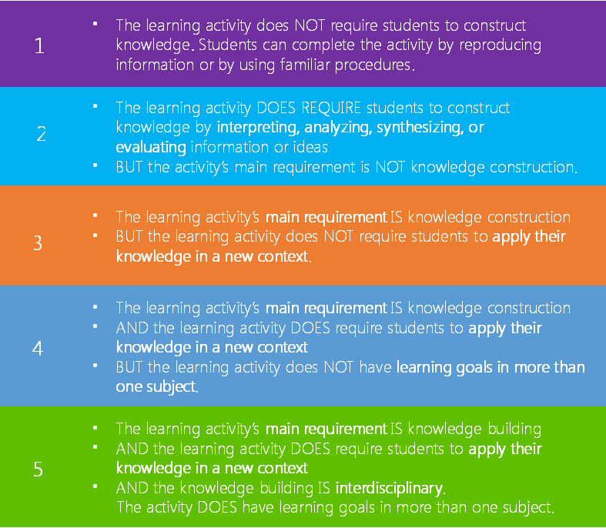
Rubric: Knowledge Construction

Slide 51
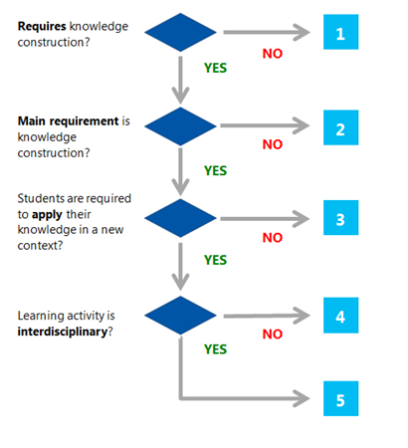
Decision tree: Knowledge Construction

Slide 52
unit iV: SELF-REGULATION

Slide 53
introduction
Self-regulation occurs when students consciously organize, monitor, evaluate and ultimately take control of their own learning. Educators can design learning activities that assist learners in building and developing their self-regulations skills. 21CLD: Self-Regulation introduces you to the idea of self-regulation and the dimensions of working on long-term projects, students planning their own work and providing opportunities to revise work based on feedback.

Slide 54
BIG IDEAs of SELF-REGULATION

Slide 55
BIG IDEA I: Long-term activity
A learning activity is considered long-term if students work on it for a substantive period of time. If the learning activity is completed within a single class period, there is no time for students to plan the process of their work nor to improve their work over multiple drafts. Length of time is a basic prerequisite for students’ opportunity for self-regulation.

Slide 56
BIG IDEA Ii: Planning own work
When students plan their own work, they make decisions about the schedule and steps they will follow to accomplish the task. Planning their own work may involve:
  Deciding how: Students break down a complex task into simpler sub-tasks, or choose the tools they will use.
  Deciding when: Students create a schedule for their work and setting interim deadlines.
  Deciding who: A group of students determines how to divide work among themselves.
  Deciding where: Students decide what pieces of the work will be done inside or outside of the school building or the school day.
If a task is long-term but students are given detailed instructions and timelines, they do NOT have the opportunity to plan their own work. Students making decisions about small aspects of tasks does NOT qualify as planning their own work.

Slide 57
BIG IDEA Iii: Opportunity to revise work based on feedback
Students have the opportunity to revise their work based on feedback when feedback is given and explicitly used to improve the work before it is submitted or finalised.
Feedback may come from the educator or from peers. Students might also have the opportunity to revise their work based on their own deliberate process of self-reflection.
Feedback can be one of the most significant influences on improving learning. Effective feedback helps students to address the gap between current performance and performance goals. It is more than simple praise; comments such as ‘good job’ or ‘great work’ do little to help the student understand what constitutes great work. Effective feedback:
  Tells the student specifically what he or she is doing well and offers specific guidance to help move their learning forward.
  Is directly connected to the learning goals and success criteria.
  Helps the student to be more aware of progress along a learning path.
  Leads to reflection and planning of next steps.

Slide 58
RUBRIC

Slide 59
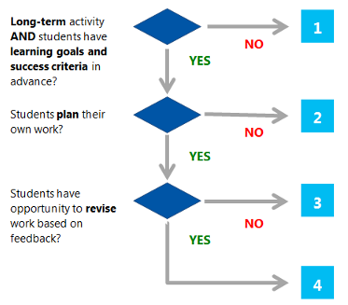
DECISION TREE

Slide 60
unit V: real-world problem-solving and innovation

Slide 61
introduction
Real world problem-solving and innovation are skills that are integral to living and working in the 21st century. Educators can provide young people with opportunities to engage in real world problems and to apply their solutions or ideas in practice. This course defines what we mean by problem-solving and the dimensions that should be present in such activities.

Slide 62
BIG IDEAs of real-world problem-solving and innovation

Slide 63
BIG IDEA I: Problem-solving
Problem-solving involves a task with a defined challenge for the student. Problem-solving happens when students must:
  develop a solution to a problem that is new to them OR
  complete a task that they have not been instructed how to do OR
  design a complex product that meets a set of requirements.

Slide 64
CONT
Learning activities that require problem-solving do NOT give students all the information they need to complete the task or specify the whole procedure they must follow to arrive at a solution.
Often, problem-solving tasks require students do some or all of the following:
  Investigate the parameters of the problem to guide their approach.
  Generate ideas and alternatives.
  Devise their own approach, or explore several possible procedures that might be appropriate to the situation
  Design a coherent solution.
  Test the solution and iterate on improvements to satisfy the requirements of the problem.

Slide 65
BIG IDEA II: Real-world problems
Real-world problems are authentic situations and needs that exist outside an academic context.
Real-world problems:
  Are experienced by real people.
  For example, if students are asked to diagnose an ecological imbalance in a rainforest in Costa Rica, they are working with a situation that affects the real people who live there.
  Have solutions for a specific, plausible audience other than the educator as grader.
  For example, designing equipment to fit a small city playground could benefit the children of the community.
  Have specific, explicit contexts.
  For example, developing a plan for a community garden in a public park in their town has a specific context; learning which vegetables grow best in which parts of one’s country does not.
  If students are using data to solve a problem, they use actual data.
  For example, real scientific records of earthquakes, results of their own experiments, or first-person accounts of an historical event, not data developed by an educator or publisher for a lesson.

Slide 66
BIG IDEA III: Innovation
Innovation requires putting students’ ideas or solutions into practice in the real world. For example, it IS innovation if students design and build a community garden on the grounds of their school; just designing the garden is NOT innovation.
In cases where students do not have the authority to implement their own ideas, it is innovation ONLY if students convey their ideas to people outside the classroom context who can implement them. For example, it IS innovation if students present their ideas for building a community garden in a public park in their town to a local environmental group or to local officials, but NOT if students design a community garden for that public park and only share their plans with their teacher and classmates.
Innovation also benefits people other than the student; it has value beyond meeting the requirements of a classroom exercise. The townspeople who tend the new garden in the public park and the teenagers who attend the rewritten Shakespeare play benefit from students’ efforts, for example.
It also counts as innovation if students create a project for a science fair or submit an original poem to a regional poetry contest, for example, because the fair and contest are not educator-controlled and have real audiences who are interested in and may benefit from the students’ work.

Slide 67
Rubric - Real-World Problem-Solving and Innovation

Slide 68
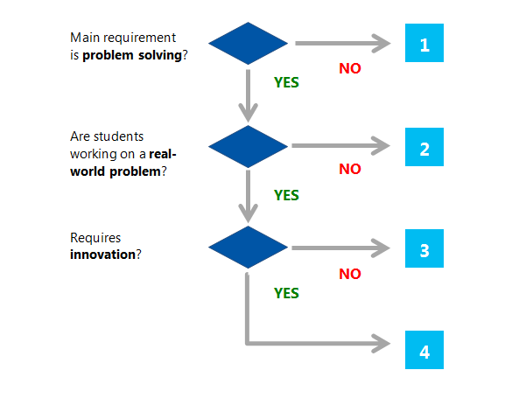
Decision Tree - Real-World Problem-Solving and Innovation

Slide 69
unit VI: Use of ICT for Learning

Slide 70
introduction
Information and communication technologies (ICT) have become common place in all aspects of life, including education. The use of ICT in education all too often supports the consumption of information and ideas. 21CLD: ICT for Learning highlights the need to use ICT to transform learning experiences and to create and design new information.

Slide 71
The Big Ideas - Use of ICT for Learning

Slide 72
BIG IDEA I: Student use of ICT
Student use of ICT happens when students use ICT directly to complete all or part of the learning activity. The educator’s use of ICT to present materials to students does not count as student use: it is important that students have control over the ICT use themselves.
Some educators’ use of ICT can enhance their teaching significantly: for example, educators can show simulations that make difficult content easier for students to visualise. However, this rubric focuses only on how the learning activity requires students to use ICT in their learning.
This unit looks at the opportunities students have to use ICT. It is considered ICT use if the students are required to use ICT or can use ICT to complete an activity.

Slide 73
BIG IDEA II: Use of ICT to support knowledge construction
Knowledge construction occurs when students generate ideas and understandings that are new to them, through interpretation, analysis, synthesis, or evaluation. This unit examines whether the learning activity requires that students use ICT in ways that support knowledge construction, either directly or indirectly.
ICT supports knowledge construction when:
  Students use ICT directly for the knowledge-construction part of a learning activity. For example, students use a computer to analyse scientific information.
  Students use ICT to indirectly support knowledge construction, by using ICT to complete one step of an activity, and then using information from that step in the knowledge-construction part of the activity. For example, students might search for terms related to current events on Twitter and then analyse people’s responses offline. The information they found on Twitter supported their analysis, so we say that ICT use supported knowledge construction.
  The knowledge construction supported by ICT must be about the learning goals of the activity: learning to use the ICT does not qualify. For example, students might learn about PowerPoint as they create a presentation for history class. But to be considered knowledge construction using ICT, it is essential that the use of PowerPoint helped them to deepen their interpretation, analysis, synthesis, or evaluation of historical ideas, not just to deepen their knowledge on how to use the tool.
  Evaluation of Internet resources related to the learning goals is also considered knowledge construction. Some learning activities are designed to help students become intelligent, ethical users of Internet resources rather than passive consumers of the information. For example, students might be required to find several sources on a topic and evaluate their credibility before they select which information to rely on.

Slide 74
BIG IDEA III: ICT required for knowledge construction
ICT is required for the knowledge construction when it allows students to do knowledge construction activities that would be impossible or impractical without the use of the ICT. For example, students might be asked to communicate with students in another country over a period of two weeks to research the impact of a recent drought on their community. In this case, email enables students to construct knowledge that they could not construct without ICT because mailing physical letters would be impractical in this short a time. The use of email is required for constructing this knowledge.
Many activities that require knowledge construction can also be done without ICT. For example, students may be asked to find information about the beaks of a variety of bird species with different diets and develop categories of different types of beaks. If students use the Internet for this activity, they are constructing knowledge, but ICT is not required: they would be able to achieve the same learning goals without ICT by using printed books in a library.

Slide 75
BIG IDEA IV: Designers of ICT products
Students are designers of ICT products when they create ICT products that others can use. For example, if students record a podcast and make it available on the internet, they are creating an ICT product others could use. The product lasts beyond the learning activity and can be used or enjoyed by an outside audience.
When students act as designers, ICT is supporting their real-world problem-solving and innovation. Students must have an authentic audience in mind, such as a community that needs the information their podcast will provide, or younger students who will learn about disease prevention from the simulation students are building. In their design, students must attend to the needs and preferences of that audience. Ideally, but not necessarily, the product might actually be used by the intended audience. Students who create a product with no particular audience in mind do not qualify as designers under this definition.

Slide 76
Rubric - Use of ICT for Learning

Slide 77
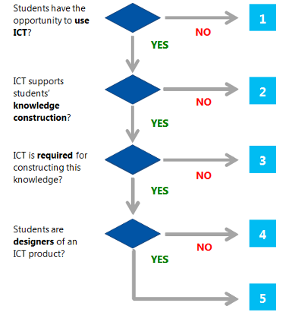
Decision Tree - Use of ICT for Learning

Slide 78
unit VII: Introduction to Inclusive Digital Literacy

Slide 79
Reflective question
Have the teachers and non-teachers in your education setting developed a shared understanding of the term digital literacy?
"Digital Literacy is as important as reading writing and maths"
Discuss with colleagues.

Slide 80
introduction
Digital technologies are now ubiquitous in the home, in school, in the workplace. It is easy to take this for granted but it is important to consider these questions:
  Can we make available and emerging technology work harder for us?
  How can we equip every young person (especially those with special education needs and disabilities) to be digitally literate in a world where government is now on-line, banking, insurance, and shopping are on-line as well as much of our social and leisure lives too?
  Are educators exploiting the digital resources we already have to the full?
  Is technology simply replacing tasks, or is technology opening new frontiers in terms of accelerating learning and personalising the education experience?

Slide 81
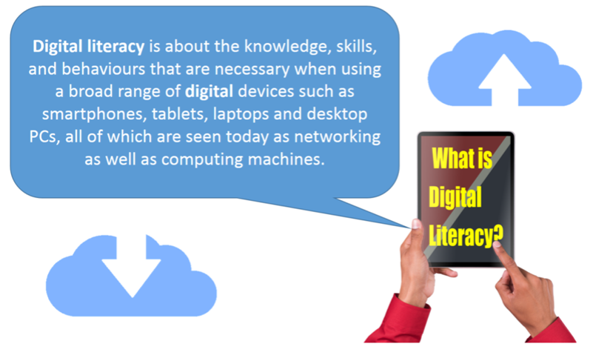
introduction

Slide 82
The Fourth Industrial Revolution:
What you can do
Watch the video from the World Economic Forum.
https://youtu.be/kpW9JcWxKq0 (To be downloaded and watch offline)
Ubiquitous, mobile supercomputing, Artificially-intelligent robots, Self-driving cars, Neuro-technological brain enhancements, Genetic editing. The evidence of dramatic change is all around us and it's happening at exponential speed. Previous industrial revolutions liberated humankind from animal power, made mass production possible and brought digital capabilities to billions of people. This Fourth Industrial Revolution is, however, fundamentally different. It is characterized by a range of new technologies that are fusing the physical, digital and biological worlds, impacting all disciplines, economies and industries, and even challenging ideas about what it means to be human.

Slide 83
The Fourth Industrial Revolution:
Reflective questions
Think about your education setting: the children and young people in your classes, the way learning is organised, managed and delivered within your education setting. Whatever age you teach, be it pre-school, primary or secondary, the learners in your care are on a life-long learning journey into, and in some cases, beyond the 21st century:
  Does your education setting's mission and vision statement say anything about what you do to prepare the children and young people in your care for the social and economic challenges that they will face over a working life of perhaps 60 years and a longevity that may well see them active well past the age of 100?!
  Laying the foundations for life-long learning should be the imperatives that drive any education setting. How does your education setting articulate these imperatives? Literacy and numeracy goals? As standards of exam performance? As social and societal outcomes? As a set of capabilities, attitudes and social/cultural expectations?
  How do you create a learning culture that acknowledges the role technology plays in supporting working, learning and living in the 21st century? After watching the video, how could your setting do better?
Answer one of these questions to share how your school prepares its students for the future.

Slide 84
Workplace Trends and the Importance of Digital Literacy: Future Work Trends
"...As technology becomes more pervasive, traditional trades disappear and the world of work becomes more globalised, the skills considered to be valuable for the future are shifting.
Problem solving, team working, and communication (commonly known as "21st century skills") are the most-needed skills in the workplace, according to our recent surveys of business executives, students and teachers. Digital literacy and creativity— and the latter's close relative, entrepreneurship—are expected to grow more important in the next three years.

Slide 85
Steps to Introducing Child-Centred Innovation in Digital Literacy to Your Learner Community
STEP 1 THINK ABOUT THE LEARNER
  Think about a learner, or small group of learners, that will be your target group.
  Think about an area of learning where you would like to see accelerated progress. How will you measure progress? What evidence will you need to collect? As you proceed through the Courses, keep reflecting on this initial selection, to see if your new learning is relevant to their needs and their learning objectives.
STEP 2 THINK ABOUT YOUR KNOWLEDGE AND SKILLS
  Use one of the Audit Tools in "Developing a Digitally Literate Pedagogy" to self-evaluate your current digital literacy levels, or to give you ideas about what areas of digital literacy you would like to personally develop.

Slide 86
Steps to Introducing Child-Centred Innovation in Digital Literacy to Your Learner Community
STEP 3 THINK ABOUT MEANINGFUL ACTIVITIES
  After completing "Developing a Digitally Literate Learner", reflect on the Digital Literacy abilities and capabilities of your target cohort:
  What can you do to make them aware of their own personal next steps in terms of digital literacy development?
  How can you build meaningful activities into their overarching learning objectives that enable them to rehearse and develop these "next steps"?
STEP 4 THINK ABOUT APPLICATION OF DIGITAL TECHNOLOGIES
  After completing "Developing a digitally Literate Curriculum" decide on what digital technologies you will choose to support the ambition outlined in Steps 2 and 3:
  You may wish to liaise with colleagues with IT responsibilities so that you use language and approaches already in train within the educational setting.

Slide 87
Steps to Introducing Child-Centred Innovation in Digital Literacy to Your Learner Community
STEP 5 START THE LEARNING JOURNEY!
  Collect some baseline evidence from your target cohort, then apply some new learning, or new approaches, to your target cohort
STEP 6 HOW DID IT GO?
  Review and evaluate the progress that has been made.
  How can the practice you have developed:
  a) be applied to other learners
  b) be shared with other colleagues
  c) what next steps need to/ Can be taken?

Slide 88
unit VIII: Teaching with Technology.

Slide 89
introduction
Office 365 provides the right environment for better learning outcomes. In this learning path, educators will learn how to become more innovative with cloud-based tools, regardless of the device they use. In this course, learn how to use basic features of Office 365 including Microsoft Teams, OneNote, Sway, Microsoft Forms, Office Online and OneDrive.

Slide 90

Microsoft Sway
From student reports to monthly newsletters, today's classrooms have many stories to tell. Digital storytelling with Microsoft Sway lets teachers and students focus on the content and not worry about the format. This course will show how Sway can be used to capture and share the digital stories that need to be told.

Slide 91

Microsoft forms
With Microsoft Forms, you can create surveys, quizzes, and polls, and easily see results as they come in. When you create a quiz or survey, you can invite others to respond to it using any web browser, even on mobile devices. As results are submitted, you can use built-in analytics to evaluate responses. Form data, such as quiz results, can be easily exported to Excel for additional analysis or grading.

Slide 92

Microsoft onenote
With Microsoft OneNote, educators can create digital notebooks that support academic standards and education outcomes across disciplines and tasks, such as writing, reading, mathematics, science, history, CTE, and elective courses. Students may use OneNote across content areas and grade levels, and use OneNote to compile and organize unstructured information, research, and content. OneNote also supports research, collaboration, information management, communication, note taking, journaling, reflective writing, and academic requirements.

Slide 93

Microsoft teams
Microsoft Teams is a digital hub that brings conversations, content, and apps together in one place. Educators can create collaborative classrooms, connect in professional learning communities, and communicate with school staff all from a single experience in Office 365 for Education.

Slide 94
unit IX: Microsoft Innovative Educator.

Slide 95

Microsoft Innovative Educator (MIE)
Microsoft supports a thriving community of passionate educators who are constantly learning, growing and working together to change students' lives and build a better world. The Microsoft Innovative Educator (MIE) Expert program is a premier program created to recognize global educator visionaries like yourself
https://education.microsoft.com/en-us

Slide 96
THANK YOU

