Slide 1
Relating Test Items to the CBC
Introduction of the new Competence Based Curriculum in 2015
    Competence: ‘The ability to use an appropriate combination of knowledge skills and attitudes, values and behaviour to accomplish a particular task successfully’
    Focuses on students being able to apply skills, not just repeat learned knowledge
    Teaching and learning methods (pedagogy) have started to adapt to allow students to develop competencies
    Competencies now included in National assessments
Notes:
Rwanda is a changing country in a changing world – REB recognised that education system needed to adapt to reflect this
Significant change in emphasis- aim to produce independent learners and responsible citizens. Knowledge is still important but only if it can be used to do something such as, for example, solving a problem or judging evidence to reach a conclusion.
Key difference- you can know something by learning it without being able to understand or apply it. For example I can learn the phrase: L’évaluation formative est un moyen essentiel d’améliorer les performances des élèves au Rwanda. But that doesn’t mean I can speak French. While I need to learn the vocabulary and grammar, I only become competent when I can apply it independently.
CBC needs a different model of teaching – move away from relying mainly on teacher talk from the front – students take a more active role, being given more opportunities to work things out for themselves.
National assessments has changed too with questions focused on assessing skills as well as knowledge being included- change in emphasis can be challenging for both teachers and students, so developing these e-assessment tests reflecting the CBC provides an excellent opportunity for you to get used to asking competence based questions and your students to answering them.

Slide 2
Relating Test Items to the CBC
The structure of the CBC syllabuses
    The syllabus for each grade includes:
      A topic area which is broken down into…
      Units of work each covering a specific area within that topic
      Each unit has
      A Key Unit Competence and Assessment Criteria
      Learning objectives for Knowledge and Understanding, Skills and Attitudes and Values
Notes:
Check everybody has copy of the S4 syllabus for their subject
Topic area- (e.g. Heat and thermodynamics or Programming) – often too big, so these are broken down into more manageable units of work to help teachers plan more efficiently and make best use of the time.
The key unit competence sets out what the students should lean and be able to do by the end of that unit and, as you would expect, is very closely linked to the assessment criteria for the unit
Each unit then has three sets of learning objects: Knowledge and Understanding, Skills and Attitudes and Values- each with a list of things that need to be covered in the unit. Notice that each one of these statements begins with a verb showing that the students need to be able to do something with the content.

Slide 3
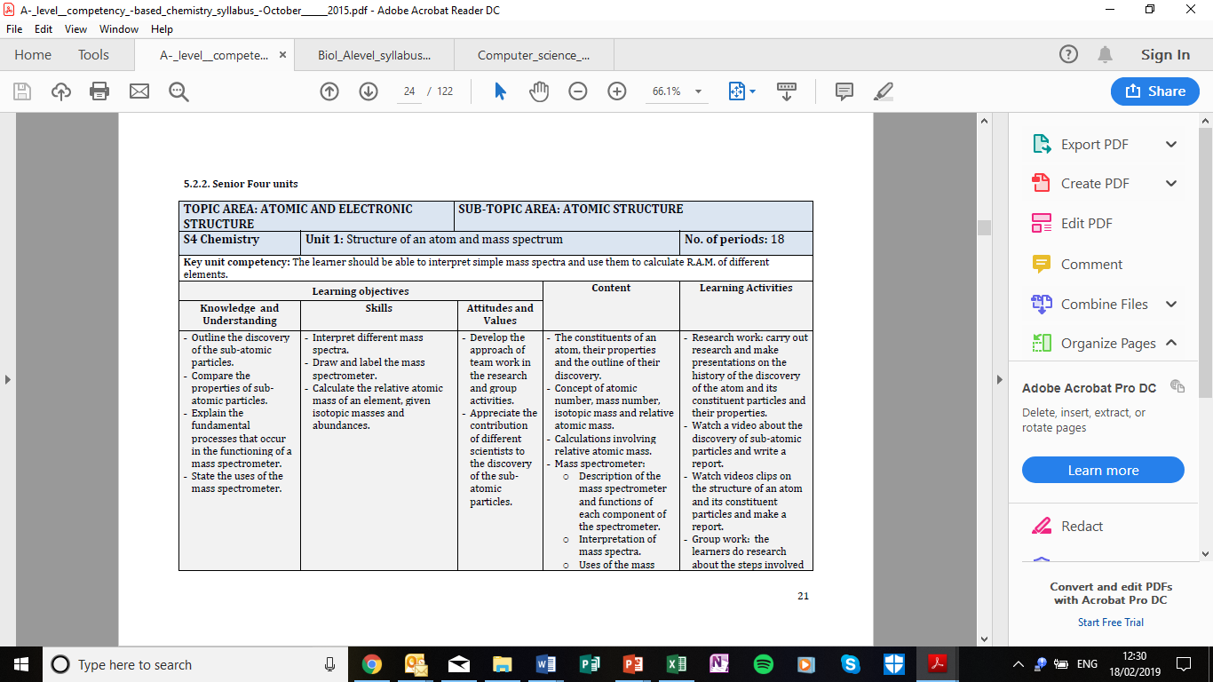
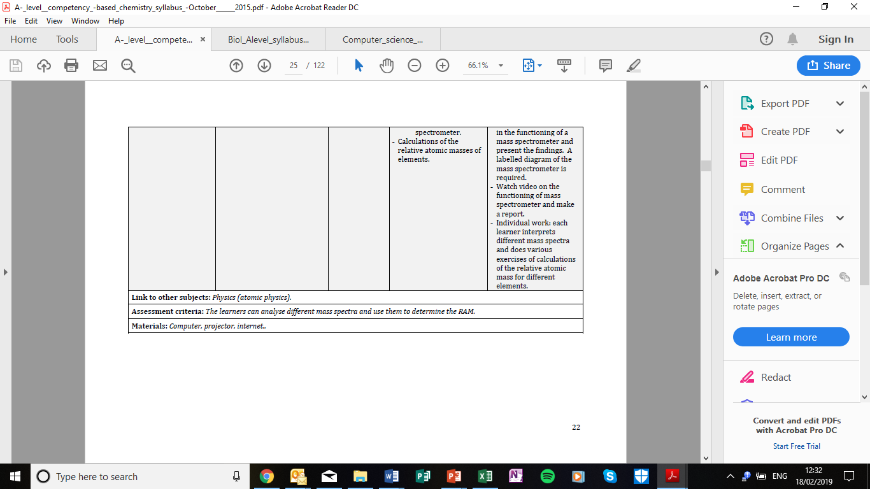
Relating Test Items to the CBC
Notes:
You will be writing tests that will provide information you can use to give formative assessment to pupils. This will help them improve by finding out where they are confident and giving feedback to improve areas where they are less secure. It will also help you to identify priorities to improve your teaching and planning.
Each test will be based on a unit- so we are now going to look at how you should use the syllabus to create a test that is a good reflection of that unit and will give you the information you need.
We will have a look at an example from Senior 4 chemistry unit one on the structure of an atom and the mass spectrum – but the organisation is similar across all subjects.

Slide 4
Relating Test Items to the CBC
Start by looking closely at the assessment criteria at the bottom of the unit- this is what the test as whole needs to assess
Most assessment criteria have two elements- the content (what the unit is about) and the skill (what the student needs to be able to do)
Here the content is related to mass spectra and relative atomic mass (RAM)
The skills the students need to use are analyse and determine

Slide 5
Relating Test Items to the CBC
    Next decide what the questions you are going write need to cover for the test to meet the assessment criteria.
    Look closely at the learning objectives for the unit
    These will give you a more detailed idea of what individual questions or groups of questions need to cover
    Are all the learning objectives assessable in an online test?
Notes:
Now you know what the test as a whole needs to assess, you need to think about what individual questions you are going to write and how they will add up to a meaningful test of the assessment criteria and therefore the unit.
Start by identifying which you think are the most important learning objectives – which are absolutely central to showing how far students are able to meet the assessment criteria of the unit. You may want to consider writing more than one question on these or covering them in questions that require more marks.
Sometimes the learning objectives will transfer very easily into questions:
For example ‘Calculate the relative atomic mass of an element, given isotopic masses and abundances’ – the question is virtually written, you would just need to decide the element and provide the figures the student would need to answer it.
Other LOs might need to be adapted- for example ‘Draw and label the mass spectrometer’- in an online test it is not practical to ask them to draw the mass spectrometer, but they could show their understanding by labelling it.
We also need to be aware that some LOs are not assessible in an online test [Ask which of the ones here is not assessible] – Will most often be under Attitudes and Values. Here, can’t assess team work in an individual, online test. These are still important, but need to be assessed in other ways.
We suggest that you tick off each learning objective as you write a question to address it- this will help you keep track of coverage which will be important when you come to construct the test.
It is important that as many of the learning objectives are represented as possible, if the unit is large and has a lot of learning objectives you could:
Prioritise which you think are the most important learning objectives or the ones which are best assessed using on online test and then find other ways to assess the ones you haven’t covered.

