Slide 1
Part 1
Question Writing Principles
Notes:
Across open and closed questions

Slide 2
General principles and style
Five aspects to consider:
    language
    visuals
    contexts
    sensitivities
    student expectations
Notes:
Language – is my question written as simply and clearly as possible to ensure that all students interpret it as intended?
Visuals – diagrams / illustrations
Context – a scenario (often used in science or mathematics) to give a situation in which to apply knowledge / rules
Student expectations

Slide 3
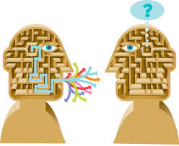
Language – keep it simple
    natural language
    concise, simple sentences
    bullet points may be useful for clarity
    active rather passive
    consistent use of language
    avoid difficult vocabulary (unless subject terminology)
Notes:
Natural language so that pupils can easily, without effort, pick up the links between the ideas that you are presenting them, but avoiding idiomatic / colloquial language use: ‘get across’ (convey)
Normally, if possible, try to avoid having a clause / phrase hanging on at the beginning of the question. Otherwise it takes a long time for the reader to get to the meat of the question to find out what they have to do.
Difficult vocabulary can only be subject specific vocabulary that is part of the curriculum.
You want to achieve the end result that: Whatever you include in the question wording cannot be given as a valid / creditworthy answer.

Slide 4
Language – keep it simple
    short sentences
    simple vocabulary
    natural sounding language
    How can you tell that a lot of time had passed between when the children first spotted the lost cat and when they rescued it? 
A lot of time passed between first spotting the lost cat and rescuing it.
How can you tell this? ✓
    After heating salt crystals and water, what happens to the salt? 
    What happens to salt crystals when they are heated with water? 
    Jane mixes some salt with water and heats it up. What happens to the salt? 
Notes:
First example.
Long sentences are very difficult to process even though they may closely resemble spoken language.
Second example.
Having a long dependent clause at the beginning makes interpretation much harder than putting it at the end. Consider creating two simpler sentences.

Slide 5
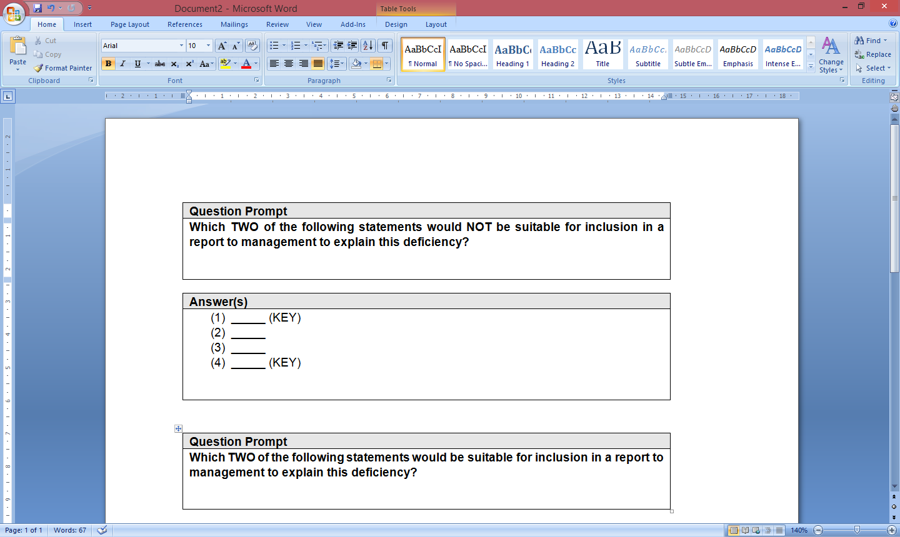
Language
Question prompts
Avoid negative formulations

Notes:
In many cases, using negatives is simply adding an unnecessary complication.

Slide 6
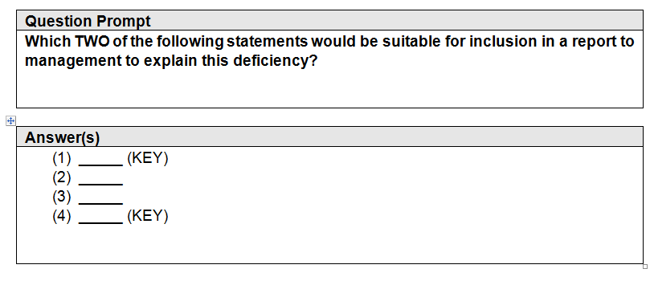
Language
Question prompts
Avoid negative formulations


Slide 7
Language
Avoid subjectivity
Avoid subjective wording, such as: are likely to be, could be
Which of the following is likely to be an objective of a
not-for-profit organisation?
Which of the following is a main objective of a
not-for-profit organisation?



Slide 8
Language
Avoid subjectivity
Avoid addressing the test-taker in the second person
What do you think the author meant in the description:
The excitement went up one gear?
What does this description reveal about the crowd?
The excitement went up one gear.



Slide 9

Language
Keep the tense consistent across the whole question and the whole set of questions (if they are linked)
Jane takes a survey of the height of her classmates.
She measures each student and records the results
in this chart:
What was the height of Jane’s tallest class mate?
What was the median height of the class?
What is the average height of the class?

Notes:
These tenses are very inconsistent.
The context is in the present tense. The first two questions are in the past tense. Pupils may genuinely think they are being asked to estimate a height from a previous point in time from the information give.
Then the last question is back in the present. Again, students may think there is an embedded message in the time shift – when it was just a case of careless writing.

Slide 10
Language
Keep the tense consistent across the whole question and the whole set of questions (if they are linked)
Jane takes a survey of the height of her classmates.
She measures each student and records the results
in this chart:
What is the height of Jane’s tallest class mate?
What is the median height of the class?
What is the average height of the class?

Notes:
These tenses are very inconsistent.
The context is in the present tense. The first two questions are in the past tense. Pupils may genuinely think they are being asked to estimate a height from a previous point in time from the information give.
Then the last question is back in the present. Again, students may think there is an embedded message in the time shift – when it was just a case of careless writing.

Slide 11

Visuals
Pros:
reduce verbal complexity and abstraction
can convey a complex idea immediately
engaging and motivating
Cons:
distracting
may give unintended information
may be purely decorative
needs to be interpreted
Notes:
Visuals (diagrams, illustrations, graphs, tables)
The saliency of a diagram or drawing is both an advantage and a disadvantage. It sticks out, so it will not go unnoticed. This can never be said of a line of text. However because it is so salient, any messages that pupils get from the visual (whether intended or unintended) will supersede what you tell them in text.
Remember that visuals need to be interpreted (just as much as does text).

Slide 12

Contexts for Questions
    A context or scenario sets the question in the real world,
    rather than asking about abstract ideas.
    Usually used for application questions
    but sometimes for knowledge questions.
    The context must be realistic, using common situations.
    The context should be recognisable to students from different backgrounds.
    Characters must have simple, easily
    distinguishable names.
Notes:
Often, a question is set in a real-world context, which can make it more direct and clear than just an abstract idea. The context should help the candidate to access the question, not add unnecessary or confusing information.
There is a judgement to be made about whether a context is necessary, and application questions are more likely to require contextualisation than knowledge questions.
Then, the context needs to be simple, clear and realistic, easy to grasp on first reading.

Slide 13
Contexts
When creating scenarios ensure that proper names are sufficiently distinct to prevent confusion

Joyce and Grace
Sam and Pam
Hakim and Haruka
Christine and Christopher

Joyce and Florence
Sammy and Pat
Hakim and Muhammad
Christine and Diane
Notes:
Sometimes, it is not obvious that names are going to be confusing.
The names have to be simple but visually distinct and not sound like each other. Ideally with a different number of syllables and different combinations of ascenders and descenders.

Slide 14

Contexts
Pros:
Makes the task familiar.
Makes the task relevant.
Makes abstract ideas concrete.
Allows the assessment of the application of principles.
Cons:
Increases reading load.
Unintended bias.
Encourages everyday knowledge and may result in confusion between content and context.
Exciting contexts may be distracting.
Notes:
Unintended bias can be created by the degree of familiarity of the context – especially in younger children. You might decide that ‘ice-cream cones’ makes a very suitable context for an arithmetic problem, but there may be children who have no idea what an ice-cream cone is because their ice-cream always comes from their freezer and never bought from an ice-cream van or high-street vendor. For them, ice-cream will not be a countable object as units but an uncountable material.
Also as soon as you introduce the real world, it encourages students to make use of what they know of the real world, especially with younger children who do not yet know the rules of test-taking and think they are being asked a question where we are interested in their opinion / experience.

Slide 15

Sensitive issues
Test materials must not bias outcomes on any grounds (see Guide to Classroom-based and National Assessments in Rwanda, section 7.5):
    Gender
    Urban / rural home setting
    Ethnicity
    Religion
    Class / family background
Notes:
As stated in section 7.5 of the Rwandan GUIDE TO CLASSROOM-BASED AND NATIONAL ASSESSMENTS IN RWANDA, materials (quote below)
Does the assessment give all candidates an equal opportunity to demonstrate their attainment?
You should make sure that the test does not discriminate in terms of student backgrounds (urban/rural), religion or disability. Be sensitive to these social issues. For example,
do not give a test whose items are based predominantly on urban or rural settings. Find a good balance. Avoid test items that may be offensive to certain religious beliefs (discussion involving eating pigs when class has Muslims in it; or those that disadvantage students living with disabilities (drawings, diagrams, maps) in case of blind students, etc.
Items must provide equality of access and opportunity by:
aiming to minimise ethnic, gender and cultural bias
avoiding disadvantaging pupils from particular backgrounds
being free from overt or covert discrimination either through wording or content.

Slide 16
Sensitive issues continued
Other aspects to consider:
    Must not glorify undesirable behaviours
    Must not be too sad
    Must be accurate
    Must not date in the immediate future
Notes:
Best to avoid:
Contexts and scenarios where undesirable behaviours are glorified / condoned, eg stealing, bullying, violence
Contexts and scenarios which deal with issues that would be better handled in class discussion / mediated via the teacher, eg death, loss of parents, hunger
Accurate and realistic.
Accurate here does not mean, for example, that mathematical calculations must be feasible or that the mark scheme is correct. It means that the contexts set up in tests must be accurate. In a spelling test about high speed trains, then the information about high speed trains must be correct – even if the point of the assessment is spelling.
When writing maths / physics questions, make the measurements, units, calculations realistic e.g. do not compose an item based on the premise of a human walking 10 miles per hour or an item to which the answer is 2.5 television sets.

Slide 17

Writing fair questions
    Students want to give the ‘right answer’
    We must make it as easy as possible for pupils to give the right answer
    If we break the ‘rules’ of test questions, then it can seem unfair
    We should not try to deliberately catch the student out
Notes:
Even if it is a difficult question, we have to make it as easy as possible, as automatic as possible to get the right answer. The difficulty of the question should not be the product of how we ask it .

Slide 18

Writing good questions
Consider the time it will take the student to read and understand the question
Include only the basic information necessary for the student to understand
In maths and sciences, use tables or charts in preference to prose if it gets the information across more swiftly
Does the question actually tests the learning objective intended
Notes:
In composing statements and prompts, the key requirement is to convey quickly to the candidates the information they need to show understanding.

Slide 19
Writing good questions
Return to your draft questions after a while and read them through with fresh eyes
Pass your questions to colleagues for review
Try working backwards from the answer required: ensure all the content is needed for the application or calculation
Notes:
Finally, a reminder that drafting a question is only the first stage. It is very important to review what you have done when some time has passed and you can look at it with fresh eyes.

Slide 20
Consider the question from the student’s point of view
    How will the student go about this question?
    Is the answer format clear?
    How might a student misunderstand it?
    Could this question be answered from general knowledge?

Slide 21

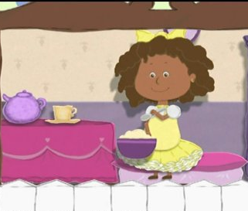
Activity – Little Miss Muffet
Little Miss Muffet
Sat on her tuffet
Eating her curds and whey.
There came a big spider
That sat down beside her
And frightened Miss Muffet away.

Slide 22
Question: How did the spider know that the little girl was frightened of him?
    Consider this range of answers and decide whether they should be creditworthy or not?
    She ran away.
    She ran away screaming and wailing.
    He frightened her away.
    By observing her.
    By observing her reaction.
    He sat down beside her.
    He was very scary and had 8 hairy legs.
Notes:
Does the pupil know what to do to answer this question?
Which of these answers do you think should be counted as creditworthy?
How could we reword this question so that we narrow down the wide range of plausible answers?

Slide 23
Question: How did the spider know that the little girl was frightened of him?
    Consider this range of answers and decide whether they should be creditworthy or not?
    She ran away. 
    She ran away screaming and wailing. 
    He frightened her away. 
    By observing her. 
    By observing her reaction. 
    He sat down beside her. 
    He was very scary and had 8 hairy legs. 
Notes:
On the basis of the current question wording, all but one of the answers seems to be reasonable.
But with a small tweak to the question wording, however, we can narrow it down / remove potential for confusion.

Slide 24
Question: What shows that the girl was frightened of the spider?
    By taking the unnecessary reference to the spider out of the question, we have narrowed down the range of acceptable answers and made this easier to mark.
    She ran away. 
    She ran away screaming and wailing. 
    He frightened her away. 
    By observing her. 
    By observing her reaction. 
    He sat down beside her. 
    He was very scary and had 8 hairy legs. 

Slide 25
Part 2
Introduction to question types

Slide 26
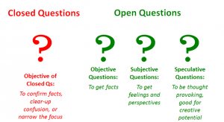
Question types
There are different ways a question can be written, depending on the type of answer the student is expected to give:
        Open – answers are generated by the students
        Closed – students choose the answer from a supplied range

Slide 27
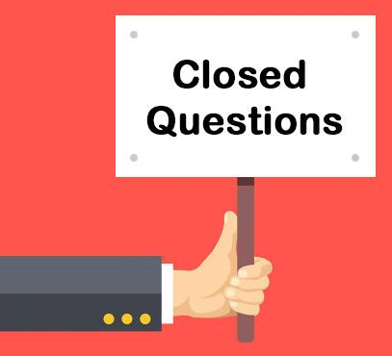
Advantages of using closed questions
All students can attempt the question.
Insecure students can gain confidence.
Opportunity to address misconceptions.
Opportunity to stretch students e.g. by asking them to reason in an unfamiliar context.
Increases marking reliability.
Quality of answers does not depend on students’ writing skills.

Slide 28
Disadvantages of using closed response questions
Forces students to choose between pre-defined answers that they may not have given otherwise
Can put ideas into students’ minds
Difficult for students to express opinions and feelings
Hard to tell whether students have misunderstood the question
Does not give deep insight into their knowledge
Not well suited to assessing higher competences

Slide 29

Multiple-choice

Slide 30
Example 1: standard multiple-choice
How high is the Karisimbi Volcano?
Tick one.
under 2000 metres
between 2000-3000 metres
between 3000-4000 metres
more than 4000 metres
Notes:
This is the standard multiple-choice question – very familiar.
Can be with three options, but four is more reliable in reducing the chances of guessing the correct response.
Can also have tick 2 / 3 from a list of several options, as on next slide.

Slide 31
Example 2: multiple responses
In which two of the following countries do gorillas live?
Tick two.
The Gambia
Sierra Leone
Rwanda
Swaziland
Lesotho
Uganda
Notes:
Correct answers: Rwanda and Uganda

Slide 32
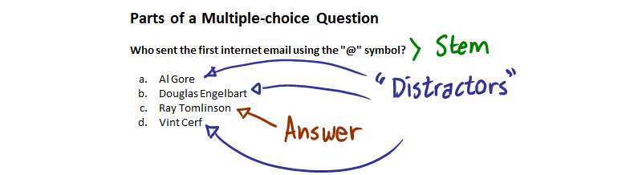
Multiple choice and distractor generation
Typical multiple choice questions usually consist of :
question statement (the ‘stem’)
a correct answer (the ‘key’ response)
at least three incorrect but plausible answers
(the ‘distractors’).
Notes:
Picture taken from: https://conversionsciences.com/best-home-page/
On the next couple of slides, we look at other MC questions with these components

Slide 33
Example 3. Two-step multiple-choice
Which of the following shapes have four sides?
A. rectangle B. triangle
C. hexagon D. square
Tick one.
A and C
B and C
B and D
A and D
Notes:
Other types of multiple choice item.

Slide 34
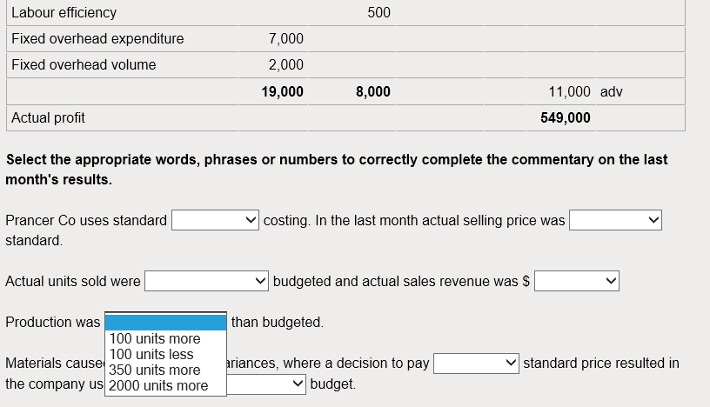
Example 4. Another type of multiple-choice: the drop-down list
Notes:
Drop-down lists are a different way of presenting MC questions, for example missing values in spreadsheets or passages of text. Students select one of the options from the drop down list. The example in this slide shows several drop down lists in the question.
You can have a single drop down list in a question – or, like this, several could be used to make the question more challenging.
This item format offers little advantage to a traditional MC format, if you are asking a single isolated question, but if it requires several questions about a single context, then it is useful.

Slide 35
The role of distractors
Notes:
Distractor should not be obvious – they need to blend in with the correct answer.

Slide 36
Generating Distractors 1 - consistency
None of the answer options should stand out.
They should be roughly equivalent in:
  their length ✓
  their grammatical structure ✓
  the complexity of their language ✓
  All distractors should be grammatically plausible responses to the question.
Notes:
If one does stand out – it definitely should not be the correct one (KEY)
1. The difficulty for question writers is that the correct answer is often the longest, because it has to be particularly carefully worded accurately – this usually results in having to add words rather than removing them. There seems to be a greater latitude in incorrectness, which means that incorrect distracters can often be rather vague and non-specific. If, as often is the case, the correct answer is the longest, then you may be able to salvage the whole question, by ‘padding’ out the incorrect options, so they look roughly the same in length – however, NB that ‘wordy’ items are not in themselves desirable.
2. This is a development of the first point. If all distractors follow the same grammatical structure then they are likely to be of roughly the same length. A distractor that carries an additional clause’s worth of information in it, is very often the right one simply because no one would bother making a tortuously long sentence for the sake of an incorrect answer. So, if the item is worth keeping because there is an important point on the syllabus that needs testing via this particular question, then you may have to lengthen the incorrect options.
3. Distractors should be written in language of the same register – either they all make use of scientific / mathematics / IT terminology or none of them do. The one exception to this is if you wish to create a powerful incorrect distractor: an option with an subject-specialist term may attract the students who are not on firm footing with that particular syllabus area.
None of the distractors should be eliminated on the grounds that it does not answer the question on the basis of syntax.
If there is a grammatical glitch, this will have three effects:
It will automatically rule out an option for the wrong reason
It will shake the confidence of the test-takers – who expect the text to be written in impeccable language
It will be biased against non-native speakers of English language, who may not pick up on these clues as readily as native speakers.
The distractors’ reading smoothly and coherently is not just a nicety. If the construction of the responses is awkward, it will cause re-reading, make understanding the assessment point embedded in it much harder and again result in the outcome that the test results will be contaminated by other factors to do with language.
Avoid ungainly constructions such as those listed.

Slide 37
Generating Distractors 2 - meaningful
The stem of the question should be meaningful WITHOUT having to read the options.
        The stem of a plant
holds the plant in the soil.
converts sunlight to starch.
conducts water to the leaves.
protects the leaves.
Notes:
The question should be meaningful without having to read all the options to make sense of it and the student should know what they are being asked before they read the options.
If the options have to be read in order to make sense of the question, the student has to do a lot more work to deduce what they are being asked. It almost becomes a task consisting of several true / false questions.

Slide 38
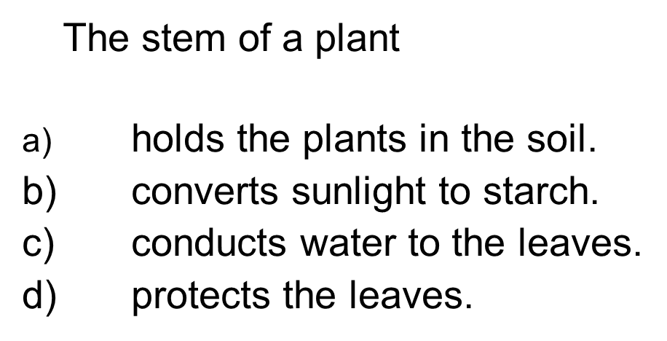
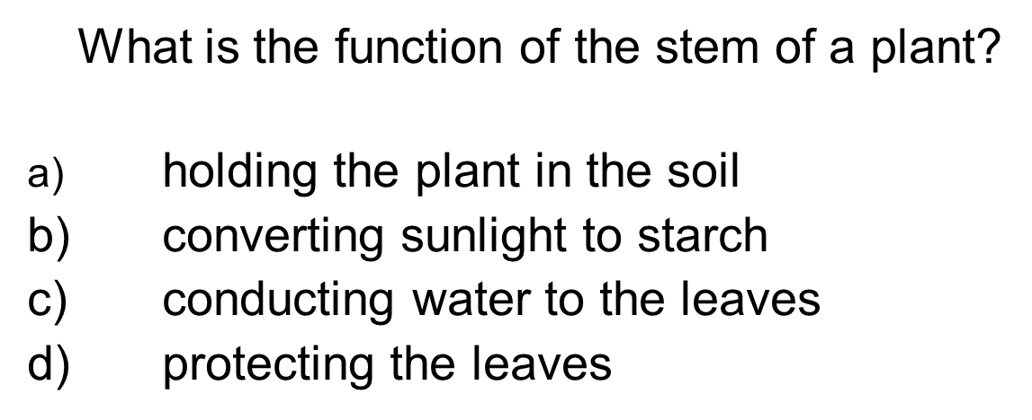
Generating Distractors 2 - meaningful
Poor Better

Slide 39
Generating Distractors 3 - plausibility
Distractors should be plausible responses to the question – not ‘random’ answers
They may represent:
  common misconceptions
  faulty reasoning
  likely errors in calculation
  answers that ‘sound convincing’
Notes:
Use common errors / misconceptions related to the concept as distractors
Imagine initially writing MC question as an open response question. Think of common plausible errors that students would be likely to make, and the answers that they would come to by making these errors. Include the most likely incorrect answers in the list of answer options as distractors.
It is sometimes hard to come up with the last incorrect PLAUSIBLE distractor. We suggest putting in a place-holder and coming back to it later, as a flash of inspiration often comes when least expected.
There should be no distractors which could be correct, under certain “interpretations” or under certain valid assumptions. Again, reviewing items after allowing a gap of time is often illuminating, as one reads it in a different light. Feasible alternative interpretations are not always obvious when in the midst of composing items – but it may be immediately apparent when returning to it a week later.
Calculation / mathematical distracters: mathematical distracters have to be as plausible as the do in all other types of items.

Slide 40
How you can manipulate plausibility:
What is the capital of Moldova?
Tick one.
Yerevan
Minsk
Tiblisi
Chisinau
Kiev
Notes:
Quite hard to answer this question. Most people would not know the answer to this question.

Slide 41
How you can manipulate plausibility:
What is the capital of Moldova?
Tick one.
Paris
New York
Berlin
Chisinau
Moscow
Notes:
This is a lot more accessible? Because of the distractors, it has become much easier to answer this question.

Slide 42
Generating Distractors 4 – other points to avoid:
  repetition of (part of) the stem in the correct option
  repetition of the same word or phrase in every distractor
  two distractors that are mutually exclusive of each other
Notes:
The key should avoid repeating part of the stem in the wording of the options
This can give a big clue to the correct answer and can result in less able candidates giving the correct answer without having taken time to properly engage with the question. If a recognisable key word needs to appear in the correct answer, it should appear in some or all of the distractors.
• Avoid repeating the same word or phrase in every distractor
This can be achieved by rewording the stem to incorporate the repeated word or phrase. Put as much of the question in the stem as possible, rather than duplicating material in each of the options. Put as much of the necessary wording into the question stem – not into the options.
Two distractors that are opposites of each other
This actually reduces the options under consideration in the answer – If you are looking at the opposite sides of a coin it reduces the options from 4 to 3.
On the following slides, we have some examples of faux pas in distracter generation.

Slide 43
Generating Distractors 5 – other points to remember:
  The stem should be free of irrelevant material
  Where possible, the stem should be stated in positive terms
Notes:
The stem should be free of irrelevant material – should only contain material needed to answer the question
Where possible, the stem should be stated in positive rather than negative terms. The use of negatives can confuse and lead to sentences that are difficult to interpret. If negatives cannot be avoided, then highlight the negative in the stem (eg bold / italic). Look at next slide.

Slide 44
Generating Distractors 6 – avoiding negatives
  Which two of the following are not safe things to do in the kitchen?
  eating while cooking
  using a knife with oily hands
  washing your hands
  not peeling vegetables with a sharp knife
  forgetting to add salt
Notes:
Extra confusion caused by having a negative in the stem and in the 4th option. Does this therefore have to be interpreted in the positive?
Potential for misinterpretation of the last option because it contains an embedded negative in ‘forgetting’.
Wording on next slide much more straightforward and easy to understand without a struggle

Slide 45
Generating Distractors 6 –
Better
  Which two of the following could be dangerous in the kitchen?
  eating while cooking
  using a knife with oily hands
  washing your hands
  not peeling vegetables with a sharp knife
  forgetting to add salt
Notes:
Option d) – still not ideal – though now we don’t have the problem of two negatives in the same concept / idea.
It may be best to try eliminating that as well. See next slide

Slide 46
Generating Distractors 6 –
Best
  Which two of the following could be dangerous in the kitchen?
  eating while cooking
  using a knife with oily hands
  washing your hands
  peeling vegetables with a blunt knife
  forgetting to add salt

Slide 47

Whole Group Activity
(15 minutes)
Examples of problem questions
Consider the following examples from an accountancy examination.
You may not understand the accountancy content - but that will show you what it feels like to be a student sitting a test.
What improvement do these stems and distractors need?
Notes:
On the following slides:
Examples of items that are less than perfect.

Slide 48
Example 1
Which two of the following targets relate predominantly to monetary policy?
increasing tax revenue
controlling the growth in the size of the money supply
reducing public expenditure
keeping interest rates low
Notes:
From a test writer’s viewpoint – the second distractor is definitely undesirable. It might be argued that this is meant to be as easy question. Candidates have to get two correct answers anyway – so live with this inequality.
However, it contravenes two of the pieces of advice on the previous slides.
The first mistake / undesirable feature:
Length - Not only is it longer – it’s longer because it hasn’t followed the grammatical structure used in the other three distracters – because the noun clause (in second option) is composed of three parts ‘growth’ and ‘size’ of ‘money supply’.
It is possible that the shorter alternative ‘controlling the money supply’ would not have been specific or accurate enough and that is why the answer is this long.
It is not good practice to have a correct answer that stands out so obviously and one strategy may be to make the other answers somewhat longer if possible.
On the next slide, the second option is reduced to the same length as the others – but this introduces the second mistake / undesirable feature.

Slide 49
Example 1
Which TWO of the following targets relate predominantly to monetary policy?
Increasing tax revenue
Controlling the money supply
Reducing public expenditure
Keeping interest rates low
Notes:
• Avoid correct answers which repeat a word or number from the question prompt or statement
If the length of the second distracter is reduced and its structure brought in line with the others, the repetition of a key word (concept) from the question prompt stands out, which will immediately mark it out as a likely correct response.
This can give a big clue to the correct answer and can result in less able candidates giving the correct answer without having taken time to properly engage with the question. If a recognisable key word needs to appear in the correct answer, it should appear in some or all of the distracters.

Slide 50
Example 2
What is the discounted payback period for the proposal?
2.9 years (KEY)
3.0 years
3.1 years
1.1 years
Notes:
What is the problem with this set of distractors?
1.The 4th answer stands out as widely aberrant from the other results. It was properly justified showing a mathematical error and not just randomly plucked from the air – but because it does not cluster around the correct answer like the other two incorrect answers, its place in the assessment should be questioned.
2. Have to be very careful that in cases where the answers are so close to each other, rounding differences could make more than one answer correct (in this case it could be 1 or 2)
What to do to improve this set of answers
Spread out the answers, so that there is not such a cluster around 3 years.
Revisit the scenario of the context and question prompt to see if another incorrect answer in the same region as 1,2 and 3 can be legitimately generated
To eliminate rounding errors, convert the answers from a decimal calculation to years and months
REMEMBER If the error that generated answer 4 is a widely held misconception – then it should be included, but then it may be better to spread out the other three answers a little more or bring the 4th in line, in order to make it look less wayward.

Slide 51
Example 3
Which of the following objectives might internal stakeholders have?
Revenue per employee
Job security
Wealth maximisation
Value for money
1, 2 and 3
2 and 3 only (KEY)
1, 3 and 4
3 and 4 only
Notes:
What is the problem with this set of distractors?
3 is in all options, therefore must be right – the question is then basically choose 1 from 3. Need to remove 3 from at least one option.

Slide 52
Example 4
Which of the following are controls that can be used to increase security of confidential information within a school or company?
anti-virus software
staff training on security risks
backing up files to personal email account
ensuring passwords are written down somewhere in case user forgets them
Notes:
What’s the matter with this set of distractors?
Options are too easy.
This question could probably be answered from general knowledge.

Slide 53
Example 5
Which of the following is NOT a problem associated with having non quantifiable objectives in Not For Profit Organisations?
If benefits cannot be quantified, they might be ignored
If not quantified, the NFPO will not know when the objective has been achieved
Choosing which key performance indicators to use is difficult
Building a balanced scorecard is impossible
Notes:
What’s wrong with this question / set of distracters?
1. Poorly articulated question – too many negatives. In all, the word Not or Non was used six times. This is not counting all the negative concepts, such as ignored and impossible. However, a negative concept is always better than using negatives – especially twice or more where they cancel each other out.
This raises the point that sometimes, by the time one is trying to come up with the last incorrect distracter, one forgets the main assessment point of the question – here it is meant to be NFPOs and this sometimes generates implausible distracters.

Slide 54
More than just multiple choice…
Closed questions can include many different item types in which students choose the answer from a supplied range – nut just multiple choice.
Especially within an e-assessment, the items can be generated to include sequencing, matching, drag-and-dropping or selecting. You will be introduced to these in our next session.

