Slide 1
Assessment principles
There is no one ‘correct’ method of assessment: but there are guiding principles underlying good practice.
Any test or assessment should be
    reliable
    valid
    manageable

Slide 2
Assessment principles
These three principles are distinct yet inter-related
Reliability
Validity
Manageability

Slide 3
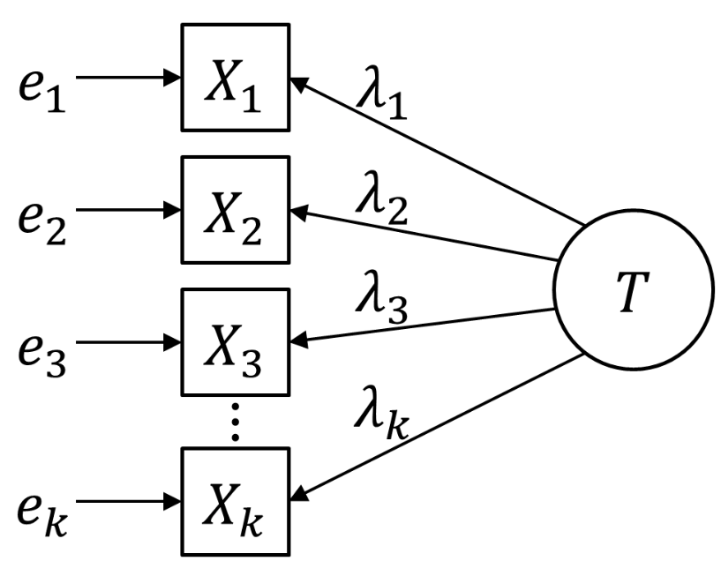
Reliability
Reliability is a complex statistical idea.
However, the main points of reliability are easy to grasp.

Slide 4

Reliability
A term often used in terms of statistical reliability when discussing assessment
But for our purposes today let us consider reliability as:
a weighing scales
This tool would not be of very much use if it gave a different result every time you weighed the same object
In the same way a test (and individual questions within the test) should give reliable results when answered by a large number of students over an extended period of time

Slide 5
Reliability
If a test is working properly, the most competent students should perform better in comparison with less competent students.
If the same test is taken by several classes of students and produces similar results, i.e. distinguishes between the most and least competent students, it is a reliable assessment which can be used time after time with broadly similar results in terms of performance.

Slide 6
External factors affecting reliability
So-called ‘random’ factors can affect the reliability of an assessment
What external factors could affect how your students might perform on a test?
Fatigue
Time of the test (e.g. morning or evening)
Practice effect
Level of motivation of the students in the subject
Quality of classroom instruction
Socio-cultural variables
Testing conditions
Notes:
These are taken from Guide to classroom based and national assessments in Rwanda

Slide 7
Internal factors affecting reliability
Question type – closed responses e.g. multiple choice, can make a test more reliable (one correct answer)
Length of test – the longer a test and the greater the number of questions, the more reliable it should be. BUT if a test is too long, some students will not attempt all questions, making it less reliable.
Competencies are easier to assess reliably than opinions and attitudes
Bias can affect reliability, for example if a question favours girls rather than boys, students from rural/urban locations
Marking guidance – unclear or insufficient instructions on how to award marks will lead to inconsistent and unreliable marking
Objective marking is generally more reliable than subjective marking

Slide 8
Validity
Assessment is designed to measure specific competencies that matter within the subject and are appropriate to the ability of the student.
If the assessment measures what it is intended to, then the assessment is valid (or has validity).
A valid assessment produces an outcome that is representative of the skills learned and so gives a meaningful picture of achievement.
Why is validity so important?
promotes confidence in teacher judgements
assists teachers to accurately guide future learning
decisions based on test data affect students’ life chances
Notes:
Reliability is desirable but it is not the only factor. Remember our metaphor of the weighing scales. An accurate pair of scales is one thing, having something worth measuring is another. If time allows could consider mentioning content, criterion and construct validity

Slide 9
Building in validity
When designing assessments we should ensure that:
the purpose is clear and defensible
everyone understands how results will be used
assessment is aligned to curriculum units and specific learning objectives
your students are interpreting your assessment items in the way that you meant for them to be interpreted
questions are fair for all students i.e. not biased
marking guidance contains clear criteria by which to judge responses

Slide 10
Manageability
Making a selection of what to measure, how often to do it and what instruments to use is about manageability.
Any assessment system must be manageable and practical for students, teachers, markers and administrators in terms of:
preparation time
resources needed
delivery methods
ensuring accurate results

Slide 11
Balancing the big three
some forms of assessment might provide reliability at the expense of validity
reliable assessments are not necessarily valid
valid assessments should always be reliable
validity focuses on the accuracy of expected outcomes
reliability concentrates on precision and measures consistency of outcomes
valid and reliable assessments can only be delivered successfully in a manageable context
No assessment will be perfect, but awareness of the three principles will lead to improved outcomes for all
Notes:
Consider how the three principles are inter related
It is possible to produce highly reliable multiple-choice tests to minimise external factors that might interfere with the outcomes.
If assessment is predominantly focused on reliability, it will foreground the skills that are easiest to measure and compare and marginalize or ignore others.
It would be possible that one school could produce an extremely valid way of assessing their pupils based around talk, drama, writing in role. Elsewhere in the country another school could have an assessment system based around formal written responses and timed tests. Both of these approaches could be equally valid, producing meaningful outcomes that measure the skills they intend to. However, the results might not be reliable. If the pupils at the first school were assessed using the methods from the second the results might not be the same for pupils of similar ability.
Assessment individually tailored for the needs of every pupil, taken only when they are ready, covering the every aspect of the curriculum, in a range of contexts will produce highly valid results, but would be extremely difficult to manage.
Similarly, an assessment system could be made extremely reliable with every piece of work by every child checked and cross checked with every other piece of work by every other child to ensure they were of the correct standard, but the time and cost implications would clearly make such an approach unmanageable.

