Slide 1
Re-cap: General principles and style
Across open and closed questions
Five aspects to consider:
    language
    visuals
    contexts
    sensitivities
    student expectations

Slide 2

More closed questions

Slide 3
Sequencing
Number the stages below to show their order in making a cup of tea.
The first one has been done for you.
boil water
put tea bag in cup
pour boiling water onto bag
fill kettle
add milk and sugar
1
Notes:
Ideal for curriculum areas where there is a chain of cause and effect (sciences) a precise sequence of stages to be followed (eg an experiment) / a narrative (history / language / literature).

Slide 4
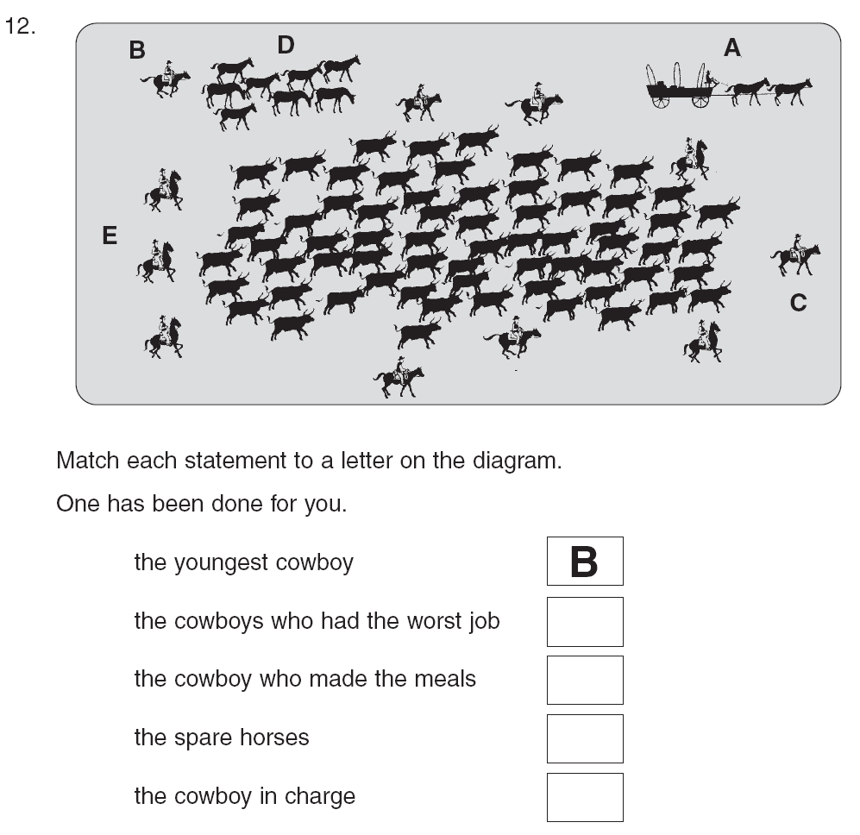
Labelling diagrams
Notes:
Labelling a diagram - ideal for sciences. Labelling parts in biology / labelling equipment needed for an experiment / literacy (to show understanding of an information text). Can be done as an open exercise, where students generate their own labels – or as here, as a closed task.

Slide 5
Matching 1
Draw three lines to match the places in the story to the characters?
Children
Tea room
Father
Schoolyard
Grandmother
Football match

Slide 6

Matching 2
A
B
C
D
Match each arrow to the force it represents.
Arrow
Force name
drag
reactive
weight
thrust
Notes:
Candidates must drag and drop the objects (arrows) and targets (forces) in order to form matching pairs. There must be an equal number of objects and targets.
There must be at least four matching pairs in order to minimise the potential of answering correctly by chance.

Slide 7
Matching 2
A
B
C
D
Match each arrow to the force it represents.
Arrow
Force name
A
drag
B
reactive
C
weight
D
thrust
Notes:
Candidates must drag and drop the objects (arrows) and targets (forces) in order to form matching pairs. There must be an equal number of objects and targets.
There must be at least four matching pairs in order to minimise the potential of answering correctly by chance.

Slide 8
Matching : unequal columns
hydrochloric
Strong acid
water
Weak acid
nitric
acetic
Neutral
oxalic
citric

Slide 9
Matching 3: unequal columns
hydrochloric
Strong acid
water
Weak acid
nitric
acetic
Neutral
oxalic
citric

Slide 10
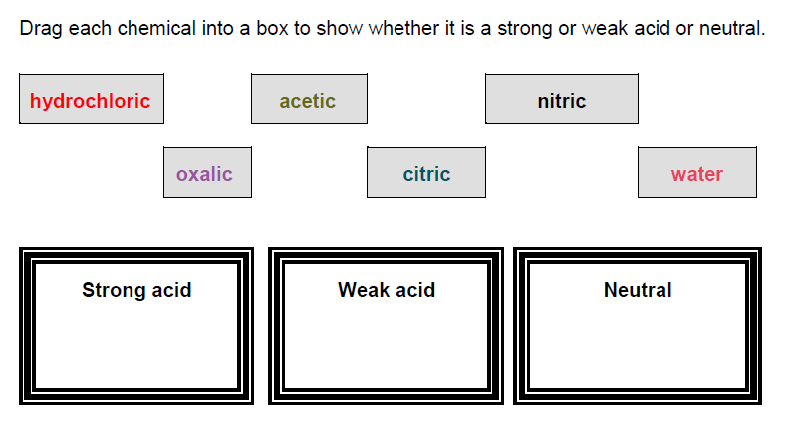
Drag and drop
Notes:
This is a different way of asking an matching question.
Students drag labels (reactions) from the list and drop them onto the appropriate area within an image, here in either the reversible or non-reversible boxes.
There can be any number of labels within the list and there can be more than two drop areas.

Slide 11
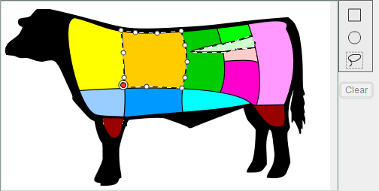
Hot spot or point and click
This is a diagram of a cow.
Point and click on the area where the cow’s heart is.
Notes:
Hot spot items may have a question stem as here and will always have a question prompt.
The area being selected is highlighted as the mouse hovers over it so that the student can see the full range of the response. Students can be required to select one or more hot spot areas but the number required must be stated.

Slide 12

Open Questions

Slide 13
What are open questions?
Questions to which students generate their own answers.
Open questions encourage a fuller response from the student and place fewer limits on the student’s response. This is in comparison to closed questions which provide a selection of limited pre-defined answers.
As well as generating quantitative data, open questions can produce more in-depth formative data.

Slide 14
Advantages of using open questions
Opportunity to assess higher order competences such as analysis and interpretation
Students give a genuine personal response
Responses can show different levels of understanding
It reflects questioning used by teachers in the classroom
Can reduce quantity of reading required

Slide 15
Disadvantages of using open questions
Students’ answers may be extensive and it can take long to analyse the answers.
There will be a lot of variation in students’ answers.
More complex mark guides to
      account for all possible correct answers that students generate
      provide enough guidance to ensure consistent marking
The quality of the response may be influenced by the student’s writing skill
Can’t be machine marked

Slide 16
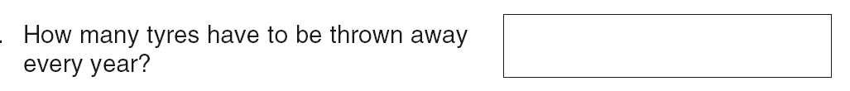
Short response 1
1 mark answers
Notes:
Markers have to use their professional judgement in combination with the published mark scheme criteria to decide whether answers are creditworthy / what mark they get.
In the case of a question like this, the range of possible acceptable answers is probably fairly narrow but it is still not clear-cut.
Decisions would have to be made about whether to credit:
Answers written in words
Misspellings
Answers rounded up or down.

Slide 17
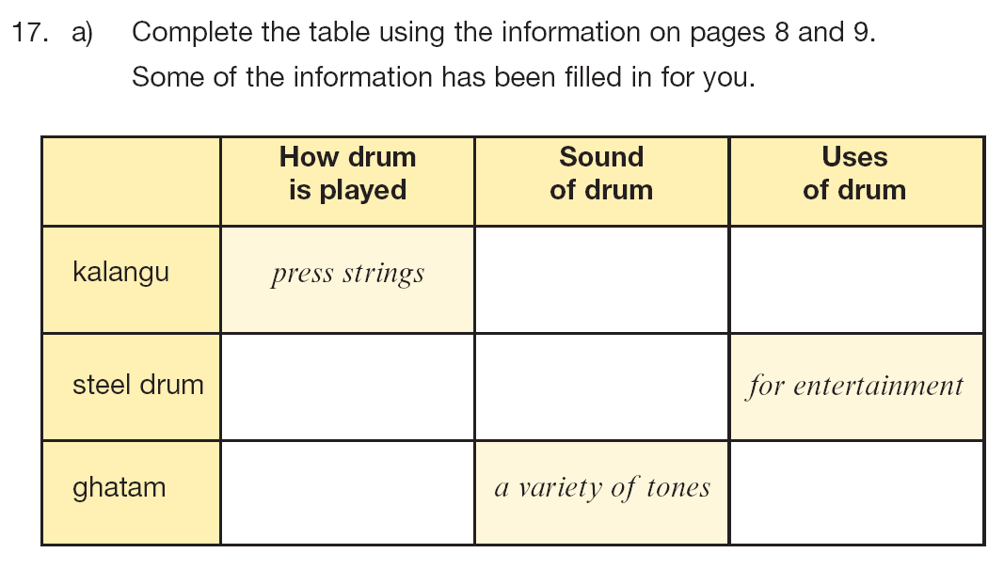
Short response 2: several short answers
Notes:
Sometimes you can combine several small pieces of information into a single question. This would probably generate 2 or more marks for complete accuracy and partial marks, if some answers are wrong.
It is useful because
The format keeps the answers short
Once the student understands the principles of what they are being asked and how they are being asked to provide their answer, then they can demonstrate a lot of understanding in an economical way.

Slide 18
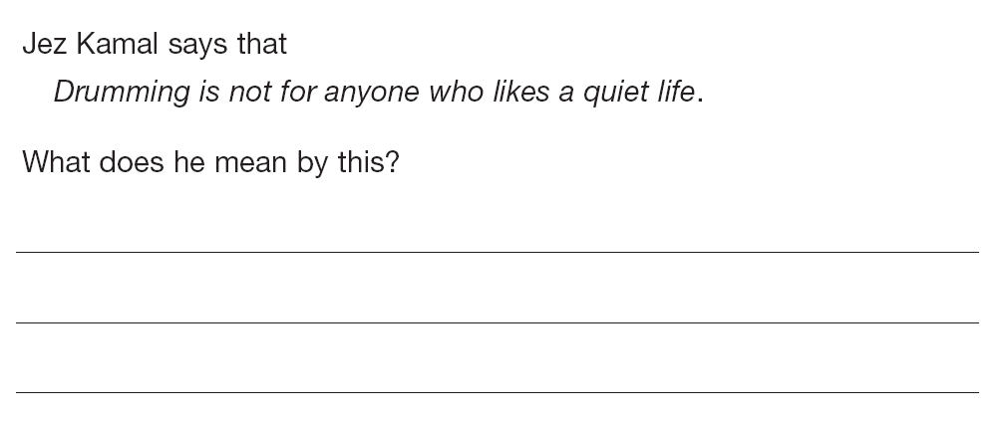
Short response 3
1 or 2 mark answers
Notes:
Longer answers expected here.
Expectation is that basic 1 mark answers provide a literal response about ‘noise’
2 mark answers recognise the metaphorical aspect of the phrase ‘a quiet life’.
Challenging to write the mark scheme for this.

Slide 19
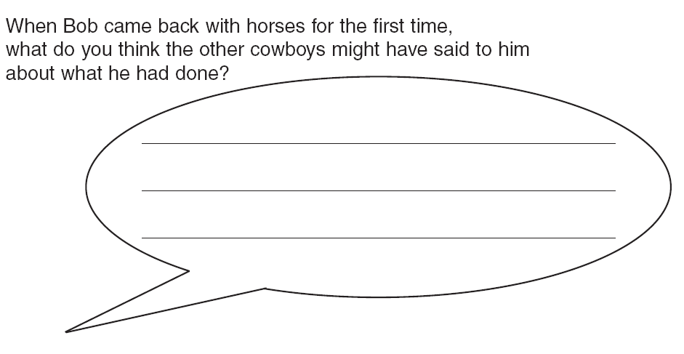
Longer response 1
1 or 2 mark answers
Notes:
It is possible to ask students to write their answers from different point of view from their own.
It is challenging to write the mark scheme for this, too.

Slide 20
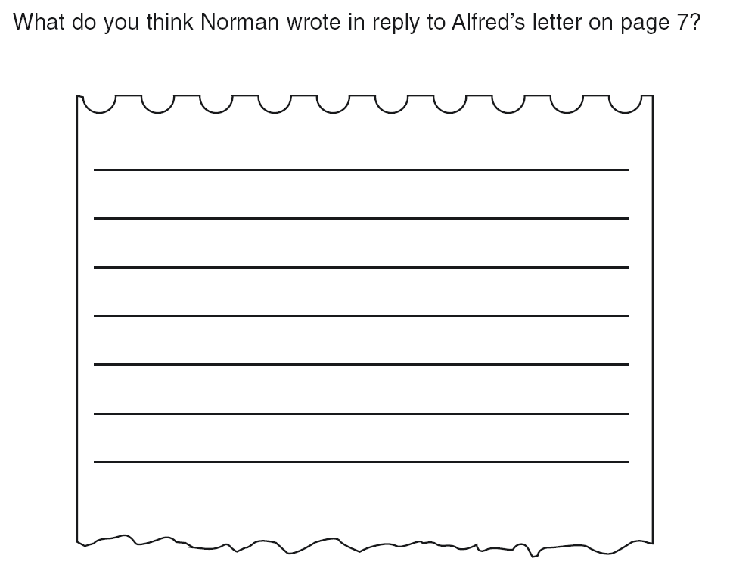
Longer response 2
1 or 2 mark answers
Length and number of answer lines may indicate how long the students’ answer is expected to be/how many marks will be given.
Notes:
In open questions, the space and format of the answer gives the student a lot of guidance about the type of answer that is expected.

Slide 21
Activity 1:
Advantages of different item types
You will now work in pairs.
Write one closed question of your choice.
Swap with your neighbour and re-write their closed question as an open response item.
Consider the advantages of the different item types (open vs closed) and when you would use each item type.

Slide 22

Mark guides
‘A marking scheme helps objectivity as the assessors are able to compare the evidence from the candidates with the requirements of the marking scheme. This will help the assessors to ensure that they give credit to all candidates in the same way.’
Guide to classroom-based and national assessments in Rwanda, 2017, Section 7.15

Slide 23
Marking guides
  Should be drafted and developed alongside the question.
  Should be reviewed by colleagues.
  Marking guides for closed questions are relatively straightforward.
  Marking guides for open questions should provide guidance for judging the correctness of answers and include example answers if possible.
  They should not consist only of examples. Example answers are not enough to guide marking.
Notes:
Mark schemes must be developed simultaneously with the item.
When colleagues review items, it may be best to give them a copy without the answers – to answer the test as authentically as possible.
Then, they must also review the mark scheme.
There is a large difference between the work that goes into the mark schemes for open and closed items. It is complex to create a mark scheme even for a 1 mark answer.

Slide 24
Developing marking guides for open items
  Think of the main point(s) you would expect the student to make
  How many marks will you award for a correct answer? How many is it worth?
  Remember students can give a correct answer in many different ways. Think about the kinds of answers students are likely to give.
  Which ones deserve marks, which do not?
Notes:
You will not have access to as many responses as this (until questions are trialled on large numbers of students) so you will have to use the resources you have. Ask colleagues to answer the question in as many different ways as they can think of.

Slide 25
Marking guide development for open items
  Think about the kinds of answers students are likely to give.
  Which are creditworthy, which are not? Is it clear how to mark the responses using your initial mark scheme?
  Organise the responses into groups based on their characteristics.
  Consider ‘allowable’ responses as well as the ideal creditworthy response and any uncreditworthy responses.
  Generic descriptions of each category followed by one or more examples are helpful for markers in applying the mark scheme more widely.
Notes:
Whether the current mark scheme makes it clear what mark it should get.
Group them according to their characteristics. These characteristics indicate what the criteria / principles are by which to judge the answers
Look at the answers that are partial / ‘just allowable’ (but not ideal) – your mark scheme has to tell markers what to do with these sorts of answers

Slide 26
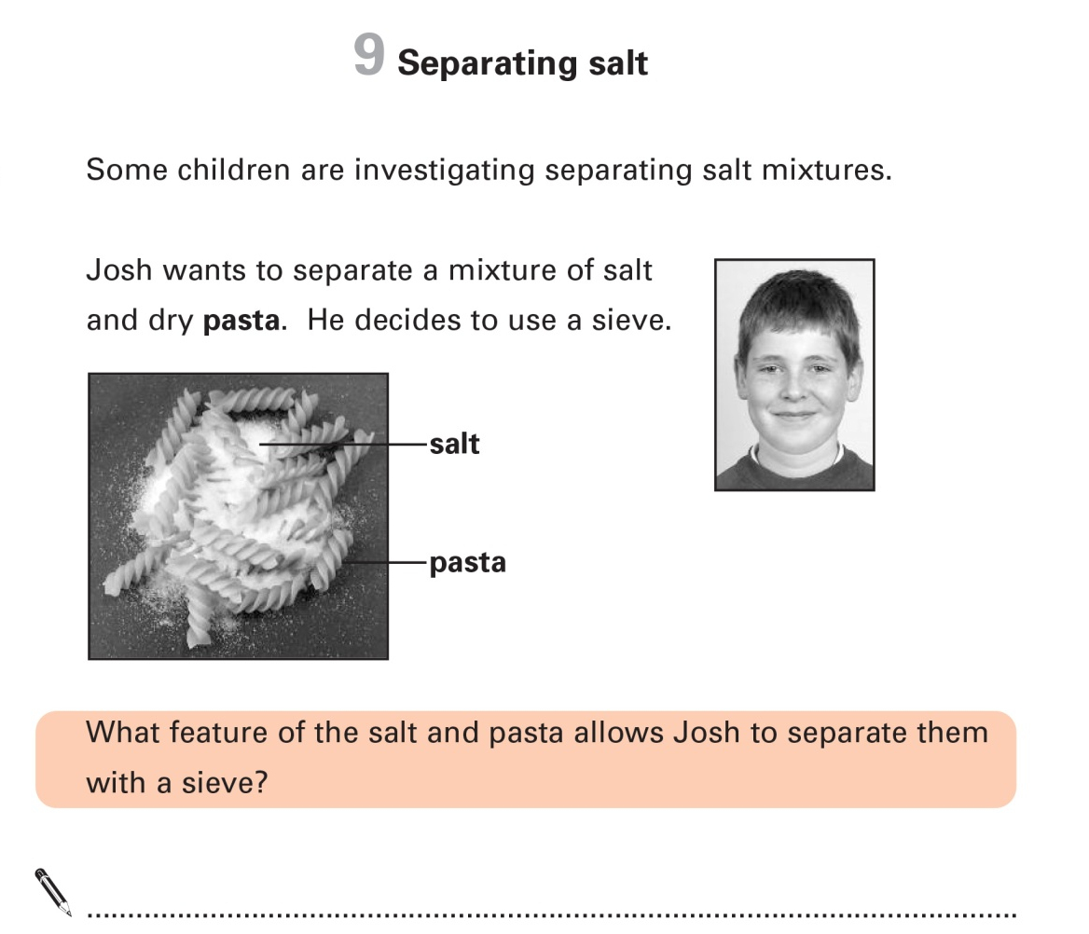
Example 1: Marking guide for open questions
Notes:
This is a simple 1-mark question from a science test for 11 years olds.
We think that the answer is fairly straightforward and that the mark scheme could be something like this: (next slide)

Slide 27
Unrealistic mark scheme
Award 1 mark for reference to:
different size.

Notes:
This would not account for many answers and would not provide markers with enough information to help them judge the acceptability of most student responses. On the next slide, you will see the mark scheme that was actually published to go with the question about separating salt from pasta.

Slide 28
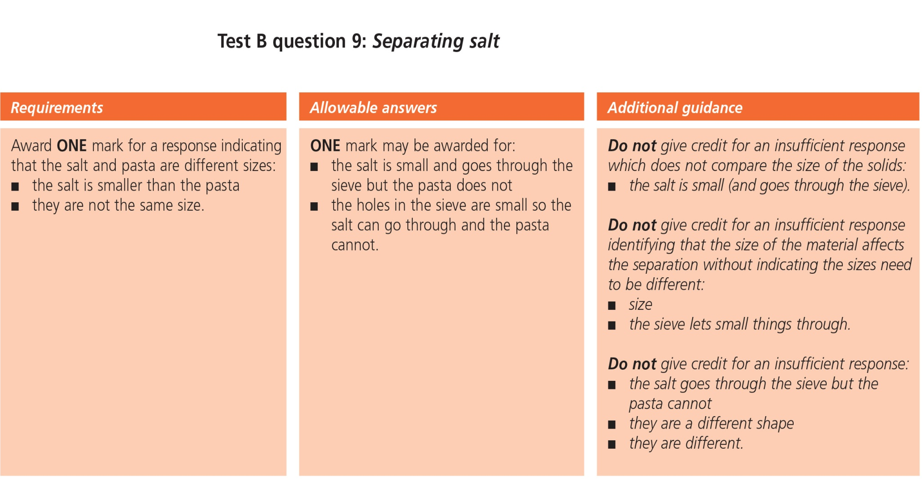
Example 1: Marking guide for open questions
Notes:
All this information was deemed necessary to ensure consistent marking for even a short question with basically one answer.
A section describing the minimum requirements of an acceptable answer (different sizes)
A section showing different borderline answers where markers may not be sure whether they fulfil the criteria (uncertainty whether the answers sufficiently express the idea of different size).
A section with additional guidance – all of these focus on reasons for not giving credit – with some explanation.

Slide 29
Example 2: Marking guide for open questions
This is the type of question where marks are given cumulatively: for the number of correct answers given.
Give two ways in which Sue can prevent tooth decay.
1.
2.
Notes:
This is the type of question where marks are given cumulatively: for the number of correct points made by the student. Markers simply count up the number of correct points and convert this to a mark. This one is a very simple question – where the student will receive one mark for each correct point.
But it would be possible to make this a harder question by asking students to give 3 answers and to convert the answer to marks like this:
3 correct answer = 2 marks
2 correct answers = 1 mark
1 correct answer = 0 marks.
Where there are two (or more) marks available, mark schemes have to be fuller as you have to include:
The acceptable points answers (as before)
The allowable / borderline answers (as before)
Additional explanation to help distinguish incorrect answers (as before)
ALSO:
explain how students achieve one / two marks.
This is demonstrated on the next slide.

Slide 30
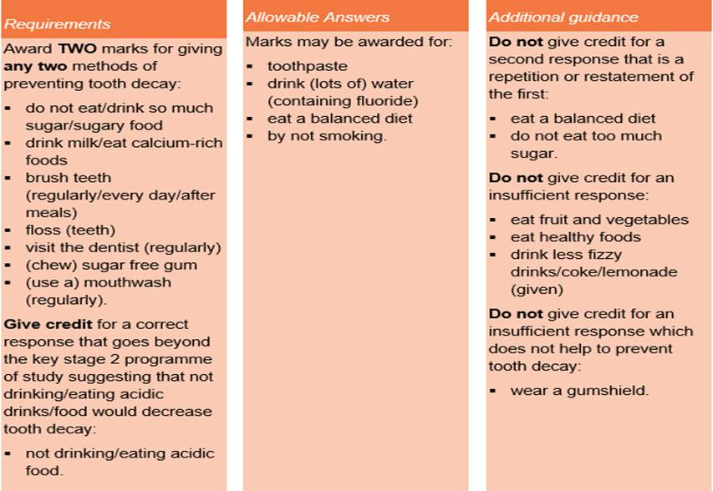
Example 2: Marking guide for open questions
Notes:
This follows the same structure as the previous mark scheme
With:
A section listing the variety of points that students can make (left hand section)
A section showing different borderline answers where markers may not be sure whether they fulfil the criteria. (middle section)
A section with additional guidance – all of these focus on reasons for not giving credit – with some explanation. (right hand section)

Slide 31
Example 3: Marking guide for open questions
This is the type of question where marks are given qualitatively: for the insight / quality / perceptiveness of the answer.
Notes:
This is the type of question where marks are given qualitatively: where the marker has to make a judgement about how good the answer is (not quantity but quality). This is where the difference between one or two mark answers is expressed through descriptive criteria and the marker has to make a judgement about which description the answer fits better.
Let’s go back to a previous example from a reading test for 11-year-olds.
Read through the question.

Slide 32
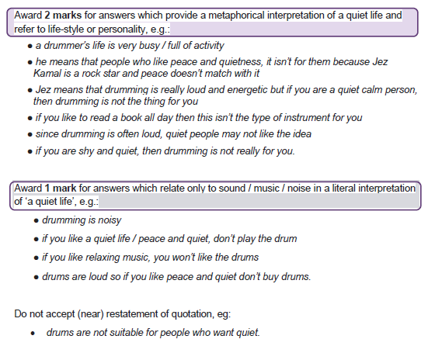
Example 3: Marking guide for open questions

Slide 33
Example 4: Marking guide for open questions
For more demanding questions assessing higher competences you may want to award more marks.
Greater number of marks = greater subjectivity = less reliable marking
To keep the marking as simple and straightforward as possible you should use a banded marking guide
Banded mark schemes are divided so that each band has a clear and precise description that shows how far the student has answered the question successfully.
For this project the maximum number of marks for a single question should be 6
For these questions you should use a banded marking guide with 3 bands of 2 marks.

Slide 34
Example 4: Mark guides for open questions
Use information from the diagram and your own knowledge to describe how adult cell cloning could be used to clone a zorse.
…………………………………………………………………………………………………………….
…………………………………………………………………………………………………………….
…………………………………………………………………………………………………………….
…………………………………………………………………………………………………………….
…………………………………………………………………………………………………………….
…………………………………………………………………………………………………….. (6 marks)
AQA GCSE Biology

Slide 35
Example 4: Marking guide for open questions
Band 3 (5-6 marks) | There is a clear, detailed and accurate description of all the major stages of adult cell cloning.
Band 2 (3-4 marks) | There is an almost complete description of the early stages of the process and some aspects of the later stages. There may be some inaccuracies.
Band 1 (1-2 marks) | There is a simple description of the early stages of adult cell cloning. However, there is little other detail and the description may be inaccurate.
0 Marks | No relevant content.
Examples of points made in the response could include: Skin cell from zorse; (unfertilised) egg from horse; remove nucleus from egg cell; take nucleus from skin cell; put into (empty) egg cell; (then give) electric shock; egg cell divides/ embryo formed; (then) place embryo in womb/uterus
Notes:
Note advantage is that it gives finer grained detail as to how well they have responded, credits partial understanding
Band descriptors are helpful in giving formative feedback, makes clear what is needed to improve
Should try to avoid being influenced by the students writing skills – we are assessing understanding of biology not English. Do not be influenced by a well written answer with little content or a poorly written one that still shows they have grasped the learning objective.
Note the inclusion of indicative content - however only a guide, not a hurdle
Note the inclusion of a zero band – important that band one is not awarded as a ‘consolation’- this may spare the student’s feelings but will not help them progress

Slide 36
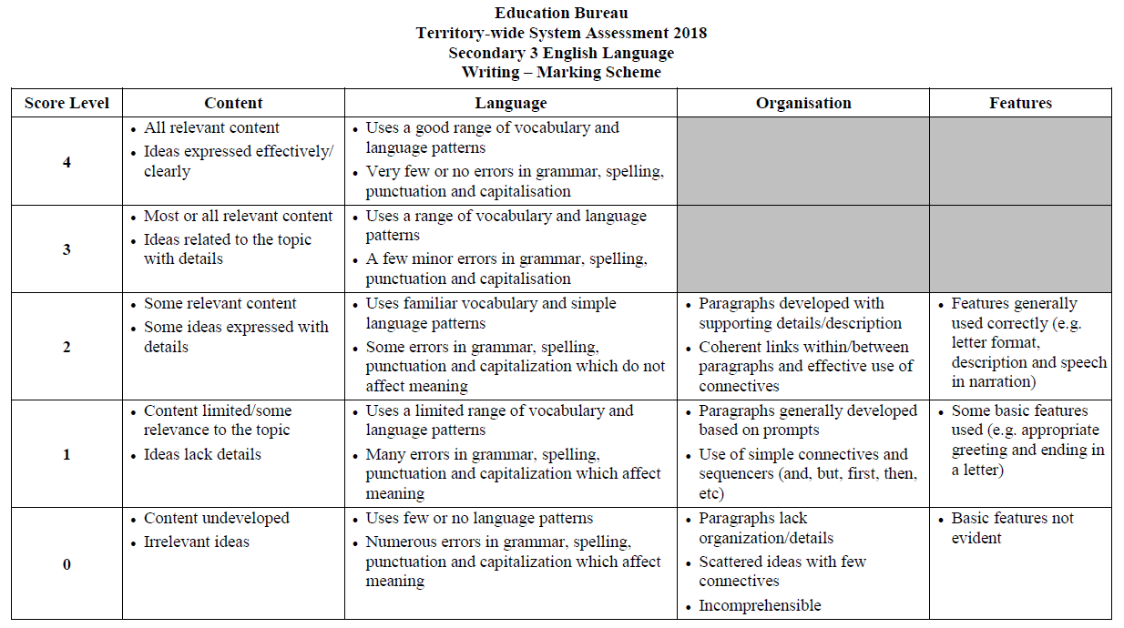
These kinds of marking guides can be very thorough.
Notes:
Here’s an example from Hong Kong. Assessing English language.
Show them this example of how far this can go (note that it is not the most complex you can get).
This assessment would be out of 12.
Note different capabilities – advantages are: more reliable marking, more precise formative feedback
Issues: time consuming, still subjective (as discussed in previous slides), need to make sure categories don’t overlap (so the same thing is credited twice).

Slide 37
What the teacher can learn from student responses
How much a student understands (quantity) ✓
Insightfulness (quality) ✓
Scope of response ✓
Use of textual evidence ✓
Use of extrinsic knowledge (legitimate and illegitimate) ✓
Engagement with text ✓
Is the student answering the question asked? ✓
Notes:
Marking for formative purposes is not the same as ‘normal’ marking. What you want to find out from formative marking is what the student did right and what they did wrong / how they can make a good answer even better and how to feed back to the student.
For formative data, we need to categorise different types of wrong answer because these are the most revealing about performance – as well as different creditworthy approaches as well.
how much a pupil understands (quantity) how many truly unique points do they make in their answer?
insightfulness (quality) – are they central / core issues or are they trivial / peripheral (missed the point)?
scope of response (local / global)
use of extrinsic knowledge (legitimate and illegitimate)
engagement with the subject
is the pupil answering the question asked?

Slide 38
Developing a marking guide
identify a learning objective from your unit that lends itself to an open question with more than one mark.
devise an open question and marking guide on this learning objective
give your question (not marking guide) to your neighbour and see how they answer.
Get the question back from you neighbour:
Look at the answer and see if your marking guide covers it.
adjust the marking guide if necessary to
        indicate how partial marks might be awarded
        ensure that wrong answers are not credited
        7. Discuss what you have learned with your neighbour

